Slide 1

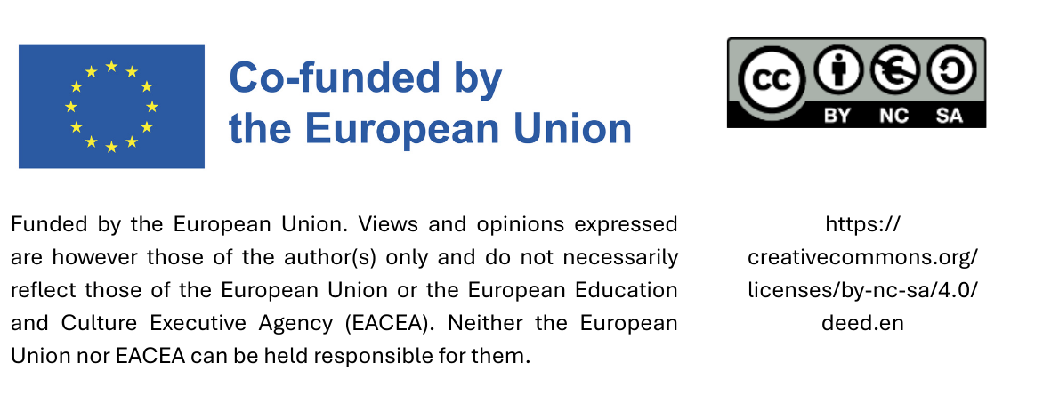
Let‘s start with a quiz

Slide 2
Food
If you take into account the water used for cultivation, harvesting and processing, a cup of tea accounts for water consumption of around 30 litres. This is also referred to as the ‘virtual water’ contained in a cup of tea. How much virtual water is contained in a cup of coffee?
60 litres
30 litres
140 litres

Slide 3
Food
If you take into account the water used for cultivation, harvesting and processing, a cup of tea accounts for water consumption of around 30 litres. This is also referred to as the ‘virtual water’ contained in a cup of tea. How much virtual water is contained in a cup of coffee?
60 litres
30 litres
140 litres
The main tea-growing areas are located in regions with high rainfall. As a result, tea has a lower water footprint than coffee. Coffee accounts for 6% of global water trade, placing it among the top commodities in this sector.

Slide 4
Paper
How many kilograms of wood does 1 package of recycled paper (500 sheets) save compared to primary fiber paper?
3 kg
0,5 kg
7,5 kg

Slide 5
Paper
How many kilograms of wood does 1 package of recycled paper (500 sheets) save compared to primary fiber paper?
3 kg
0,5 kg
7,5 kg
Approximately 7.5 kilograms of wood are needed to produce 500 sheets of primary fiber paper. No wood is needed to produce recycled paper, which means that 100% of the wood consumption of primary fiber paper can be saved.

Slide 6
Electrical appliances and IT
How much CO₂e can be saved if a notebook is used for 6 years instead of just 3?
- 10 %
- 28 %
- 52 %
Notes:
Quelle: Broschüre „Computer am Arbeitsplatz: Wirtschaftlichkeit und Umweltschutz – Ratgeber für Verwaltungen“; Prakash et. al., uni 2016

Slide 7
Electrical appliances and IT
How much CO₂e can be saved if a notebook is used for 6 years instead of just 3?
- 10 %
- 28 %
- 52 %
Most CO₂ emissions from notebooks are attributable to manufacturing. Using a notebook for longer reduces emissions — buying a new one after 6 years causes 28 % fewer emissions than buying a new one after 3 years.
Notes:
Quelle: Broschüre „Computer am Arbeitsplatz: Wirtschaftlichkeit und Umweltschutz – Ratgeber für Verwaltungen“; Prakash et. al., uni 2016

