Slide 1


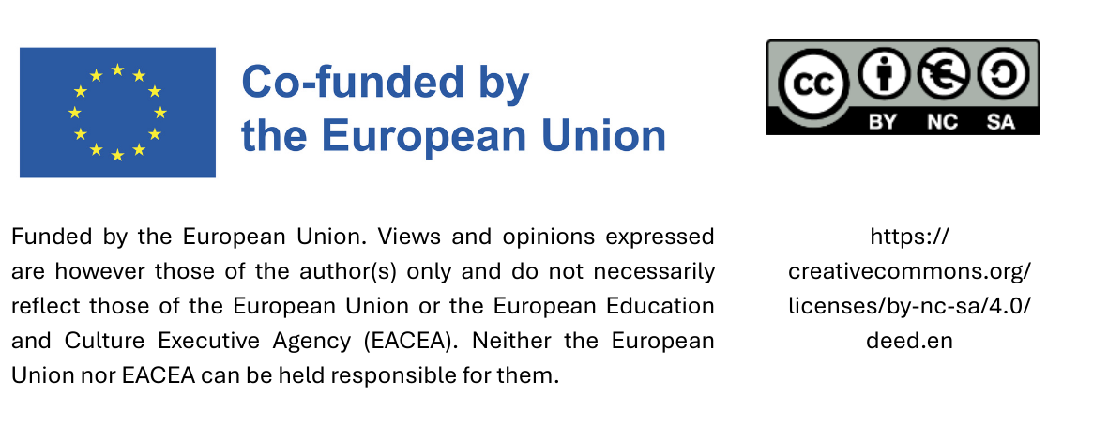
Train the Trainer:
Why it matters:
Sustainable procurement for Small Municipalities
Date

Slide 2
Public Spending is a lever for change
For small municipalities, sustainable procurement is not a restriction, but an integrated local development lever.
They connect three strategic dimensions:
Environmental
Economic
Governance

Slide 3

Example Economic:
In small municipalities, where interventions have a modest economic scale, the effects are multiplicative:
A €100,000 municipal tender to refurbish public lighting with LEDs and smart sensors can reduce energy consumption by 60% and stimulate local plant engineering companies to specialise in green technologies.

Slide 4


Example Environmental:
The introduction of “green” procurement for urban green maintenance - with electric machinery, on-site composting and use of reclaimed water - reduces not only CO₂ emissions, but also long-term operating costs.
In this way, the environmental transition becomes an integrated objective in the day-to-day management of public expenditure.

Slide 5
Example Governance
For small municipalities, applying sustainability criteria in public spending also means strengthening the quality of local governance, reducing risks and increasing transparency.
By introducing an internal control system for municipalities and training on GPP (Green Public Procurement) for all civil servants, formal errors and disputes are reduced in compliance with European and national regulations.
When an administration demonstrates consistency between principles and actions, it strengthens its legitimacy and institutional credibility.

Slide 6
Local Economic Support
This also reduces the carbon footprint associated with transporting goods over longer distances.
Sustainable procurement often emphasises sourcing from local suppliers, which helps stimulate the local economy. By supporting small businesses and local producers, municipalities can help create jobs, promote local entrepreneurship, and keep financial resources within the municipality.

Slide 7
Circular Economy
Municipalities can transform circular economy principles into concrete purchasing practices:
This approach not only reduces environmental impact but also generates circular and resilient local economies.
Durability, reparability and reusability criteria in technical specifications (for furniture, equipment, ICT, etc.).
Sustainable management of waste and materials in public works, promoting recovery and regeneration.

Slide 8
Thank you!

