Slide 1


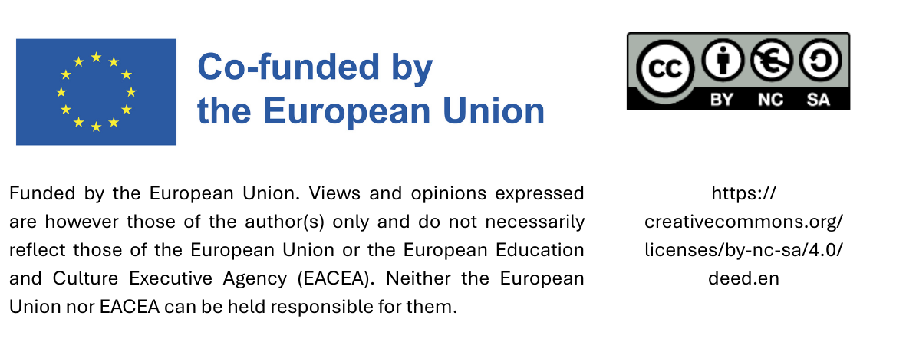
Train the Trainer:
Monitoring & Evaluation
Date

Slide 2
Agenda
Introduction to Monitoring & Evaluation
Tracking implementation locally
KPIs & reporting
Feedback machanisms

Slide 3
1. Introduction to Monitoring & Evaluation

Slide 4

Monitoring & Evaluation
Monitoring involves tracking progress by regularly collecting data and analyzing it using key indicators.

Slide 5
How to monitoring progress
Step 1: Review of data types collected by the municipality
Step 2: Developing key indicators based on existing data
Step 3: Developing additional key indicators
Step 4: Developing a system to ensure regular data delivery
Step 5: Regular analysis of data
Step 6: Discussion and reporting of results
Notes:
Siehe proCURE Handbuch S. 35-37

Slide 6
2. Tracking implementation locally

Slide 7
Step 1: Review of data types collected by the municipality
Gaining an overview of what data is currently being collected within the municipality and its departments
How it is being stored or processed (e.g., in an Enterprise Resource Planning software)
Is additional data necessary?

Slide 8
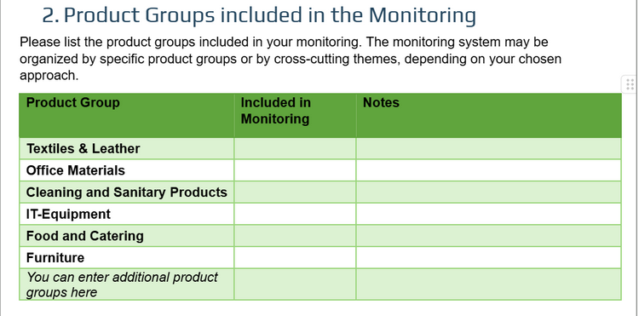
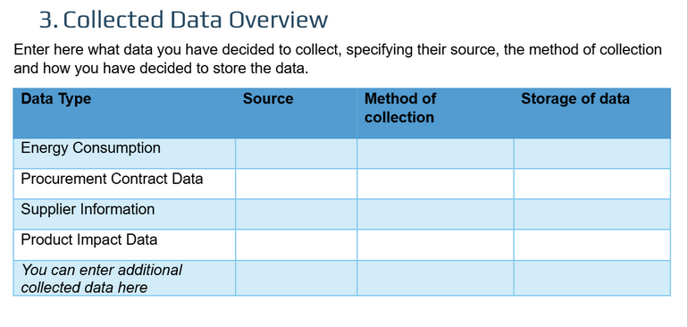
Tracking implemenation locally
From the Tool „Monitoring Results – Reporting Template“:

Slide 9
3. KPIs & Reporting

Slide 10
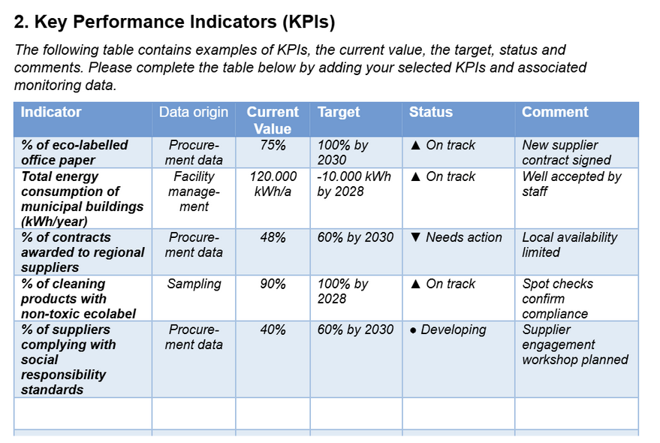
Was sind Schlüsselindikatoren?
From the Tool “Template for a Monitoring Report on Sustainable Procurement”:

Slide 11
How to monitoring progress
Step 1: Review of data types collected by the municipality
Step 2: Developing key indicators based on existing data
Step 3: Developing additional key indicators
Step 4: Developing a system to ensure regular data delivery
Step 5: Regular analysis of data
Step 6: Discussion and reporting of results
Notes:
Siehe proCURE Handbuch S. 35-37

Slide 12
Step 2: Developing key indicators based on existing
It is essential to assess which of the data already collected by the municipality can help determine whether procurement is progressing in the right direction.
There are at least three types of data that can be used to develop key indicators:
Procurement and contract data, e.g., does the procured product have an eco-label?
Supplier data, e.g., supplier location – is it a regional supplier?
Impact data, e.g., the municipality’s electricity consumption

Slide 13
Step 3: Developing additional key indicators
A key principle is to keep monitoring
as simple as possible: as few key indicators as possible, but enough to be effective.
If further key indicators are needed there is a wide range of possibilities to develop key indicators and they may be linked to:
Data collected during the procurement process and the contract, e.g., information on whether the product carries a specific label or if the supplier has a particular social management system in place;
Data from suppliers/service providers, e.g., information on whether the products they supply to the municipality meet the established criteria; and
Control data, such as checks on the cleaning products used - is it actually a cleaning product with an ecolabel?

Slide 14
Step 4: Developing a system to ensure regular data delivery
For any data that needs to be collected separately, such as supplier or control data, a system must be set up to ensure regular and consistent data collection.
Data
Person responsible for monitoring

Slide 15
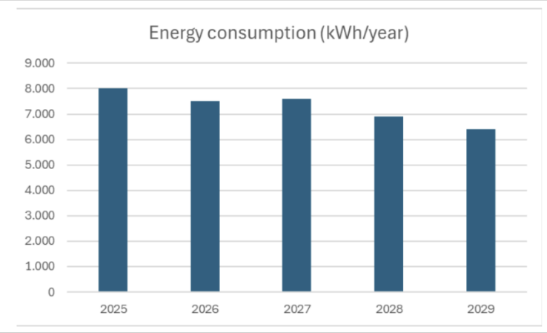
Step 5: Regular analysis of data
Data for each key indicator should be plotted on a timescale. This example chart displays data over a specific period, with time (e.g., years) on the x-axis and the event or measurement (e.g., annual energy consumption) on the y-axis.
Notes:
Bildquelle: proCURE Handbuch S. 37

Slide 16
4. Feedback mechanisms

Slide 17
How to monitoring progress
Step 1: Review of data types collected by the municipality
Step 2: Developing key indicators based on existing data
Step 3: Developing additional key indicators
Step 4: Developing a system to ensure regular data delivery
Step 5: Regular analysis of data
Step 6: Discussion and reporting of results
Notes:
Siehe proCURE Handbuch S. 35-37

Slide 18


Step 6: Discussion and reporting of results
Review the monitoring results within the sustainable procurement working group.
There may be logical explanations for rising KPIs e.g., the purchase of electric vehicles, if energy consumption is raising.
The results should then be presented to decision-makers, such as the mayor or the local council, who have the authority to adjust the municipality’s sustainable procurement strategy.

Slide 19
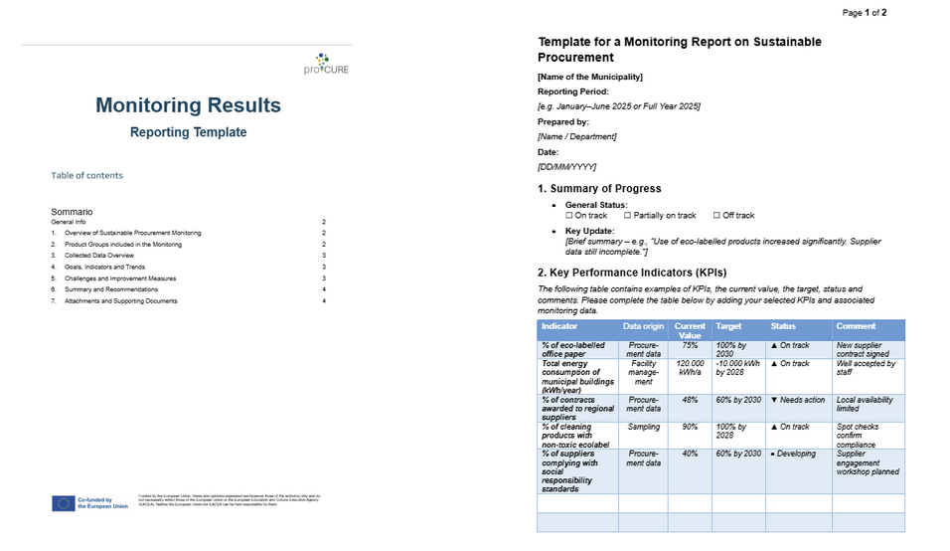
Tools: Reporting templates

Slide 20
Feedback mechanism
Collecting data
Adjusting sustainable procurement strategy
Analyzing data
Reporting data
Discussing data

Slide 21
Thank you!

Slide 22
Sources:
Handbuch „Kleine Schritte, große Wirkung: Nachhaltige Beschaffung in Gemeinden“ aus dem Projekt proCURE, veröffentlicht vom Gemeindenetzwerk Allianz in den Alpen.
Online verfügbar:
https://alpenallianz.org/de/projekte/procure/procure-toolbox

