Slide 1


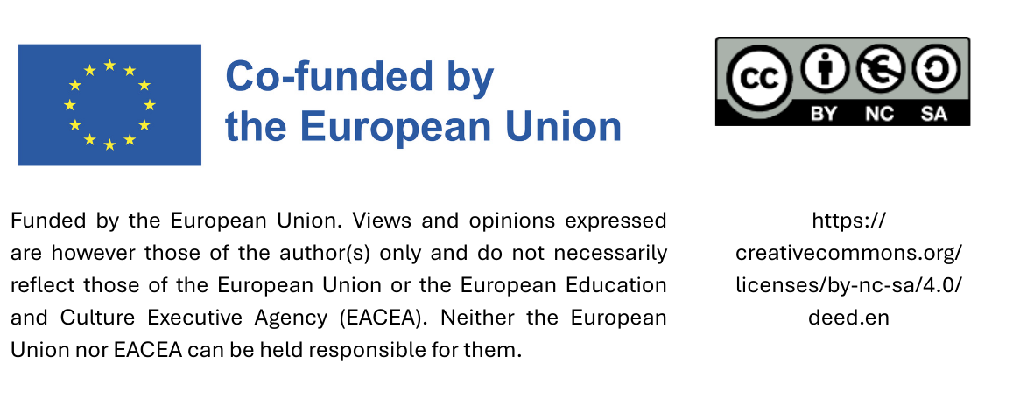
Train the Trainer:
Training Skills - Introduction
Date

Slide 2
Content
Background knowledge
Adult Learning Principles
Common training challenges & how to handle them

Slide 3
      1. Background knowledge
Knowledge transfer remains the most commonly used approach for initiating behavioural change.
Problem knowledge: knowledge about issues, e.g. environmental problems, social impacts
Action knowledge: knowledge about useful behaviours
Knowledge as a basis for justifying the need for behavioural change.
BUT: The connection between knowledge and action is rather weak: knowledge alone is not enough to achieve behavioural change!

Slide 4
      1. Background knowledge
Conveying knowledge about a problem without offering concrete options for action (action knowledge) leads to cognitive dissonance.
Definition: An unpleasant emotional state that arises when one's actions do not match one's beliefs/values/assumptions (state of tension).
E.g. Flying is bad for the climate, but I want to go on a long-distance trip.

Slide 5
      1. Background knowledge
When more sustainable options are less available, more complicated, less convenient and more expensive than conventional options, there are 2 main consequences:
People who want to behave sustainably find it difficult to resolve cognitive dissonance by changing their behaviour.
They often tend to resolve it by adjusting their own assumptions:
  Trivialisation (‘If it were really that bad, it wouldn't be allowed.’)
  Externalising responsibility (‘Politicians need to do something first.’)
  Downward social comparisons (‘Others behave much less sustainably than I do.’)

Slide 6
Ways out of the dilemma:
Values:
    Convey values relating to sustainability
    BUT: do not hope for short-term, measurable effects; values and norms can only be influenced in the long term
Make greater use of the power of social norms
    Communicate how many and which people are already active and make these committed individuals publicly visible as multipliers
Promote group identity, strengthen collective self-effiacy

Slide 7
2. Adult Learning Principles
Need to know | relevance and impact on personal life
Self-Concept | take control of their leaning process, make choices on what, how and when
Prior Experience | background and experience shape how adults perceive new information
Readiness to learn | readiness to learn is linked to current needs
Orientation to learning | problem-solving and real-world relevance, task-oriented
Motivation to learn | mostly intrinsic, personal investment

Slide 8
2. How to use these principles
Be and work…
Collaborative
Contextual
Interactive
Flexibel
Relevant
Experiential
Self-Directed

Slide 9
3. Common Training Challenges
Too much information
Rigid system within municipality - unclear procedure
Unclear relevance
No time
Different knowledge levels
Lack of feedback and support systems
Resistance

Slide 10
Too much information
Explore the municipality before doing the training and choose content according to your findings concerning these questions:
What are the goals of the municipality?
What are the skills already in place?
Which specific skills need knowledge and practice?
Who can be responsible for what? Assign roles. What knowledge do they need?
Focus on small steps rather than trying to cover everything at once!

Slide 11
Unclear procedure
How does the municipality work? Who is responsible?
Meet with the people responsible for internal management procedure and define areas of change and responsibilities.
Encourage the establishment of a feedback system.
Stick with the content of your training to the areas defined in the preliminary work, even if the areas are small.
The chances that people will continue on their own are higher when they see their work actually leading to changes.

Slide 12
Unclear relevance
How does the municipality work? What are its future goals? What is the overarching political framework?
Find out what the municipality would like to change
Communicate the official goals to your participants
Focus on showing them, why they are relevant/why their individual skills are needed to the success of each specific goal
Encourage taking on areas of responsibility. This leads to self-efficacy and the feeling of relevance.

Slide 13
No time
Together with your participants, find out where exactly time is missing. Use the following questions as a guideline.
What is our process now?
What needs to be changed?
What can stay the same?
What can go?
Usually it is more the need of a time shift than actual lack of time.

Slide 14
Different knowledge levels
Get to know the participants and their knowledge about sustainability and sustainable procurement. What are their passions? What are they willing to invest in adapting the procurement in their municipality?
Encourage exchange among participants.
Involve participants and their knowledge in your training.
Give them the stage.
Each of the participants will likely be more inspired to continue great work when they realise what is already done rather than you just telling them to do something.

Slide 15
Lack of feedback and support systems
Take your findings on how the municipality works and who is responsible. Listen to the participants in your training.
Meet with the people responsible for internal management.
Take feedback from the participants in your training.
Encourage the establishment of a feedback system.
Establishing even a short time-effective feedback loop makes sure that new processes remain operational.

Slide 16
Resistance
Clarify common ground and definitions of terms.
Follow the rules of good communication: remain respectful, listen actively, let people finish speaking.
Maintain an educational ethical stance.
Prepare for discussions with facts about environmental and social sustainability.
Understand disinformation strategies.

Slide 17
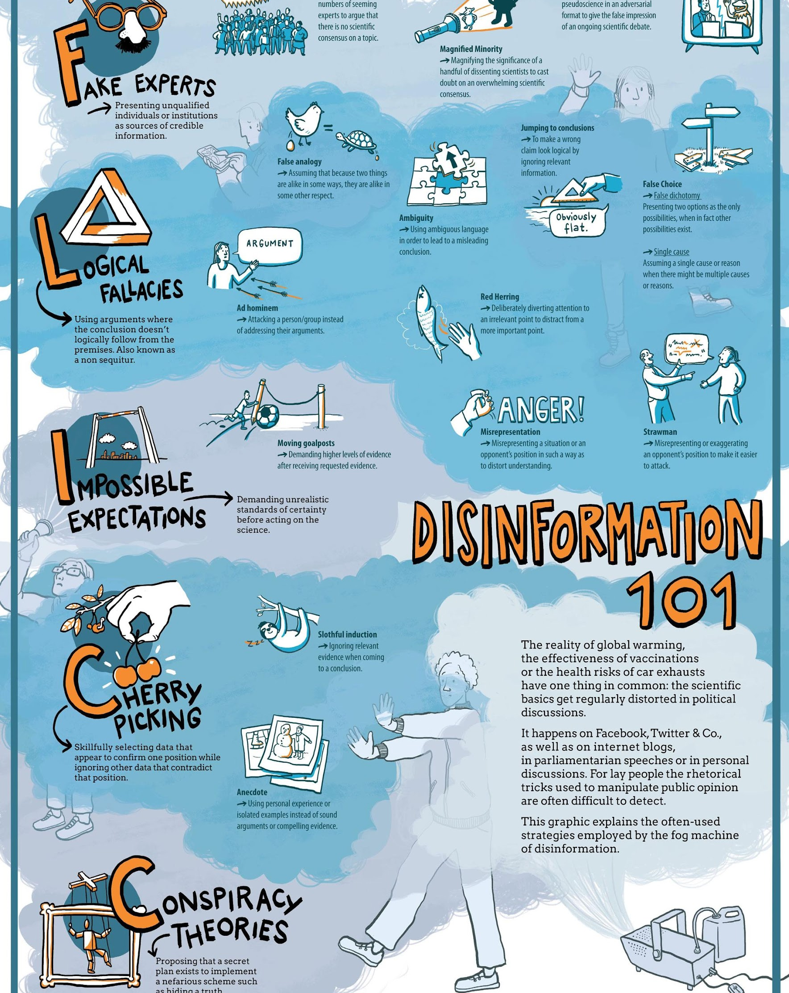
Disinformation Strategies
www.klimafakten.de

Slide 18
Strategies for a good discussion
Accept that participants with fixed opinions can rarely be completely convinced, and focus instead on the remaining participants.
Ask questions instead of judging.
Name and acknowledge emotions.
Ask for alternatives. This directs attention forward and leads the discussion towards possible solutions.
Allow time for reflection, interrupt the discussion and continue/conclude with a writing prompt or a period of silent reflection.
Enable self-positioning, however do not force it. Some learners need time.
Empowerment instead of blame: focus on options for action and
potential for change.
Notes:
Emotionen benennen und anerkennen: Z. B. „Ich merke, dass das Thema starke Reaktionen auslöst. Das ist verständlich – es betrifft zentrale Werte.“
Zeit geben für Reflexion: Manchmal ist es hilfreich, eine Diskussion zu unterbrechen und mit einem Schreibimpuls oder einer stillen Denkzeit fortzusetzen.
Nach Alternativen fragen
„Es ist einfach, etwas abzulehnen und nur die Nachteile aufzuzeigen. Die Frage nach Alternativen lenkt den Blick nach vorne und führt die Diskussion hin zu Lösungsansätzen“, sagt Hegenberg. So spreche man über machbare Verbesserungen und kreise nicht nur um die Probleme.
Bildungsethische Haltung bewahren
Offenheit und Nicht-Überwältigung: Studierende nicht zu bestimmten Positionen drängen, sondern zu kritischer Reflexion anregen.
Selbstpositionierung ermöglichen, nicht erzwingen: Manche Lernende brauchen Zeit, um eigene Haltungen zu entwickeln oder zu artikulieren.
Empowerment statt Schuldzuweisung: Auch bei harten Fakten (Klimakrise, soziale Ungleichheit) den Fokus auf Handlungsoptionen und Veränderungspotenzial legen.

Slide 19
Thank you very much!

