Slide 1


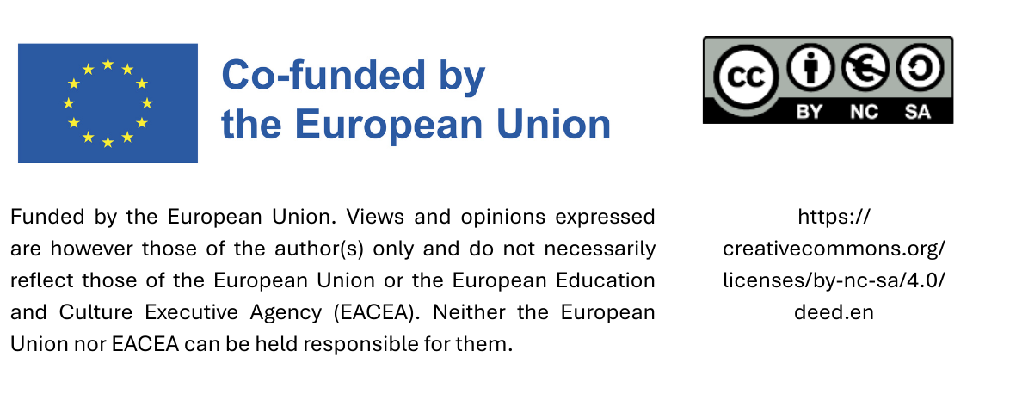
Train the Trainer:
Local Case Studies –
Peer Sharing
Date

Slide 2
Agenda
Practice example: Product labels
Practice example: LED lighting
Practice example: (E-)Catalog
Practice example: Engaging municipal employees
Practice example: Engaging stakeholders
Practice example risk: Electric cars

Slide 3

1. Practice examples
Product labels
The city of Munich procures exclusively fair trade sports balls for schools, where available. Every two years, sports professionals and students test these balls for their suitability for use in lessons. Framework agreements are concluded based on the results. The range of fair trade sports balls has expanded in recent years.
https://www.fairtrade.net/de-de/produkte/fairtrade_produkte/sportbaelle.html
Notes:
Quelle Text: https://www.eineweltnetzwerkbayern.de/fileadmin/assets/Kommunen_Eine_Welt/2024_6_A/2024_-_Kommunen_Eine_Welt_-_6_A_-_EWNB.pdf S. 36
Quelle Bild: https://www.fairtrade.net/de-de/produkte/fairtrade_produkte/sportbaelle.html

Slide 4




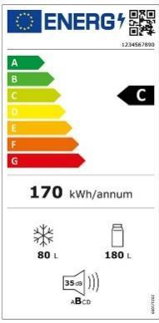







Examples of product labels
Labels from certification initiatives for products and services
Legally required labels
Labels awarded for individual or specific end products
Notes:
See the proCURE Handbook, pp. 29–31
Quality labels are a crucial tool for sustainable procurement, particularly for small local authorities. With the help of quality labels, local authority procurement officers can quickly determine whether a product or service is sustainable. The use of quality labels in the procurement process is permitted provided that the labels meet certain criteria:
The requirements of the quality label are based on objectively verifiable and non-discriminatory criteria that are suitable for determining the characteristics of the service.
The quality labels are introduced through an open and transparent procedure in which all relevant stakeholders can participate.
The quality labels are accessible to all interested parties.
The requirements for the quality labels are set by an independent third party over which the companies applying for the quality label cannot exert any significant influence.
Although there are a large number of quality labels, only a limited number meet the above requirements. The challenge lies in familiarising oneself with the quality labels that meet these requirements and recognising them on products. Four types of quality labels are described below. The first three types of quality labels generally meet the above requirements.
Quality labels from broad-based certification initiatives: In the EU, there are several certification initiatives that provide guidelines for a wide range of products and services. These initiatives are often backed by government bodies or institutions closely associated with them, such as standards organisations. The quality labels awarded by these bodies are generally among the most meaningful indicators of a product’s or service’s sustainability. The certification initiatives have guidelines for individual product and service groups, in which the relevant sustainability and quality criteria are described in detail. Companies wishing to obtain such a certificate must demonstrate that they meet the criteria set out in the guidelines. If this is confirmed during an audit, the companies are granted the right to use the relevant quality label for a specific period. Examples: the EU Ecolabel, the Austrian Ecolabel, the Blue Angel, NF Environnement and C2C.
Labels awarded for individual end products: This type of label is also awarded by independent third parties. However, there is a major difference compared to the labels mentioned above: only a few product groups are certified. Often, the organisations responsible for awarding the labels are private bodies. Labels of this kind are primarily found for textiles, food and IT equipment. A small selection of these labels: TCO-certified, Oeko-Tex Standard 100, GOTS, Fair Wear and ASC.
Legally required labels: Some labels that indicate compliance with a specific quality standard are required by law. These include, for example, the EU organic logo, which must appear on all packaged food produced in the EU and marketed as an organic product. The energy consumption label, which must be affixed to electrical appliances, for example, is also included.

Slide 5
Group exercise: Product labels
Work in groups and discuss the following questions:
What do you think was the decisive factor for success?
What are the pitfalls to avoid?
Would there be difficulties in your municipality compared to the good practice example?
Does your municipality already procure products with labels?
  If yes, which ones?
  If not, which products could be suitable for your municipality?

Slide 6
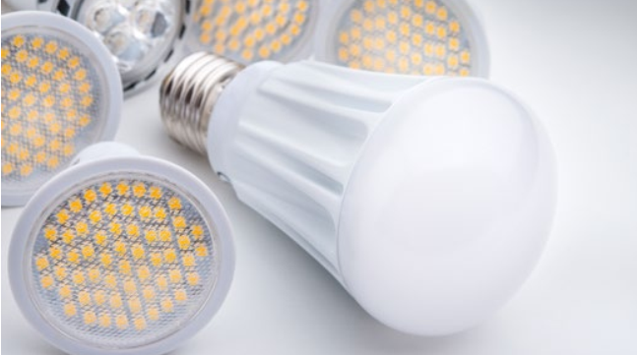
2. Practice example: LED lighting
After a profitability check showed that switching to LED lighting would be worthwhile, the municipality of Mutters (Austria) decided to replace the indoor lighting in its public buildings with LED lamps. The project covered the municipal office, the school, two fire stations, and the community.
The new lighting reduced electricity consumption for illumination by almost 67%.
Notes:
Source Text: „NACHHALTIG EINKAUFEN – EINE ORIENTIERUNG FÜR STÄDTE UND GEMEINDEN“ edited by BUNDESMINISTERIUM FÜR LAND- UND FORSTWIRTSCHAFT, UMWELT UND WASSERWIRTSCHAFT page. 43
Source Picture: „NACHHALTIG EINKAUFEN – EINE ORIENTIERUNG FÜR STÄDTE UND GEMEINDEN“ edited by BUNDESMINISTERIUM FÜR LAND- UND FORSTWIRTSCHAFT, UMWELT UND WASSERWIRTSCHAFT page. 43

Slide 7
Group exercise: LED lighting
Work in groups and discuss the following questions:
What do you think was the decisive factor for success?
What are the pitfalls to avoid?
Would there be difficulties in your municipality compared to the good practice example?
Does your municipality already use LED lighting?

Slide 8
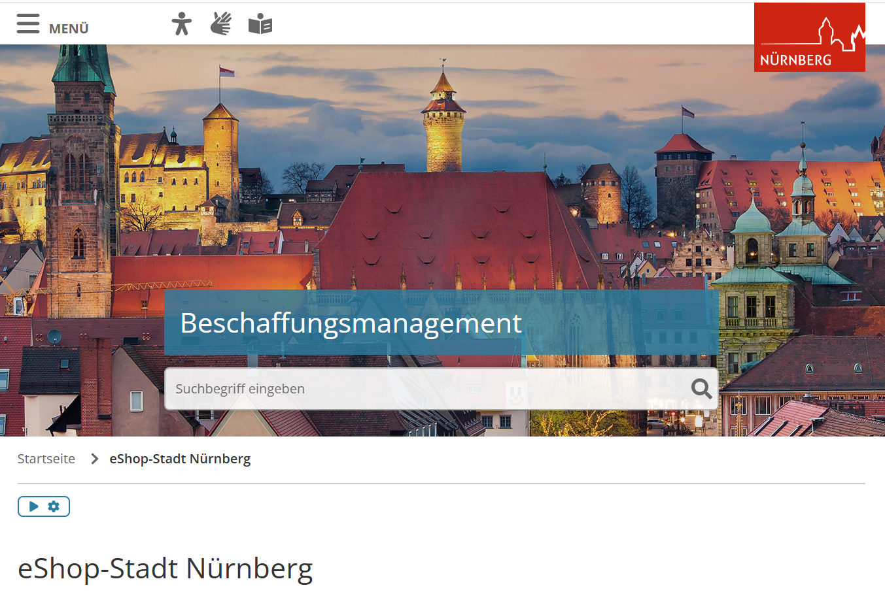
3. Practice example: (E-)Catalog
Since March 2023, the city of Nuremberg has been using a new electronic purchasing system. The catalog shop system supports decentralized procurement by departments and municipal enterprises. Product catalogs in the system are based on tendered framework agreements or negotiated discount agreements. The central procurement office selects the suppliers and carries out the award procedures.
The platform can be used to:
Order products directly from framework agreement catalogs
Place direct orders up to €5,000 net outside of framework agreements
Report individual requirements (“free text orders”) to the central procurement office
Notes:
Source Text: https://www.kompass-nachhaltigkeit.de/kommunaler-kompass/bayern/rahmenbedingungen-nutzen#c42191036
Source Picture: https://www.nuernberg.de/internet/beschaffung/ekv_shop.html#_0_3

Slide 9
Group exercise: (E-)Catalog
Work in groups and discuss the following questions:
What do you think was the decisive factor for success?
What are the pitfalls to avoid?
Would there be difficulties in your municipality compared to the good practice example?
Does your municipality already have an (E-)Catalog?
  If yes, how did you get there?
  If not, would it be a possibility (just for your municipality or as joint procurement together with other municipalities)?

Slide 10

4. Practice example Engaging municipal employees
The cleaning staff of the municipality of Payerbach (Austria) completed a training course on ecological cleaning provided by “die umweltberatung.” The course covered ingredients, dosages, and occupational and skin protection. As a result, the municipality switched its cleaning methods and products to environmentally friendly alternatives.
The training led to greater awareness and motivation within the team, a more responsible approach to environmental issues, and a significant reduction in the use of chemicals. At the same time, the costs for cleaning agents were reduced and ecological standards were improved.
Notes:
Source Text: https://gemeindebund.at/images/uploads/downloads/2017/Projekte/Ressourceneffiziente_Gemeinde/Projekt_Ressourceneffiziente_Gemeinde_Massnahmenkatalog.pdf S. 41-42
Source Picture: https://www.umweltberatung.at/img/1400/4409.jpg

Slide 11
Group exercise: Engaging employees
Work in groups and discuss the following questions:
What do you think was the decisive factor for success?
What are the pitfalls to avoid?
Would there be difficulties in your municipality compared to the good practice example?
Has your municipality already carried out initiatives to engage employees?
  If yes, how did the initiative look like?
  If not, what could be a suitable initiative?

Slide 12
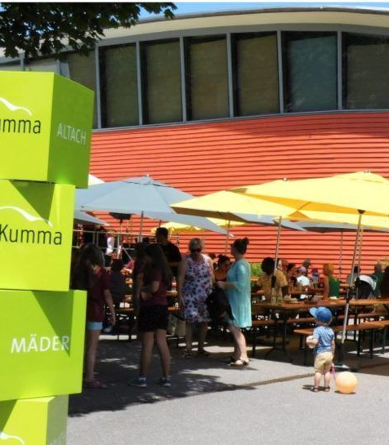
5. Practice example Engaging stakeholders
For 15 years, the municipality of Mäder (Austria) has been hosting the Sonnenfest (Sun Festival) and inviting over 1,000 co-owners of the photovoltaic system on the roof of the ÖKO secondary school to attend. The festival promotes environmental education and is hosted by a different Mäder association each year, with organic and regional products.
The journey there is climate-friendly, either on foot, by bike, or by public transport. Thanks to free bike cleaning and free public transport, car parking spaces are no longer necessary.
Sonnenfest Mäder 2023
Quelle: vol.at
Notes:
Source Text: https://www.klimabuendnis.at/wp-content/uploads/2024/03/6_kbu_lf_beschaffung.pdf
Source Picture: https://www.vol.at/maeder-feiert-sonnenfest/8131894 Sonnenfest Mäder 2023

Slide 13
Group exercise: Engaging stakeholders
Work in groups and discuss the following questions:
What do you think was the decisive factor for success?
What are the pitfalls to avoid?
Would there be difficulties in your municipality compared to the good practice example?
Has your municipality already carried out initiatives to engage stakeholders?
  If yes, how did the initiative look like?
  If not, what could be a suitable initiative?

Slide 14
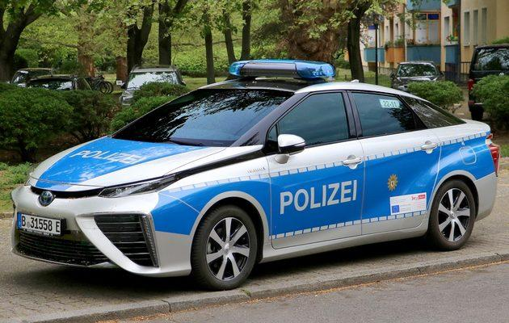
6. Practice example: Risk Electric cars
The Berlin Police Department has purchased electric cars, but users are not entirely happy with them.
What risks might there be?
Notes:
Source Text: Film from this website (from min. 18:15): https://www.kompass-nachhaltigkeit.de/grundlagenwissen/einblick-in-die-beschaffungspraxis
Source Picture: https://polizeibericht.info/ausruestung/fuhrpark/
Explanation: Police patrol cars must be ready for action day and night. Long charging times for electric cars require a great deal of logistical effort to ensure operational readiness.
Procurement officers at the Berlin Police Department would like to see certificates for the manufacture of vehicles (for cars with combustion engines as well as electric cars) so that they can also ensure sustainability for combustion engines.
In addition to electric cars, the Berlin police are also procuring hydrogen-powered cars.

Slide 15
Group example: Risk Electric cars
Work in groups and discuss the following questions:
What do you think are the risks if the Berlin Police Department procures electric cars?
How can these risks be dealt with?
Would there be difficulties in your municipality procuring electric cars?
What risks concerning sustainable procurement occurred in your municipality?
What possible risks could you think of?
Notes:
Explanation: Police patrol cars must be ready for action day and night. Long charging times for electric cars require a great deal of logistical effort to ensure operational readiness.
Procurement officers at the Berlin Police Department would like to see certificates for the manufacture of vehicles (for cars with combustion engines as well as electric cars) so that they can also ensure sustainability for combustion engines.
In addition to electric cars, the Berlin police are also procuring hydrogen-powered cars.

Slide 16
Thank you!

Slide 17
Sources text:
„Kommunen und Eine Welt – Handreichung für kommunale Eine Welt-Arbeit in Bayern“ Dr. Alexander Fonari, Vivien Führ und Norbert Stamm für Eine Welt Netzwerk Bayern e.V. 6. Auflage, Augsburg 2024. S. 36. Available online: https://www.eineweltnetzwerkbayern.de/fileadmin/assets/Kommunen_Eine_Welt/2024_6_A/2024_-_Kommunen_Eine_Welt_-_6_A_-_EWNB.pdf
Kompass Nachhaltigkeit „Nürnberg - Elektronisches Einkaufssystem zur Steuerung nachhaltiger Beschaffung (2023)“. Available online: https://www.kompass-nachhaltigkeit.de/kommunaler-kompass/bayern/rahmenbedingungen-nutzen#c42191036
Kompass Nachhaltigkeit, Film „Einblicke in die Beschaffungspraxis“. Available online: https://www.kompass-nachhaltigkeit.de/grundlagenwissen/einblick-in-die-beschaffungspraxis
Leitfaden „Klimaschutz in Gemeinden“, Kapitel „Nachhaltige Beschaffung für Gemeinden“, 2016. Herausgeber und Vertrieb: Klimabündnis Österreich GmbH. „Good-Practice Beispiel: Sonnenfest – Gemeinde Mäder, Vorarlberg“ S. 8. Available online: https://www.klimabuendnis.at/wp-content/uploads/2024/03/6_kbu_lf_beschaffung.pdf
Maßnahmenkatalog „ Ressourceneffiziente Gemeinde“ 2016, Hrsg. Ressourcen Management Agentur (RMA).S. 41 – 42. Available online: https://gemeindebund.at/images/uploads/downloads/2017/Projekte/Ressourceneffiziente_Gemeinde/Projekt_Ressourceneffiziente_Gemeinde_Massnahmenkatalog.pdf
„NACHHALTIG EINKAUFEN – EINE ORIENTIERUNG FÜR STÄDTE UND GEMEINDEN“ edited by BUNDESMINISTERIUM FÜR LAND- UND FORSTWIRTSCHAFT, UMWELT UND WASSERWIRTSCHAFT page. 43

Slide 18
Sources photos:
Die Umweltberatung „Ökologisch und effizient reinigen“. Available online: https://www.umweltberatung.at/img/1400/4409.jpg
Fairtrade.net „Fairtrade-Sportbälle“. Available online: https://www.fairtrade.net/de-de/produkte/fairtrade_produkte/sportbaelle.html
„NACHHALTIG EINKAUFEN – EINE ORIENTIERUNG FÜR STÄDTE UND GEMEINDEN“ edited by BUNDESMINISTERIUM FÜR LAND- UND FORSTWIRTSCHAFT, UMWELT UND WASSERWIRTSCHAFT page. 43
Nuernberg.de „e-Shop Stadt Nürnberg“. Available online: https://www.nuernberg.de/internet/beschaffung/ekv_shop.html#_0_3
Polizeibericht.net „Polizeibericht 2021 – Fahrzeuge“. Available online: https://polizeibericht.info/ausruestung/fuhrpark/
Vol.at „Mäder feiert Sonnenfest“. Available online: https://www.vol.at/maeder-feiert-sonnenfest/8131894

