Slide 1


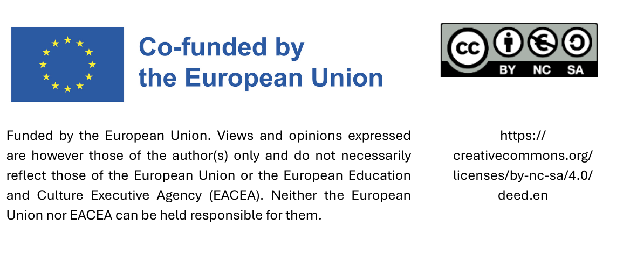
Train the Trainer:
Introduction to sustainable
procurement
Datum

Slide 2
Agenda - Content 1:
Basics of Sustainability
Introduction to „Sustainability“
Introduction to „Climate Change“
Agenda 2030
Global Goals for Sustainable development: SDGs
Introduction to „Sustainable Procurement“

Slide 3
Introduction to
„Sustainability“

Slide 4



Important definitions
United Nations (UN): The United Nations, founded in 1945 and now comprising 193 Member States, serves as a global forum where nations collaborate to address shared challenges and promote the common good.
European Union (EU): The European Union (EU), established in 1993, is a political and economic alliance of European nations.
ISO 20400: ISO 20400 is a standard offering guidance to organizations of any size or sector on how to incorporate sustainability into their procurement practices. It is designed for all stakeholders involved in or affected by procurement activities.
Bildquelle: Pexels
Notes:
Quellen:
https://www.un.org/en/about-us
https://ec.europa.eu/eurostat/statistics-explained/index.php?title=Glossary:European_Union_(EU); https://next-generation-eu.europa.eu/index_de
https://www.iso.org/standard/63026.html#:~:text=ISO%2020400:2017%20provides%20guidance,by%2C%20procurement%20decisions%20and%20processes.

Slide 5




What does „sustainability“ mean?
A few historical dates
1972 – United Nations Conference on the Human Environment
1972 – Report „The Limits of Groth“
(Club of Rome)
1987 – Brundtland Report: „Our Common Future“
Bildquelle: Pexels
Notes:
Sustainability is not a new concept; it is the result of decades of global diplomacy. A key turning point was the 1972 United Nations Conference on the Human Environment in Stockholm. This was the first global conference to make the environment a central theme. It led to the Stockholm Declaration and the establishment of the United Nations Environment Programme (UNEP), the world’s leading authority on environmental issues.

Slide 6

1972 – United Nations Conference on the Human Environment
Was the first world conference to make the environment a major issue;
The Stockholm Declaration was adopted;
One of the major results of the Stockholm conference was the creation of the United Nations Environment Programme (UNEP).
Bildquelle: Pexels

Slide 7
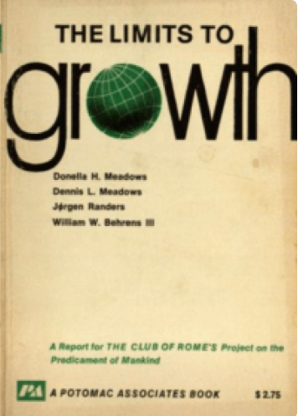
1972 – Report “The Limits to Growth” (Club of Rome)
1970 - an international team of researchers at the Massachusetts Institute of Technology (MIT) began a study of the implications of continued worldwide growth.
1972 – the Club of Rome published the Report “The Limits to Growth”
The report highlighted the need for sustainable development and responsible resource management.
The study predicted that if these trends continued, the earth's resources would be exhausted by the late 21st century, leading to potential economic and ecological collapse.
Bildquelle: Pexels
Notes:
In the same year as the Stockholm Conference, the Club of Rome published a groundbreaking report entitled ‘The Limits to Growth’. Using computer models developed at MIT, the researchers warned that the Earth’s resources would be exhausted by the end of the 21st century if population growth and resource consumption continued at their current rates. This report served as a “wake-up call”, calling for the responsible use of resources to prevent total economic and ecological collapse.

Slide 8
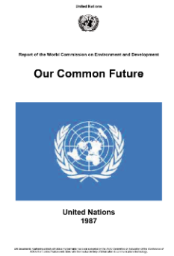
1987 – Brundtland Report: “Our Common Future”
1983 - World Commission on Environment and Development (WCED) had been set;
1987 - WCED published the report «Our common future». The document came to be known as the «Brundtland Report» after the Commission's chairwoman, Gro Harlem Brundtland.
The term ‘Sustainable Development’ is officially coined, defined as «the process that allows the needs of the present generation to be met without compromising the ability of future generations to meet their own needs».
Bildquelle: Pexels
Notes:
Fifteen years later, the Brundtland Report (officially titled ‘Our Common Future’) provided the best-known definition of sustainable development: ‘a process that enables the needs of the present generation to be met without compromising the ability of future generations to meet their own needs’. This concept is of crucial importance, as it introduces the notion of intergenerational justice, meaning that we must live in such a way that we do not ‘deprive’ the future of anything.

Slide 9
3 main pillars of sustainability
Economic
The Brundtland Report identifies 3 pillars as a foundation for sustainability:
environmental, economic and social.
Social
Environmental

Slide 10
1 more pillar
Institutional
The Institutional pillar did not originate in the Brundtland Report but was added later to reinforce the idea that sustainable development requires strong governance structures to function.
“OUR COMMON FUTURE" ...
"In essence, sustainable development is a process of change in which the exploitation of resources, the
direction of investments, the orientation of technological development; and institutional change are all in
harmony and enhance both current and future potential to meet human needs and aspirations."
Notes:
Sustainability is often depicted as a building supported by pillars. The Brundtland Report identified three pillars: environmental, social and economic. Later, however, a fourth pillar was added: the institutional pillar. This underscores the fact that sustainability is not just about being ‘green’ – for it to actually work, strong governance structures, clear laws and political will are required.

Slide 11
Introduction to „Climate Change“

Slide 12
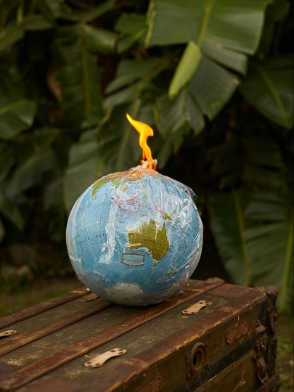
What is climate change?
«Climate change» refers to long-term changes in temperatures and weather patterns.
Since the 19th century, human activities have been the main factor behind climate change, which is mainly attributable to the burning of fossil fuels such as coal, oil and gas.
Bildquelle: Pexels
Notes:
Climate change refers to long-term changes in temperatures and weather patterns. Whilst some of these changes are of natural origin, the sources make it clear that human activities since the 19th century have been the main cause, primarily through the burning of fossil fuels. This releases greenhouse gases such as CO₂, methane and nitrous oxide, which trap heat in the atmosphere.

Slide 13
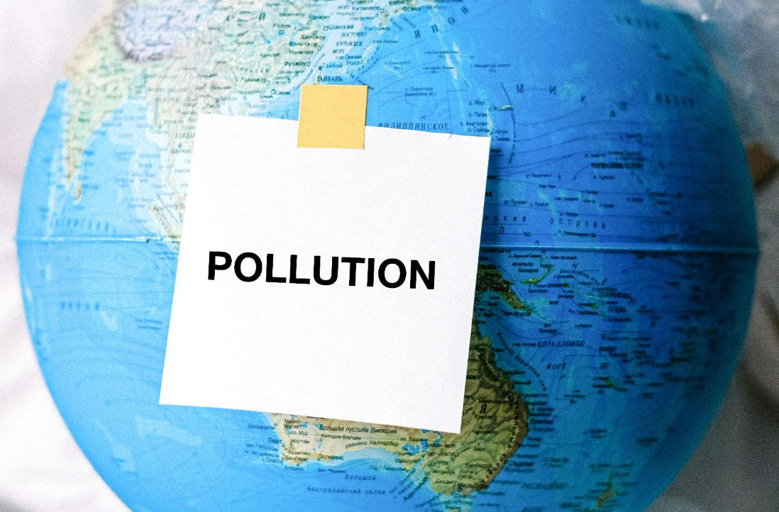
Causes and consequences
Greenhouse gas emissions (CO2, methane, nitrous oxide) – Energy, industry, transport, construction, agriculture and land use are among the main emitters.
Deforestation
Pollution
Unsustainable use of natural resources
Bildquelle: Pexels
Notes:
Zu den Hauptursachen des Klimawandels zählen Entwaldung, Umweltverschmutzung und die nicht nachhaltige Nutzung von Ressourcen.

Slide 14
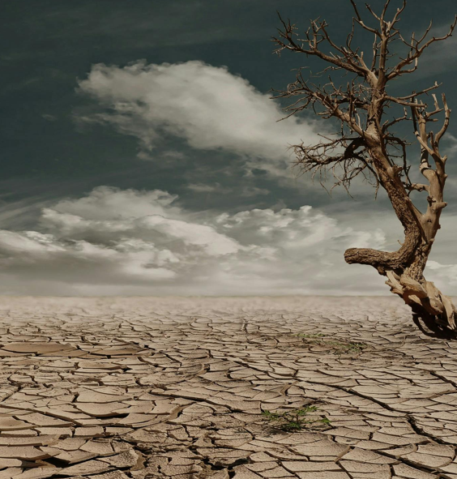
Causes and consequences
Rising global average temperatures
Melting glaciers and rising sea levels
Extreme weather events (hurricane, droughts, heat waves, floods)
Loss of biodiversity
Impacts on agriculture, human health and economies
Bildquelle: Pexels
Notes:
The consequences are already evident: rising global temperatures, melting glaciers, rising sea levels and more frequent extreme weather events such as droughts and floods. These changes threaten biodiversity, human health and the global economy.

Slide 15
Agenda 2030 for Sustainable Development
An action plan for people, planet and prosperity

Slide 16

History
The 2030 Agenda for Sustainable Development, adopted by all United Nations Member States in 2015, provides a shared blueprint for peace and prosperity for people and the planet, now and into the future.
At its heart are the 17 SustainableDevelopment Goals (SDGs), which are an urgent call for action by all countries in a global partnership.
Bildquelle: Pexels
Notes:
The 2030 Agenda is the current global ‘action plan’ for people and the planet. It builds on earlier initiatives such as the 1992 Rio Earth Summit (Agenda 21) and the Millennium Development Goals (MDGs) from 2000, which aimed to combat extreme poverty. In 2012, at the ‘Rio+20’ conference, nations agreed to create a more comprehensive set of goals, which gave rise to the 17 SDGs.

Slide 17
History
The SDGs build on decades of work by countries and the UN:
1992, at the Earth summit in Rio more than 178 countries adopted the Agenda 21
1997 the Kyoto Protocol was adopted
2000 the Millenium Summit led to the elaboration of 8 Millenium Development Goals (MDGs) to reduce extreme poverty by 2015
2012 beschlossen die Mitgliedstaaten auf der Konferenz der Vereinten Nationen über nachhaltige Entwicklung (Rio+20) einen Prozess zur Entwicklung einer Reihe von SDGs einzuleiten.
2013 richtete die Generalversammlung eine 30-köpfige offene Arbeitsgruppe ein, um einen Vorschlag zu den SDGs zu erarbeiten.

Slide 18
2015
January 2015, the General Assembly began the negotiation process on the post-2015 development agenda
2015 was a landmark year for multilateralism and international policy shaping, with the adoption of several major agreements, including
Paris Agreement on Climate Change (December 2015)
Adoption of the 2030 Agenda for Sustainable Development with 17 Sustainable Development Goals (SDGs).

Slide 19
Gobal Goals for sustainable development: SDGs
17 Sustainable Development Goals
Bildquelle: Pexels

Slide 20
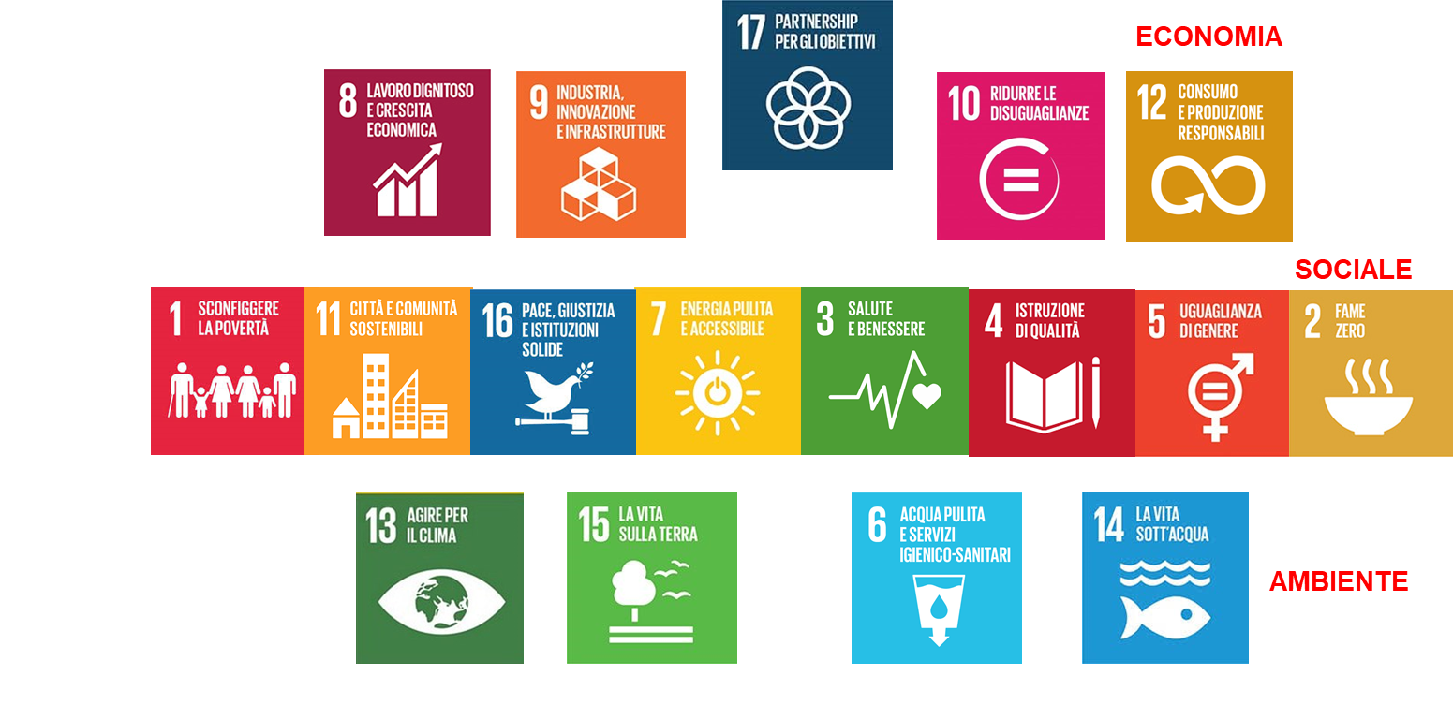
17 SDGs and 169 targets
ECONOMIC
SOCIAL
ENVIRONMENTAL

Slide 21
What are the SDGs?
SDGs are the UN Sustainable Development Goals.
They comprise 17 thematic Goals, which in turn are broken down into 169 Targets, expressing quantitative targets. Measurable with 230 potential indicators;
The Goals have been signed by 193 countries
They replace the Millennium Development Goals in force from 2000 to 2015

Slide 22
What are the characteristics of the SDGs?
They have a global and local dimension
They are clear
They are scalable and long-term
They are adaptable to governments, local institutions, businesses of various sizes and sectors
They are transversal and not sectoral
They define sectoral responsibilities between the various stakeholders
They favour the measurement of positive (accountability) and comparable impacts.
Notes:
The SDGs are more than just buzzwords; they form a technical framework comprising 17 goals, 169 targets and 230 measurable indicators. They are designed to be clear and long-term in focus, and can be adapted to different levels of government and sectors. Above all, however, they are cross-cutting, meaning that progress on one goal (such as education) often contributes to achieving other goals (such as gender equality).

Slide 23

Local Authorities: Key Actors for the SDGs
Local authorities are closest to citizens and manage critical services: transport, housing, education, waste, water, energy, etc.
Over 65% of the SDG targets can only be achieved with local and regional government involvement.
Cities and municipalities are on the front line of tackling climate change, poverty, and inequality.
Local action has global impact: sustainable urban development, social inclusion, and green innovation all contribute to global goals.
Bildquelle: Pexels
Notes:
Although the SDGs are international in nature, their success depends on action taken at local level. Local authorities are responsible for key service sectors: transport, waste management, water supply and housing. It is estimated that over 65% of the SDG targets can only be achieved if local and regional authorities are actively involved.

Slide 24




Sustainable Public Procurement: A strategic tool for the SDGs
Public procurement represents 15–20% of GDP in many countries — a powerful economic lever.
Through sustainable procurement, local governments can:
- reduce environmental impact (SDG 12, SDG 13)
- promote decent work and social inclusion (SDG 8, SDG 10)
- foster innovation and sustainable infrastructure (SDG 9, SDG 11)
Embeds SDG principles in daily decision-making and long-term strategies.
Sends clear signals to markets, supporting responsible businesses and circular economy models.
Notes:
Public procurement – that is, the process by which governments purchase goods and services – accounts for 15 to 20 per cent of GDP in many countries. Given the sheer scale of the funds involved, it represents a powerful economic lever. By opting for sustainable options, governments can reduce environmental damage (SDG 13), promote fair working conditions (SDG 8) and encourage companies to innovate.

Slide 25
Introduction to sustainable procurement

Slide 26
Agenda - Content 2:
Introduction to sustainable procurement
Development models compared
The GPP definition
European Tools for the dissemination of GPP
Advantages of SPP

Slide 27
Development Models compared

Slide 28
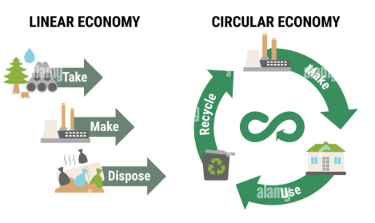
Linear vs. Circular economy
LINEAR ECONOMY:
Extract;
Produce;
Dispose
CIRCULAR ECONOMY:
Extract;
Produce;
Dispose
Reuse
Bildquelle: Pexels

Slide 29




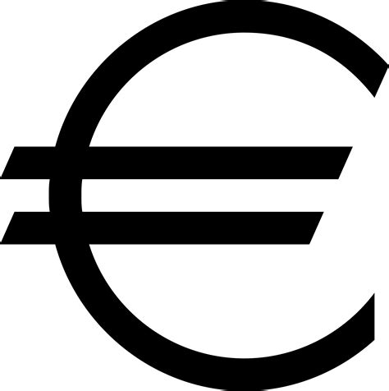
The Linear Economy model is unsustainable
Intensive use of finite natural ressources
Massive production of waste
Relies on fossil fuels, which are responsible for GHGs emission
Causes raw material supply crisis
Loss of economical value of product that is used for only one life cycle
Notes:
The linear economy is based on a ‘take-make-dispose’ model, which leads to the depletion of resources and waste crises. The circular economy adds a crucial step: reuse and recycling.

Slide 30
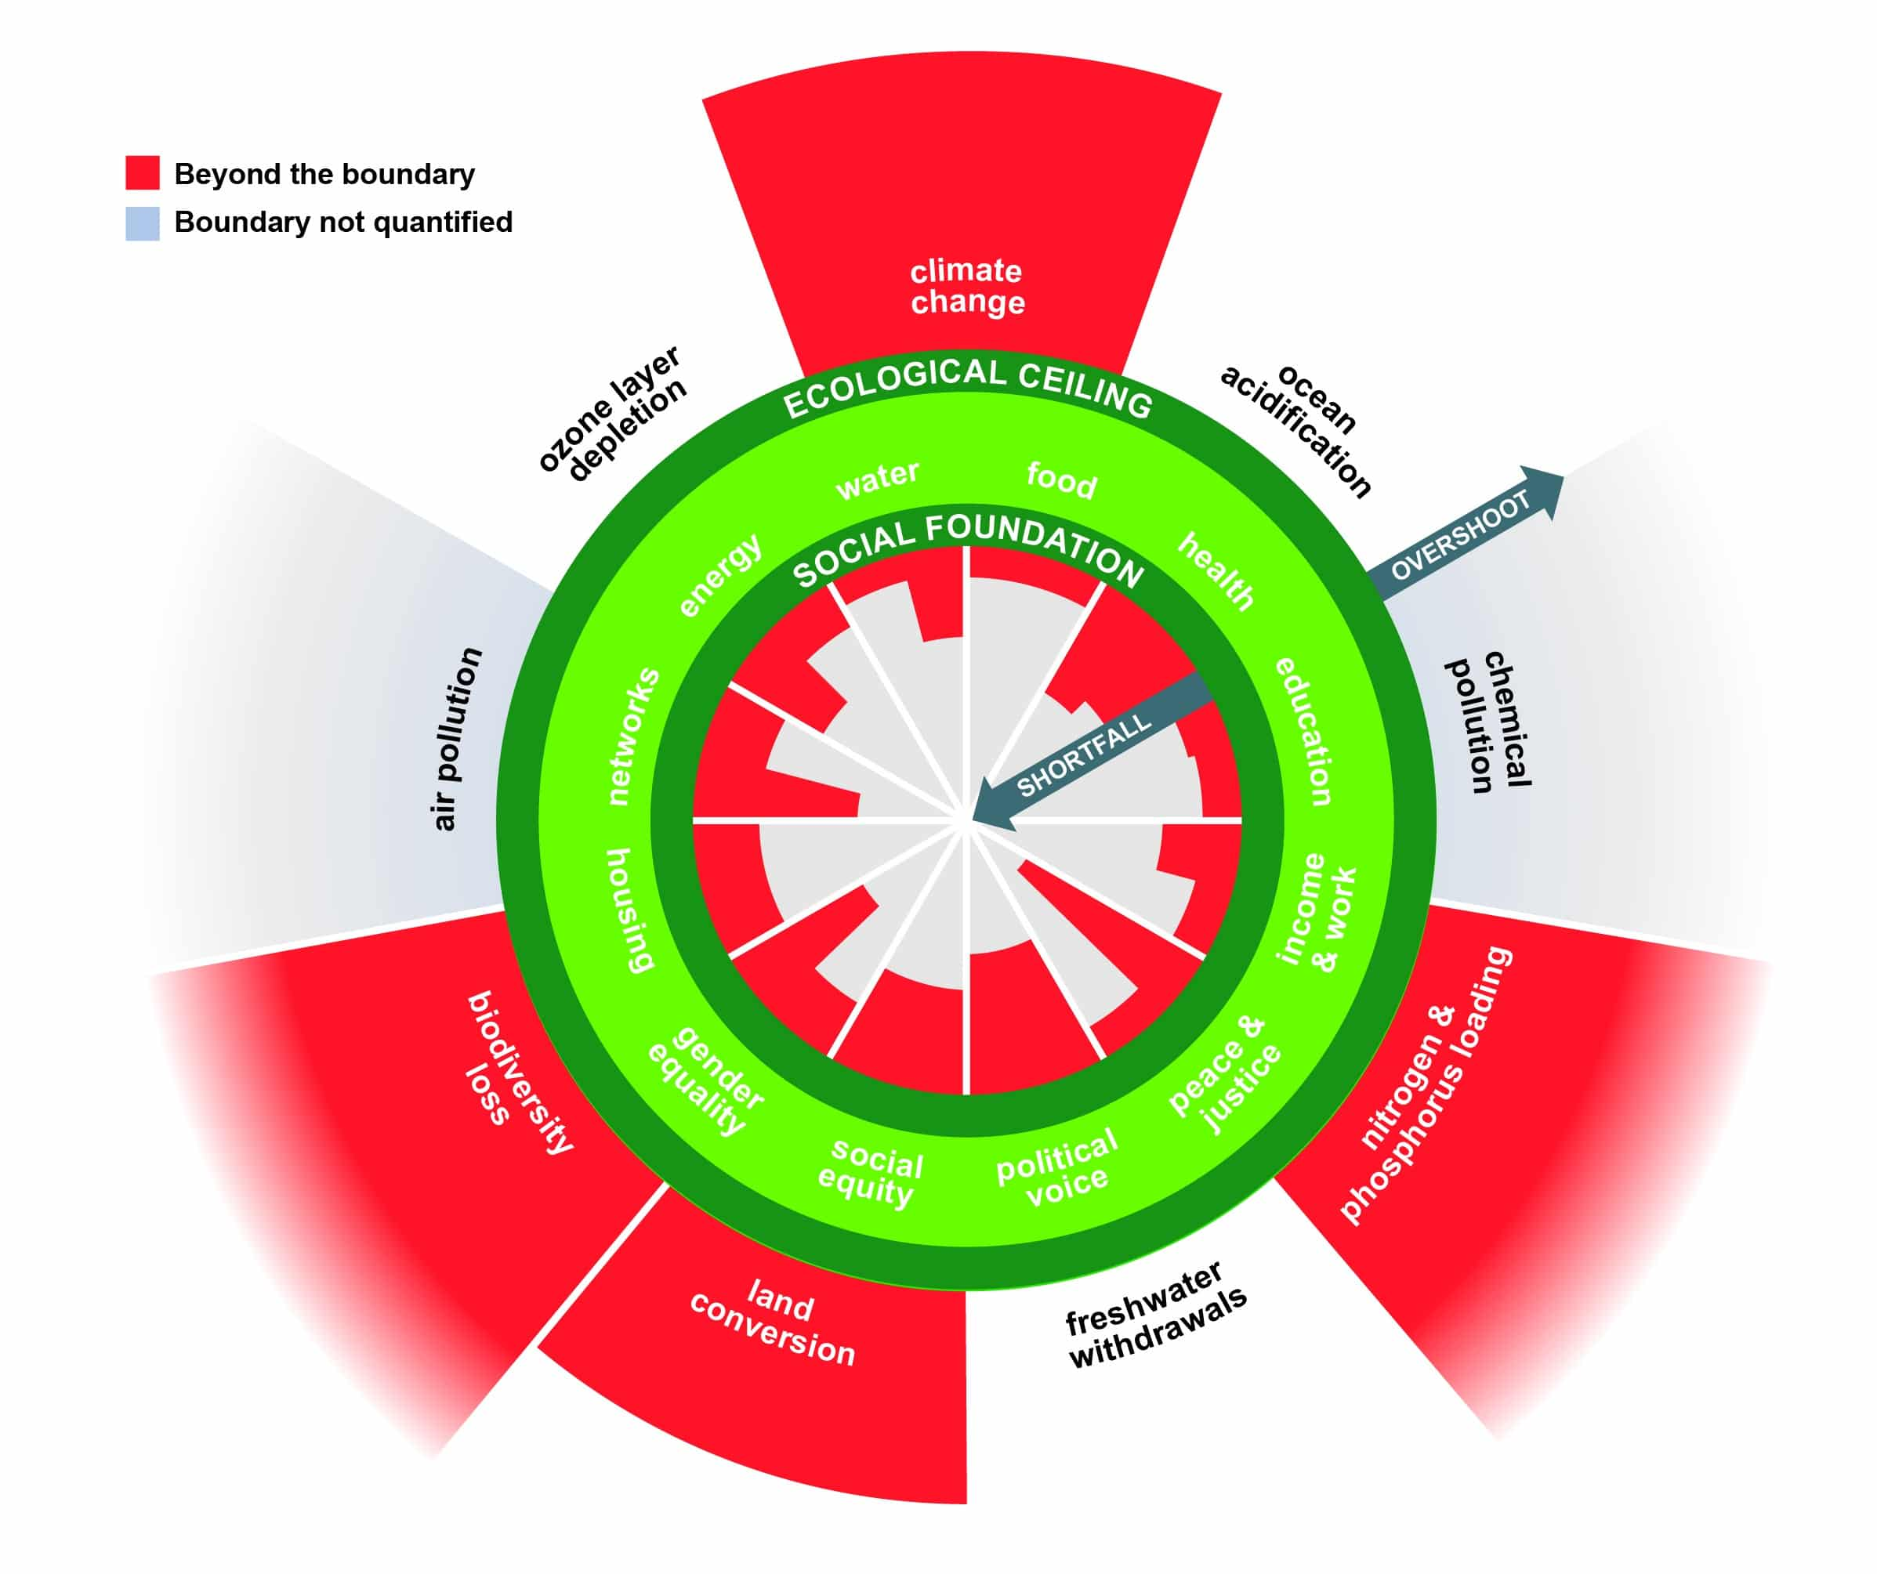
Doughnut
Economics
KATE RAWORTH – «Human well-being depends not only on maintaining the use of resources in an overall good natural state, but also on satisfying the needs of making to lead a life of dignity and with the right opportunities.»
Picture: https://earth.org/what-is-doughnut-economics/
Notes:
Die „Doughnut-Ökonomie“ ist eine Theorie von Kate Raworth, nach der das menschliche Wohlergehen ein Gleichgewicht zwischen unseren sozialen Bedürfnissen und der „ökologischen Obergrenze“ der Erde erfordert.
Picture: https://earth.org/what-is-doughnut-economics/

Slide 31
The GPP definition

Slide 32
Green Public Procurement
“Green Public Procurement (GPP) is the approach whereby public authorities integrate environmental criteria at all stages of the purchasing process, encouraging the dissemination of environmental technologies and the development of environmentally sound products by researching and selecting results and solutions that have the least possible impact on the environment throughout the entire life cycle”
The European definition of Green Public Procurement emphasises five aspects
Notes:
GPP is defined as the process whereby public authorities incorporate environmental criteria into all stages of the procurement process. The aim is to promote the development of environmentally sustainable products by selecting solutions that have the lowest environmental impact throughout their entire life cycle.

Slide 33
Five GPP aspects
Perimeter
Public
administrations
Life cycle
Process steps
process steps
Integration criteria
Impacts

Slide 34
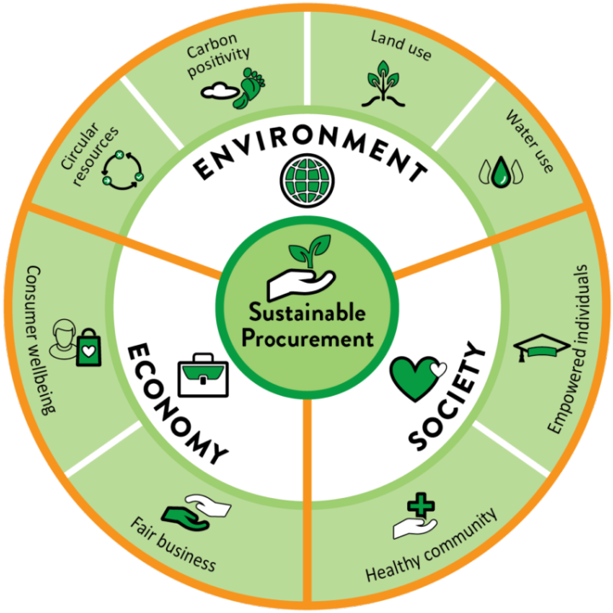
What is SPP – Sustainable Public Procurement?
Sustainable Public Procurement means making sure that the products and services purchased are good value for money on a life-cycle cost basis and generate benefits for the environment,
society and the economy.
Sustainable Public Procurement reflects broader objectives related to resource efficiency, climate change, social responsibility and economic resilience.
Bildquelle: Pexels
Notes:
Whilst GPP focuses on the environment, SPP is a more comprehensive concept. It involves ensuring that procurement, based on life-cycle costs, offers good value for money whilst also delivering benefits for the environment, society and the economy.

Slide 35
Sustainable Public Procurement Principles
Good public procurement is Sustainable Public Procurement
SPP implementation needs leadership
SPP implementation is based on sound organizational management principles
SPP contributes to broad policy goals
SPP engages all stakeholders
SPP monitors its outcomes and results
Notes:
A successful SPP requires strong leadership, a focus on overarching policy objectives and sound administration. It must involve all stakeholders (including suppliers and citizens) and, above all, monitor results to ensure that sustainability targets are actually met.

Slide 36
Sustainable vs. Green public procurement
🌿 Green Public Procurement (GPP): Focuses on minimizing environmental impacts through procurement choices (e.g., energy efficiency, low emissions, recyclability).
🔄 Sustainable Public Procurement (SPP): A broader concept that includes environmental, social and economic considerations.
➡️ GPP is a subset of SPP. All SPP is GPP, but not all GPP is SPP.
⚖️ SPP integrates criteria like fair labor practices, diversity, ethical sourcing, and lifecycle costing, alongside green criteria.
Notes:
To clarify: GPP is a subset of SPP. All ‘green’ procurement is sustainable, but sustainable procurement also encompasses social criteria such as fair working conditions, ethical procurement and accessibility for people with disabilities.

Slide 37




Strategic Role of SPP in Public Policy
Aligns public spending with national and local sustainability goals.
Supports SDG implementation (especially SDGs 8, 9, 10, 12, and 13).
Stimulates demand for sustainable products and services in the market.
Contributes to just transition, social cohesion, and climate targets.
Notes:
The EU promotes green public procurement (GPP) as this benefits European industry, which often has higher environmental and social standards than its global competitors. By setting high standards in public tenders, the EU helps steer the global market towards more sustainable production.

Slide 38
The Public Procurement Instrument and GPP
The inclusion of environmental and social criteria in public procurement in EU member states benefits European industry and the European economy, which still has a higher environmental and social performance than industries in competing countries.
The inclusion of environmental and social criteria in procurement displaces non-European competitors and steers production in a direction that has more future.

Slide 39
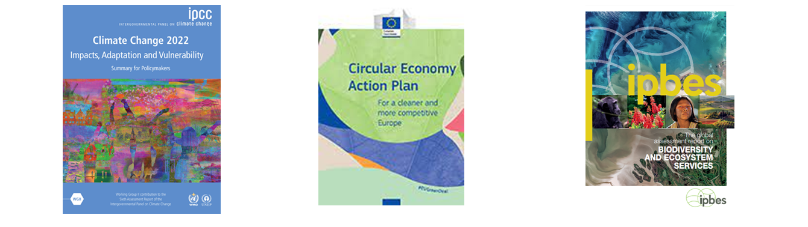
The Public Procurement Instrument and SPP
Decarbonisation
Circular Economy
Biodiversity

Slide 40
GPP in European Policies
For these reasons, the European Union's interest in GPP has been built up over time in six phases :
The initiation of GPP: (2001-2004);
The construction of the policy context for GPP: (2004-2008);
Facilitating the uptake of GPP: (since 2009)
Strengthening the policy context: (2010-2014);
Placing GPP in the context of the Circular Economy (2014 to date), the European Green Deal and the Recovery Plan;
GPP is at the heart of the DNSH principle included in the Environmental Taxonomy and the PNRR
Notes:
Interest in green public procurement (GPP) across Europe has evolved in six phases since 2001, transforming from a voluntary approach into a key component of the European Green Deal and the Circular Economy Action Plan.

Slide 41
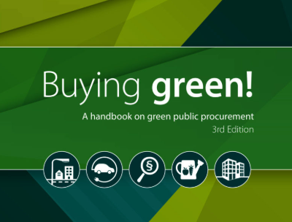
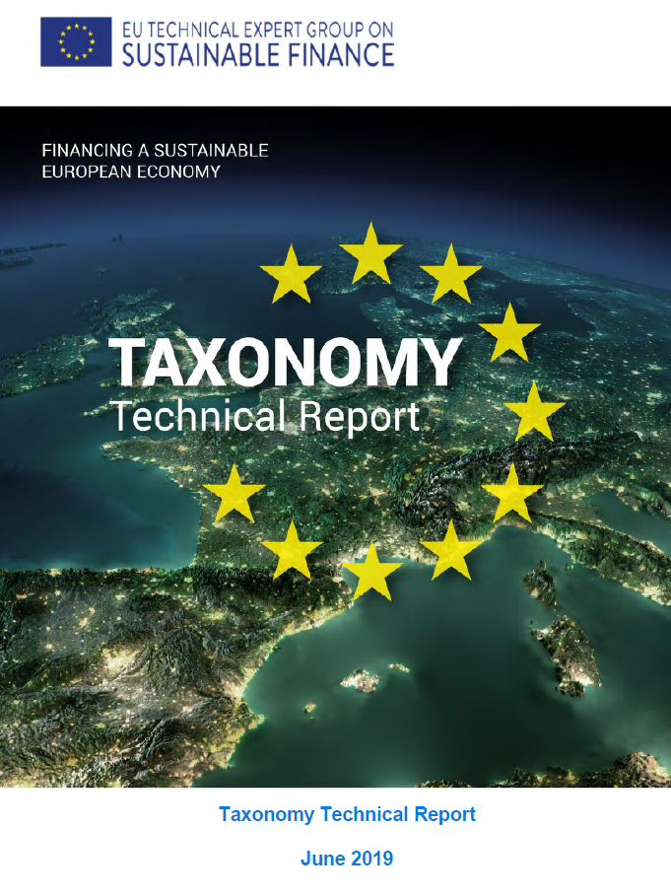
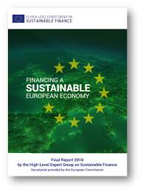
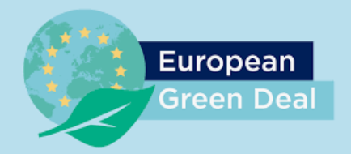
9 key documents
The Communications 274 of 2001 and 566 of 2001;
Integrated Product Policy and National Action Plans;
The Buying Green manual!
Communication 400 of 2008: Public Procurement for a Better Environment (and Communication 572 of 2017) The European Strategy 2020;
Circular Economy;
Social Procurement;
European Green Deal;
Green Deal and Sustainable Finance;
DNSH and PNRR

Slide 42
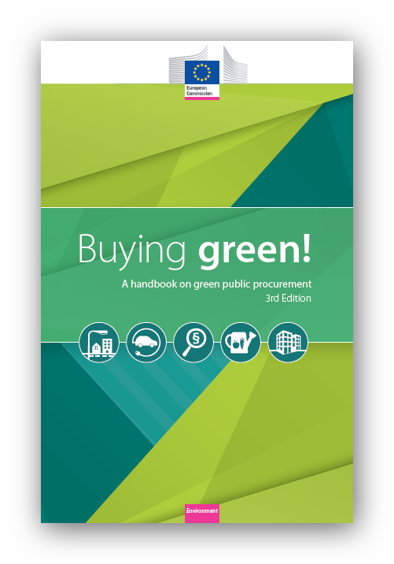
Buying green!
The manual Buying Green! has had three editions: 2004, 2011, 2016.
The manual illustrates the possibilities for application of GPP made available within the framework of the public procurement directives.
The manual helps public authorities to plan and implement GPP.
It provides a practical explanation of the possibilities made available by EU legislation, indicating a simple and effective approach, also illustrating good practice.
Notes:
The EU provides practical guides to assist public authorities. The ‘Buying Green!’ handbook explains how environmental criteria should be applied under EU law.

Slide 43
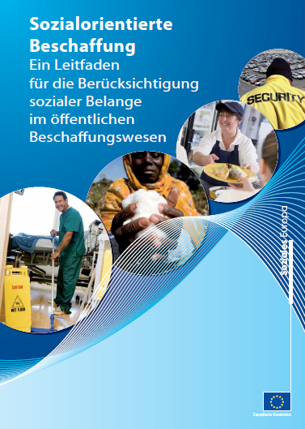
Social procurement
The second edition (2021) of the European Union's “Social Procurement” guide promotes 'Socially responsible public procurement (which) aims to achieve positive social impacts. The objectives are:
Promoting fair employment and social inclusion opportunities (job opportunities for young and older workers, gender equality, social participation and employment opportunities for people with disabilities)
Creating opportunities for the social economy and social enterprises
Promoting decent working conditions
Ensuring respect for social and workers' rights
Accessibility and appropriate design for all
Respect for human rights and ethical trade issues
‘Lightened regime’ for the provision of high quality social, health, educational and cultural services
Notes:
The ‘Buying Social’ guide (2021) focuses on achieving positive social impacts, such as gender equality and employment opportunities for disadvantaged workers.kungen, wie beispielsweise die Gleichstellung der Geschlechter und Beschäftigungsmöglichkeiten für benachteiligte Arbeitnehmer.

Slide 44
Euopean Green Deal
Three key points:
Adoption of minimum mandatory green criteria or targets for public procurement in legislation on sectoral initiatives, EU funding or specific products
Adoption of a common definition of green procurement
Extension of life-cycle costing methodologies
The Communication to the Commission 'Investment Plan for a Sustainable Europe. Investment Plan for the European Green Deal‘ (21/2020) states that ’The Commission will propose minimum mandatory green criteria or targets for public procurement in legislation on sectoral initiatives, EU funding or specific products. These minimum criteria will effectively establish a common definition of green procurement. (...) At the same time, public purchasers should apply life-cycle cost methodologies wherever possible."
Notes:
The Green Deal aims to make binding minimum criteria for environmental performance an integral part of EU legislation and funding. This effectively establishes a uniform definition of green procurement across all Member States.

Slide 45
European Tools for the dissemination of GPP

Slide 46
European Tools for the dissemination of GPP
National Action Plan for GPP
EU GPP Criteria
GPP Goal
Monitoring indicators
Circular Economy
23 out of 27 countries
20 EU GPP Criteria
50%
Green/total purchases
CE indicator n.2
European Toolkit
Notes:
The EU supports green public procurement (GPP) through various instruments: national action plans (in 23 of the 27 Member States), 20 specific EU GPP criteria, and the overall target of making 50% of all procurement environmentally friendly.

Slide 47
EU GPP criteria
The Commission Communication on Public Procurement for a Better Environment (No. 400 of 2008) establishes Common European Criteria (GPP Criteria) which:
Are defined on the basis of: Life cycle analysis (background documents) and Multi-stakeholder sharing
Provide a definition and scope of application
Identify the main environmental impacts (environmental aspects and GPP approach)
Define GPP Criteria: basic and general
Describe verification systems
Calculate life-cycle costs
Notes:
The EU criteria are not arbitrary; they are based on life cycle assessment (LCA). They define the product’s scope of application, identify the most significant environmental impacts and provide for verification systems to enable public authorities to demonstrate that they are procuring sustainably.

Slide 48
EU GPP Criteria: 20 groups of products and services
Cleaning products and services
Copying and graphic paper
Paints, varnishes and road signs
Electrical and electronic equipment
Electricity
Food, catering and vending machines
Interior furnishings
Notes:
The EU has set criteria for 20 specific categories, ranging from cleaning products and electricity to food, transport and data centres.

Slide 49
EU GPP Criteria: 20 groups of products and services
Data centres
Imaging equipment, consumables and printing services
Road design, construction and maintenance
Sanitary fittings
Street lighting and traffic signs
Textiles
Sanitary vessels and urinals
Notes:
The EU has set criteria for 20 specific categories, ranging from cleaning products and electricity to food, transport and data centres.

Slide 50
EU GPP Criteria: 20 groups of products and services
Transport
Road transport (NEW)
Waste water infrastructure
Water heating
Public space maintenance
Computers, monitors, tablets, smartphones (NEW)
Data centres, server rooms and cloud services
Notes:
The EU has set criteria for 20 specific categories, ranging from cleaning products and electricity to food, transport and data centres.

Slide 51
Advantages of Sustainable Public Procurement

Slide 52
Advantages of SPP
Reduction of Emission, Pollution and Waste
Strengthens the circular economy
Reduces greenhouse gas emissions
Biodiversity and Resource Prevention
Social inclusion, Fair Labor and Local Economic Development

Slide 53
Thank you very much!

Slide 54
Sources
https://www.are.admin.ch/are/en/home/media/publications/sustainable-development/brundtland-report.html
https://www.clubofrome.org/publication/the-limits-to-growth/#:~:text=Published%201972%20%E2%80%93%20The%20message%20of,long%2C%20even%20with%20advanced%20technology.
https://www.un.org/en/conferences/environment/stockholm1972
https://unric.org/it/che-cosa-sono-i-cambiamenti-climatici/
https://asvis.it/goal-e-target-obiettivi-e-traguardi-per-il-2030/
https://sdgs.un.org/2030agenda
https://sdgs.un.org/goals
https://gpp.mase.gov.it/Home/PianoAzioneNazionaleGPP?utm_source=chatgpt.com
https://gpp.mase.gov.it/Struttura-dei-CAM
https://thedocs.worldbank.org/en/doc/e77a9257967cac8b62484c7e8c974e70-0290012024/original/WB-SUSTAINABLE-PROCUREMENT-16574-CH1.pdf
https://procuraplus.org/fileadmin/user_upload/ManualProcura_online_version_new_logo.pdf
https://www.oneplanetnetwork.org/sites/default/files/10yfp_spp_programme_principles_of_sustainable_public_procurement.pdf

