Slide 1

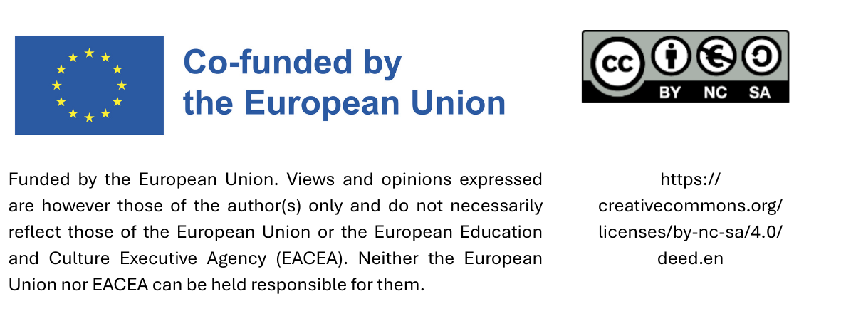
For good reasons:
Prejudices and arguments for sustainable procurement

Slide 2
Sustainable procurement does not reduce the environmental impact of production and consumption.
By considering ecological criteria, procurement helps protect the climate and environment by reducing emissions, conserving resources, and increasing product longevity.

Slide 3
Focusing on regional products boosts local value, keeps profits within the community, strengthens businesses, and enhances municipal tax revenues, while supporting climate protection and long-term economic growth.
Sustainable procurement causes higher costs.
Sustainable products and services can lead to long-term cost savings by improving efficiency and reducing follow-up costs, as their higher quality makes them more cost-effective over their lifecycle.

Slide 4
Sustainable procurement has no positive internal effects.
Sustainable procurement not only benefits the environment and economy but also enhances the health and well-being of municipal employees by reducing harmful emissions and improving the work environment.
Communities that embrace sustainable procurement show responsible governance, boosting their reputation. As citizens grow more environmentally and socially conscious, supporting sustainable practices fosters trust and pride in local leadership, leading to stronger community engagement and better relationships with stakeholders.

Slide 5
Sustainable procurement has no positive external effects.
Due to the enormous market power of the public sector, public procurement can have a major impact on the market and contribute to the well-being of the community by aligning procurement decisions with fair labour standards.
Municipalities can contribute to global sustainability goals through mindful procurement, supporting broader environmental and social objectives like the UN SDGs. This can inspire others, creating a ripple effect of positive change.

Slide 6
Sustainable procurement is purely voluntary.
Sustainable procurement is partially compulsory. Many governments are adopting sustainability regulations in procurement. By acting now, municipalities can stay ahead of trends, avoid future compliance issues, and position themselves as sustainability leaders.

Slide 7
Thank you!

