Slide 1

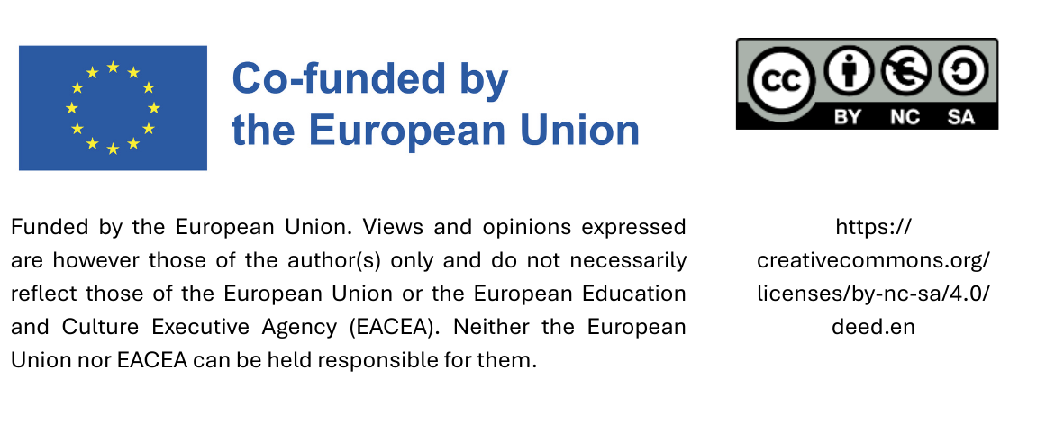
What not to procure -
negative list

Slide 2
Note
The following slides contain products and materials that should NOT be procured, as they do not meet the environmental and social standards for sustainable products and services.

Slide 3

Tropical wood
Tropical wood, where native wood species or other materials are suitable for the purpose in question.

Slide 4
Timber from non sustainable sources
Timber and timber products that cannot be proven to originate from legal and sustainable forest management. Proof can be provided by certification with the PEFC or the FSC label, an equivalent label or individual verifications.

Slide 5
Imported agricultural products infringing human rights
Imported agricultural products from countries of the Global South (see DAC list), such as coffee, tea, cocoa, rice, sugar, orange juice, roses, that are not produced in compliance with ILO core labour standards and not certified with the Fairtrade label or an equivalent label.
DAC List see: https://www.oecd.org/en/topics/sub-issues/oda-eligibility-and-conditions/dac-list-of-oda-recipients.html

Slide 6
Genetically modified food
Avoiding genetically modified food supports biodiversity, protects traditional seed systems, and responds to consumer demand for transparent, natural food production.

Slide 7
Drinks in disposable packages
Mineral water, soft drinks and alcoholic beverages in disposable packaging with the exception of sparkling wine and wine in glass bottles. This does not apply to events where the provision of drinks in reusable packaging poses a security risk.

Slide 8
Disposable packaging
Disposable crockery and cutlery in canteens, cafeterias and events. Exceptions may be made to avoid safety risks.

Slide 9
Harmful cleaning products
Chlorine-releasing cleaners (hypochlorite and dichloroisocyanurate) as well as cistern additives and air fresheners.

Slide 10
Hygiene products with microplastic
Detergents, cleaning agents and cosmetics containing microplastics.

Slide 11
Textiles and leather infringing human rights
Carpets, leather, clothing (workwear) from countries of the Global South (see DAC list), that have not been produced in compliance with ILO core labour standards.
DAC List see: https://www.oecd.org/en/topics/sub-issues/oda-eligibility-and-conditions/dac-list-of-oda-recipients.html

Slide 12
Natural rubber products infringing human rights
Natural rubber products (work gloves, dust control mats) from countries of the Global South (see DAC list) that have not been produced in compliance with ILO core labour standards.
DAC List see: https://www.oecd.org/en/topics/sub-issues/oda-eligibility-and-conditions/dac-list-of-oda-recipients.html

Slide 13
Inefficient electrical appliances
Electrical appliances subject to energy labelling (A–G) that do not fall into one of the higher efficiency classes within their product group.

Slide 14
Toys and sporting goods infringing human rights
Toys and sporting goods from countries of the Global South that (see DAC list) that have not been produced in compliance with ILO core labour standards.
DAC List see: https://www.oecd.org/en/topics/sub-issues/oda-eligibility-and-conditions/dac-list-of-oda-recipients.html

Slide 15
Natural stones infringing human rights
Natural stones and paving stones from countries of the global South (see DAC list) that were not produced in compliance with ILO core labour standards.
DAC List see: https://www.oecd.org/en/topics/sub-issues/oda-eligibility-and-conditions/dac-list-of-oda-recipients.html

Slide 16
PVC
Products made from PVC (also known as polyvinyl chloride or simply vinyl) should be avoided whenever possible. When PVC is incinerated - whether in waste facilities or by uncontrolled burning - it can release highly toxic dioxins. Dioxins are among the most dangerous environmental pollutants and pose serious risks to human health.

Slide 17
Pesticides
Pesticides (herbicides, fungicides, insecticides) for public green and recreational areas.

Slide 18
Exceptions
Exceptions to this negative list can be made in single cases that should be justified.

Slide 19
Contact
If you intend to use this negative list - or an adapted version of it - in your municipality, please include your local contact for sustainable procurement.

