Slide 1


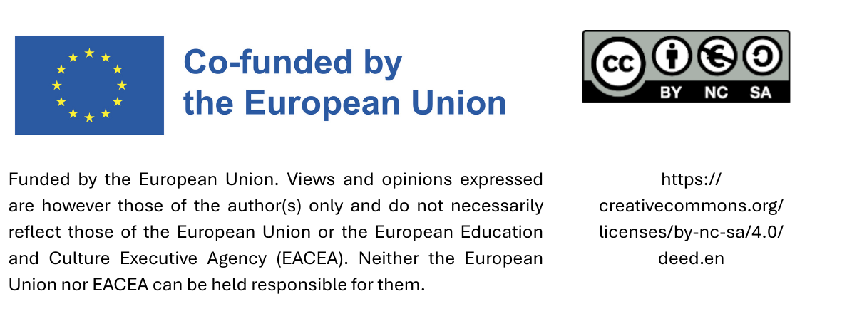
Sustainable Procurement:
Key Benefits and insights into implementation

Slide 2
Key benefits

Slide 3
Key benefits
Ecological benefits
Health benefits
Social benefits
Economic benefits

Slide 4
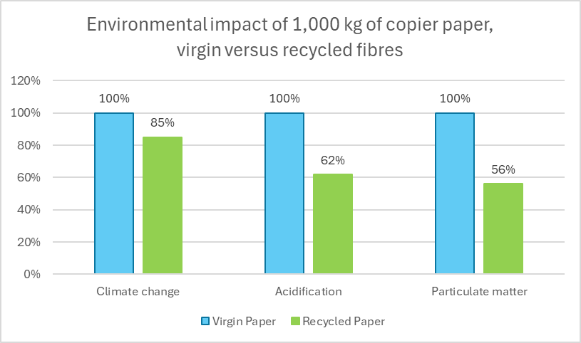
Example for ecological benefits
Source: German Environment Agency 2022 „Aktualisierte Ökobilanz von Grafik- und Hygienepapier“, p. 46

Slide 5


Example: Health benefits
  Limitation of health-hazardous substances
The procurement of sustainable furniture ensures low emissions of VOCs – substances that can cause irritation or long-term health effects (see hazard symbols
on the left)
Labeled substances may cause cancer, genetic damage, or respiratory sensitization
Labeled substances may cause irritation, allergies, or health harm if inhaled or swallowed

Slide 6
Example: Social benefits
  Working conditions comply with the core principles of the ILO (freedom of association, no child or forced labor, etc.)
  Fair Trade: Additionally ensures fair wages
  Employment of disadvantaged groups in the labor market (e.g., older adults, people with disabilities, young people/apprentices)

Slide 7
Example: Economic benefits
  Value creation is generated locally or within the region
  Procurement costs are reduced by purchasing durable products
  Operating costs are lowered by sourcing energy-efficient goods

Slide 8
Implementation of sustainable procurement

Slide 9
Topics
1. Four procurement approaches
2. Product labels as essential tools
3. Development of a procurement catalogue
4. Purchasing products locally and regionally
5. Risk management and stumbling stones

Slide 10
Four procurement approaches

Slide 11

Four procurement approaches
1. Purchasing below the national tendering threshold
2. Conducting a tender
3. Procuring via a central purchasing body
4. Procuring jointly with other municipalities

Slide 12

1. Purchasing below the national tendering threshold
If the value of a procurement is below the threshold for tenders, a direct purchase or a simplified procedure can be used.
In direct purchases and simplified procedures, there are numerous opportunities to procure sustainable products or services.

Slide 13

2. Conducting a tender
Options for including sustainability criteria in the tendering process:
Technical specifications
Award criteria
Contact clauses
Selection criteria

Slide 14
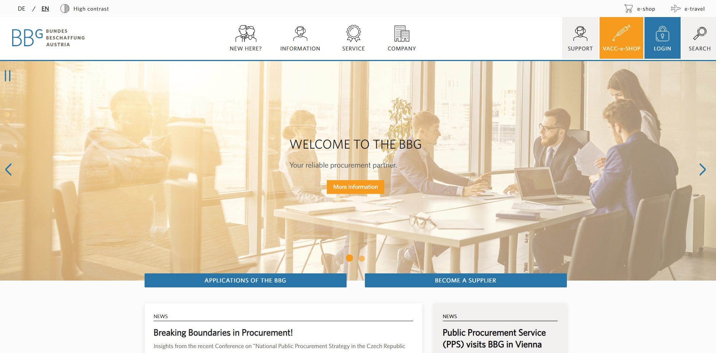
3. Procuring via a central purchasing body
Central procurement agencies generally offer products and services through framework agreements.
Check whether sustainable options are available.
In some cases, sustainable offers are especially highlighted.

Slide 15
4. Procuring jointly with other municipalities
.
Advantages:
Sustainability criteria can be more easily enforced, as suppliers are more willing to meet requirements when contracts are financially attractive.
Prices are more favorable when products or services are procured in larger quantities.
Procurement processes can be made more efficient, and administrative costs can be reduced.

Slide 16
Product labels as essential tools

Slide 17






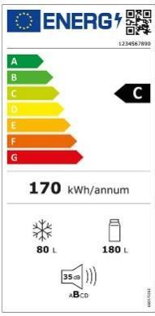




Product labels as essential tools
Product labels from large-scale certification initiatives
Legally required product labels
Product labels from certification initiatives with a limited product range

Slide 18
Development of a procurement catalogue

Slide 19

Creating a procurement catalogue
Step 1: Creating a catalogue
Step 2: Identifying and evaluating suppliers
Step 3: Using the catalogue
Step 4: Reviewing and updating regularly

Slide 20
Content of the procurement catalogue
List of regularly procured products and services
Sustainability criteria for products and services
Information on the municipality’s procurement process
Details of suppliers providing sustainable products and services

Slide 21

Identifying and evaluating suppliers
Consultation with potential suppliers to determine if sustainable products can be delivered
Requesting proof of compliance with sustainability criteria and verification of this proof by the municipality
Comparison of prices and entry into the procurement catalog

Slide 22
Reviewing and updating regularly
An e-shop enables procurement officers in the municipality to order pre-selected products and services directly from various suppliers – for example, cleaning supplies from a local provider or fire trucks through the central purchasing body.
As markets continue to evolve,
the catalog must be updated regularly.
One way to keep the catalog up to date is to develop it into an e-shop

Slide 23
Purchasing products locally and regionally

Slide 24
Purchasing products locally and regionally
By taking these suggestions into account, municipalities can promote the local and regional economy while ensuring that procurement is legally compliant.
Applying Life Cycle Costing on transport emissions
Dividing contracts into smaller lots
Requiring shorter response times
Defining quality criteria that local suppliers are more likely to meet

Slide 25
Risk management and stumbling stones

Slide 26
Managing risks in sustainable procurement
In sustainable procurement, it is important to identify and consider potential risks early on.
Possible risks:
Product does not meet expectations
Sustainable solutions are more expensive to purchase
Limited availability of sustainable products and services

Slide 27
Risk: Product does not fulfill requirements
Examples:
Clothes wear out faster
Coffee doesn’t taste good
The range of the electric car decreases rapidly during use

Slide 28
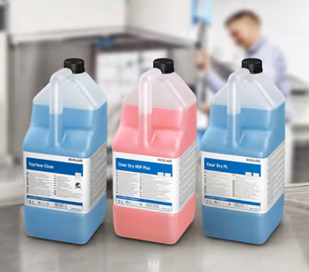
Risk mitigation
Gather as much information as possible about the product before purchase (e.g., reviews)
Test the product under real conditions with the actual users (e.g., cleaning staff testing cleaning agents)
Initially order only small quantities
Notes:
Source picture: Ecolab https://de-at.ecolab.com/offerings/liquid-dishmachine-products/professional-dishwasher-liquid-rinse-aids

Slide 29
Stumbling stone:
Budgetary constraints
Possible solutions:
Ensure transparency in prices and costs
Consider ways to reduce the quantities purchased
Achieve better prices through central procurement agencies
Leverage price advantages through joint procurement

Slide 30
Stumbling stone:
Limited market availability
Possible solutions:
Collaboration with other municipalities
Cooperation with suppliers
Step-by-step implementation

Slide 31
Thank you!

