Slide 1


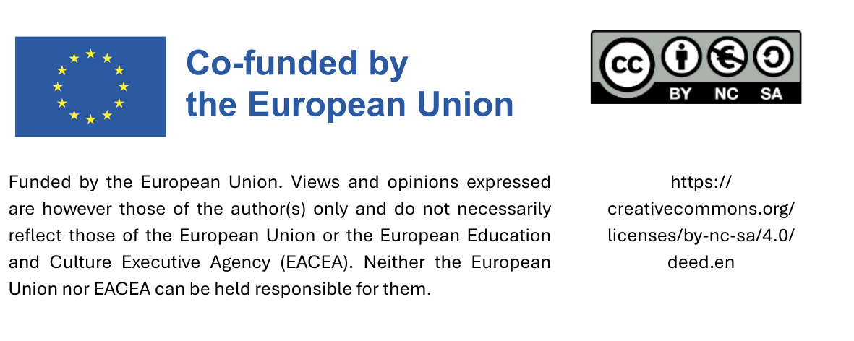
Sustainable procurement curriculum
Module 3: Use of labels in the procurement procedure
Date

Slide 2
Content
What kind of labels exist?
How can I use labels in the tendering process?
How do I find out how reliable labels are?

Slide 3
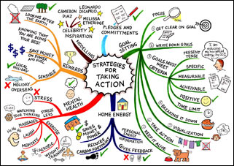
Agenda
Labels, certifications, management systems - light in the labelling jungle
Use of labels in the context of tenders
Exercise
Presentation of selected labels

Slide 4















So many labels…

Slide 5
1. Labels, certifications, management systems - light in the labelling jungle

Slide 6
What types of labels are there?
Legally required labels
Eco-labels Type I
Social labels
Private labels
Regional brands
Company certifications / management systems

Slide 7
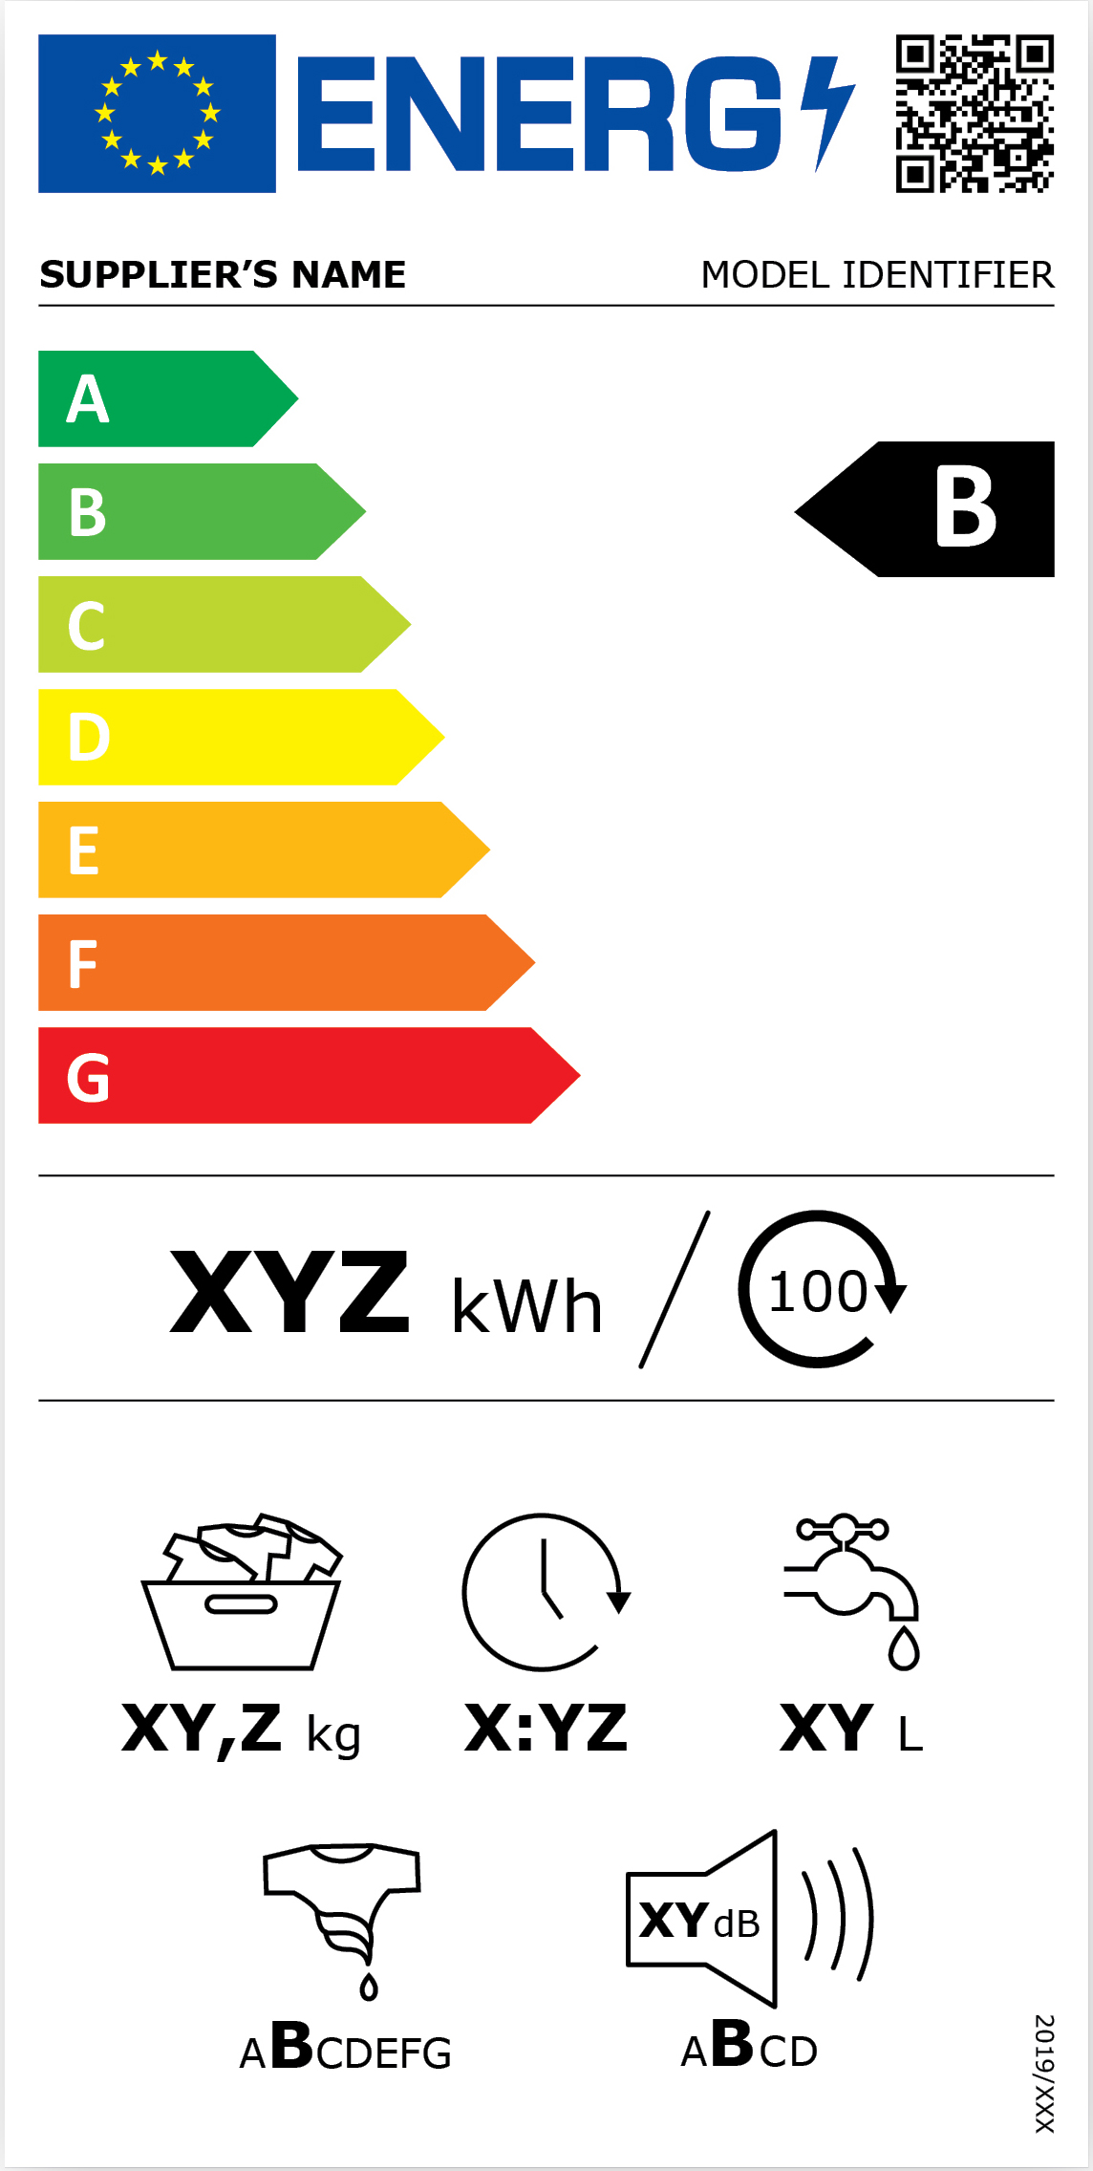
Legally required labels
EU energy label and EU energy consumption labelling for various products
  Household appliances, lamps, water heaters…
Appliances are classified according to their energy consumption values
New labelling since 2021 - energy classes A-G initially for
  Refrigerators and freezers incl. wine storage cabinets
  Dishwashers Washing machines incl. washer-dryers
  Electronic displays incl. televisions
  Lamps and lights
Notes:
EU energy label, a legally required label that helps consumers and procurement professionals make energy-efficient choices.
The EU energy label is mandatory for a wide range of household and electronic appliances.
These appliances are classified based on their energy consumption, making it easy to compare efficiency at a glance.
Since 2021, a new labelling system has been introduced:
Energy classes now range from A to G, replacing the older A+++ to D scale.
The scale is designed to leave room for innovation, so A is reserved for the most efficient appliances — even if very few currently qualify.

Slide 8

Legally required labels
EU organic logo for agricultural products
Must appear on all packaged food products produced within the EU that are marketed as organic

Slide 9


Voluntary ecolabels or type I ecolabels
Certification of products by independent third parties
Statements about certain environmental properties
  Compliance with limit values for pollutants
  Compliance with defined energy consumption values
  Reduction of emissions during production
  Recyclability of a product
Basis for awarding the contract
  Development with the involvement of relevant stakeholder groups
  Publicly accessible catalogue of requirements/criteria
Notes:
These labels are based on certification by independent third parties. This means the product's environmental performance is verified by an impartial organisation, lending trust and credibility to the label.
They provide statements about certain environmental properties of the product, which go beyond just marketing claims. These include:
Compliance with limit values for pollutants, ensuring that the product doesn’t exceed harmful emission thresholds.
Compliance with defined energy consumption values, promoting energy-efficient products.
The reduction of emissions during production, which encourages cleaner manufacturing processes.
And the recyclability of the product, supporting a circular economy approach.
Importantly, the basis for awarding the eco-label involves a transparent and inclusive process:
Criteria are developed with the involvement of relevant stakeholder groups, such as industry experts, NGOs, and consumer organisations. This ensures the criteria are balanced, practical, and reflect societal priorities.
Also, there's a publicly accessible catalogue of requirements, so everyone can see what’s behind the label and how it’s awarded. This transparency builds public trust and helps consumers make informed choices.
Overall, Type I eco-labels offer a comprehensive, science-based assessment of a product's environmental impact across its life cycle, and they promote genuine sustainability improvements in the marketplace.

Slide 10

Voluntary social label type I similar
Independent certification by third parties and development of criteria in a transparent process
Criteria often aligned with ILO core labour standards
  No forced labour
  Trade union freedom
  No discrimination based on race, gender or skin colour
  Equal pay for equal work
  Prohibition of exploitative child labour
Fair Trade (additionally to ILO)
  Minimum price and fair remuneration (living wages)
  Long-term supply contracts
  Pre-financing
  Fairtrade premium to support social projects in the community or paying school fees etc.
Notes:
Voluntary Social Labels focus on the social and labor conditions in supply chains. These labels are designed to promote ethical production standards and protect workers' rights.
Like eco-labels, independent certification by third parties plays a key role. These third parties assess whether companies comply with established criteria. Criteria are developed transparently, often involving consultations with stakeholders to ensure legitimacy and accountability.
Criteria of social labels are often aligned with the ILO’s core labour standards—the International Labour Organisation’s fundamental principles, which include:
The prohibition of forced labour
Freedom of association, including the right to form and join trade unions
Non-discrimination based on race, gender, or skin color
Equal pay for equal work
And the prohibition of exploitative child labour
In addition to these core labor standards, Fair Trade certifications—go even further:
They guarantee a minimum price and fair remuneration, often referred to as living wages
They promote long-term supply contracts, providing economic stability for producers
Pre-financing options are often included to support farmers or producers ahead of harvest
And finally, a Fairtrade premium is provided, which is used for social projects like education, healthcare, or community development

Slide 11
Social and environmental label type I and type I similar
Some labels combine ecological and social criteria
Often one aspect in the foreground, the second is also considered

Slide 12
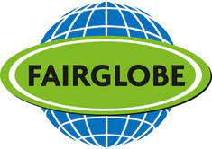
Self declarations type II
Product lines of a trading company that have a certain quality
Used exclusively within the company or a group of companies
Not independently certified​
Have additional benefits - for example organic or fair trade products
Notes:
Self-Declarations, also known as Type II Labels. These are different from third-party certifications.
These labels typically refer to product lines of a trading company that claim to meet a certain quality standard. However, these claims are made by the company itself, not verified externally.
They are used exclusively within the company or a group of affiliated companies, meaning the standards and messaging are controlled internally rather than through independent oversight.
A major distinction is that these claims are not independently certified. There’s no external body verifying the environmental or social claims made about the product, which can raise concerns about credibility and consistency.
Many of these products still offer additional benefits, such as being organic or fair trade, but the label itself doesn’t guarantee third-party verification of those benefits.

Slide 13


Regional labels or designations of origin
Products from the region - definition of the region varies
Can be:
State labels of the regional authorities
Private associations - regional brands
Notes:
These labels highlight the geographical origin of a product, often associating it with specific qualities, traditions, or reputation from that region.
They indicate that the product comes from a particular region, though it's important to note that the definition of a 'region' can vary. It might be a city, a province, or a broader area, depending on the label's criteria.
These labels can take two main forms:
State labels: Issued by regional authorities as part of official programs to promote local goods.
Or they can come from private associations, often in the form of regional brands created by producer cooperatives or marketing groups.
These labels are especially common in the food and agricultural sectors—think of things like wines, cheeses, or specialty produce—but they can also apply to crafts or other regionally unique products.
Regional labels help promote local identity, support local economies, and build consumer trust in the origin and quality of products.

Slide 14


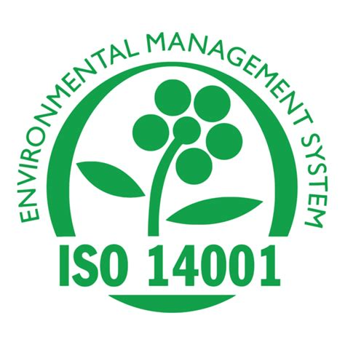
Company certifications / management systems
Company or production site-related certifications - Process management
Examples
  EMAS (Eco-Management and Audit Scheme - Community eco-management and audit scheme)
  SA8000 standard (ILO core labour standards)
  Fair Wear Foundation (labour conditions in the textile sector - textile supply chain)
Notes:
Company or production site-related certifications are part of broader process management systems rather than product-specific labels.
These certifications evaluate how a company or a production site manages its processes—whether environmental, social, or ethical. The emphasis is on improving internal systems, practices, and accountability rather than certifying a specific product.
Examples:
EMAS: The Eco-Management and Audit Scheme is a voluntary EU initiative designed to improve companies' environmental performance. It supports organizations in evaluating, reporting, and improving their environmental impact through regular audits and transparent communication.
SA8000: This is a globally recognized standard for decent working conditions, developed by Social Accountability International. It is based on ILO core labour standards and covers issues such as child labor, forced labor, health and safety, and fair remuneration.
Fair Wear Foundation: Focused specifically on the textile sector, this initiative aims to improve labour conditions in garment supply chains. It works with brands, factories, and other stakeholders to implement fair labor practices throughout the production process

Slide 15
Questions?

Slide 16
Agenda
Labels, quality marks, certifications - light in the labelling jungle
Use of labels in the context of tenders
Exchange with practice partners
Presentation of selected labels
Practical assistance

Slide 17
2. Use of labels in the context of tenders

Slide 18

How can labels be used in procurement?
Requirements for labels
Use of the criteria for the technical specifications
Help with verifying compliance

Slide 19
Requirements for labels – EU-Directive
They only concern criteria which are linked to the subject matter of the contract;
They are based on objectively verifiable and non-discriminatory criteria;
They are established using an open and transparent procedure in which all relevant stakeholders, incl. government bodies, consumers, social partners, manufacturers, distributors and non-governmental organisations, may participate;
They are accessible to all interested parties;
They are set by a third party over which the economic operator applying for the label cannot exercise a decisive influence
Article 43 of Directive 2014/24/EU on public procurement
Notes:
This slide outlines the conditions under which labels can be used in public procurement to demonstrate compliance with specific requirements — such as environmental, social, or ethical standards.
Point 1: "They only concern criteria which are linked to the subject matter of the contract"
Any label requirements must directly relate to what is being purchased. For example, if the contract is for office furniture, the label must reflect attributes relevant to furniture — not the company’s unrelated activities.
Point 2: "They are based on objectively verifiable and non-discriminatory criteria"
Criteria must be measurable and fair. This ensures all potential suppliers have equal opportunity to meet the requirements, without bias.
Point 3: "They are established using an open and transparent procedure..."
Importance of stakeholder involvement. Labels should be created through a transparent process that includes input from various groups — such as government, NGOs, industry, and consumers — to ensure legitimacy and broad acceptance.
Point 4: "They are accessible to all interested parties"
Labels must not be exclusive. All potential suppliers must be able to access the label information and the process for obtaining it.
Point 5: "They are set by a third party..."
The economic operator (i.e., the supplier) must not have control over the organisation issuing the label. This guarantees independence and credibility of the label.

Slide 20
Admissibility of labels for verification
Manufacturer/trademark
certifies itself
Certified by an independent body
No
Yes
Notes:
This illustrates point 5 of the former slide – a self certification does not fulfill the requirements of Article 43 of Directive 2014/24/EU on public procurement and can thus not be used in the procurement procedure as means of verifying compliance

Slide 21
Further provisions
In the event that the product/service does not have to fulfil all the requirements of the label, the contracting authority must specify the relevant requirements.
The contracting authority must accept other labels that impose equivalent requirements on the service.
Other suitable evidence must only be accepted if a company has demonstrably been unable to obtain a quality label for reasons that cannot be attributed to it.
Notes:
A general reference to a label is only possible when the product or service has to fulfil all criteria of the label. If only certain criteria have to be fulfilled, then these requirements must be specified in the tender documents.
Other equivalent labels must be accepted - If a supplier has a different label that meets the same standards, the buyer has to accept it.
Other evidence can also be accepted — but only in special cases: If a supplier couldn’t get the label for reasons beyond their control, they must be allowed to prove they meet the requirements in another way. This might be the case if the label wasn’t available in their country or the supplier is new on the market and the process took too long despite their efforts

Slide 22
Reliability of the labels
Type 1 labels are based on a multi-criteria approach agreed with interested parties (so-called stakeholders) and are awarded by independent certification and testing bodies.
  Examples of the Blue Angel and EU Ecolabel
In contrast to labels awarded by public bodies, it is not possible to make a blanket statement about the suitability/reliability of private labels (NGOs or associations)
Quick check on reliability
  Are the criteria well-founded, transparent and developed in a participatory manner?
  Are the award criteria publicly accessible?
  Is there an external independent audit?
  How transparent is the certification body/initiative towards consumers? Are test reports published and are problems/violations communicated?
Directory of labels including description "Ecolabel Index": https://www.ecolabelindex.com/
Notes:
Type 1 labels are considered the most trustworthy. They are based on a multi-criteria approach, meaning they evaluate products or services across a range of environmental and/or social aspects, rather than just one factor. The criteria are developed in consultation with a broad group of stakeholders, including government bodies, consumer representatives, industry experts and civil society organisations. They are also awarded by independent certification and testing bodies to help ensure impartiality and credibility.
Examples: The EU Ecolabel and the Blue Angel are well-established Type 1 labels recognised across the EU.2.
Unlike Type 1 labels, private labels issued by NGOs, industry groups or associations can vary widely in terms of quality and credibility. As these labels are not always based on standardised, transparent procedures, it is not possible to make a general statement about their reliability. Each label must be assessed on a case-by-case basis using clear, objective criteria.
Quick check on label reliability
These guiding questions can be used to quickly assess the reliability of any label:
Are the criteria well-founded and developed transparently and inclusively? This ensures that the label reflects broad societal interests and not just the view of one organisation.
Are the award criteria publicly accessible? If the criteria are not open and available, transparency is lacking and the label's legitimacy is questionable.
Is there an independent external audit? Third-party verification is a key indicator of trustworthiness.
How transparent is the certification process towards consumers? Are test results published and are violations or issues made public? A credible label should communicate openly, including when things go wrong.

Slide 23
Possibilities for the use of labels
Criteria from labels can be used to describe the requirements for the tender.
Bidding companies may be required to provide a certification with a label as proof that the required standards are met.

Slide 24
Use of criteria for the requirements
Mention of the criteria in the tender documents
  General reference: Product must fulfil the criteria of the Fairtrade label or
  Individual criterion: Exclusion of exploitative child labour according to ILO 182 (from Fairtrade label)
Notes:
The criteria of the labels can be used to formulate the requirements and specifications of a contract.
A general reference to a label and its criteria can be made in the case the product or service has to fulfil all criteria. In this case it can be specified that „the product must fulfil the criteria of the Fairtrade label”, and a reference or a link to a website where these criteria can be found must be provided.
If the product has to fulfil only specific criteria from a label, these must be mentioned.

Slide 25
Use of labels for verifying compliance
Certification with label as proof of compliance with criteria
Equivalent evidence must be accepted
  Equivalent label
  Compliance with the criteria by other means (technical data sheets)
Proof of equivalence by the bidder
  Tendering authority can determine when proof is equivalent
Notes:
The tendering authority may request certification bearing a specific label to prove compliance with the tender criteria. Example: Products certified with the Blue Angel.
Equivalent labels must be accepted. If a supplier has a different label that meets the same standards, the buyer must accept it.
Other evidence may only be accepted in special cases. If a supplier could not obtain the label due to circumstances beyond their control, they should be permitted to demonstrate that they meet the requirements in another way. This may be because the label was unavailable in their country, or because the supplier is new to the market and the process took too long despite their efforts.
Bidders must provide evidence that the label they present is equivalent to the label requested by the tendering authority. The tendering authority may specify when another label is equivalent, for example when it fulfils a specific criterion.

Slide 26
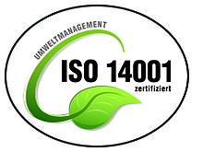
Environmental management as selection criterion
Requirements for the technical and professional capacity of the bidders
Link to the subject matter of the contract and appropriate in view of the scope and nature of the contract
Connection can be assumed if the subject matter of the contract requires compliance with certain environmental standards or requires certain environmental behavior
Contracts in the areas of transportation services (e.g. local public transport), cleaning services, waste management, construction services, the maintenance or renovation of buildings or the procurement of chemicals
Notes:
An Environmental Management System (EMS) can be required as part of the technical and professional capacity of bidders — in line with public procurement rules.
EMS as part of technical and professional capacity
Public buyers can require bidders to demonstrate that they have the necessary technical and professional ability to carry out a contract. One way to do this — especially for contracts with environmental relevance — is to ask for an Environmental Management System (such as ISO 14001 or EMAS).
This is a selection criterion — part of the eligibility check.
Key legal requirement: Link to the subject matter
It is essential that this requirement is linked to the subject matter of the contract and is proportionate — meaning it must make sense given the scope and nature of the contract.
You cannot just ask for EMS from all bidders in all situations — it must be relevant and justifiable.
When is this link justified?
You can assume a valid connection if the contract involves compliance with environmental standards or requires specific environmental behavior from the contractor during execution.
For example, if the contractor needs to manage emissions, reduce waste, handle hazardous substances, or use eco-friendly procedures — having an EMS is directly relevant.
Examples of appropriate contract types
This requirement is especially suitable for contracts in areas such as:
Transportation services (e.g., local public transport where emission reduction is a goal)
Cleaning services (due to use of chemicals and waste handling)
Waste management
Construction services
Building maintenance or renovation
Procurement of chemicals
In these cases, an EMS can demonstrate that the bidder has systems in place to meet environmental obligations effectively and consistently.

Slide 27
Questions?

Slide 28
Agenda
Labels, certifications, management systems - light in the labelling jungle
Use of labels in the context of tenders
Exercise
Presentation of selected labels

Slide 29
3. Exercise
Label Detective

Slide 30
Label Detective: Investigating Sustainability Claims on Products
Evaluate sustainability labels on different products using online research and a provided checklist.
Assess the credibility, transparency, and relevance of each label and present findings.
Research questions:
  Who issues the label? (e.g., government, NGO, private company)
  What criteria are used? (social, environmental, economic standards)
  How is compliance verified? (independent audits, self-reporting, etc.)
  Is it transparent and trustworthy?
  Does it align with sustainable procurement goals?

Slide 31
Agenda
Labels, certifications, management systems - light in the labelling jungle
Use of labels in the context of tenders
Exercise
Presentation of selected labels

Slide 32
4. Presentation of selected labels

Slide 33
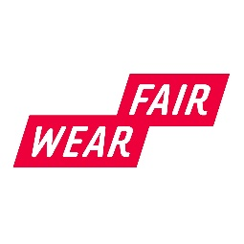
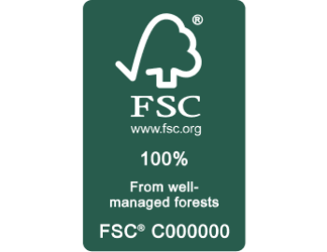





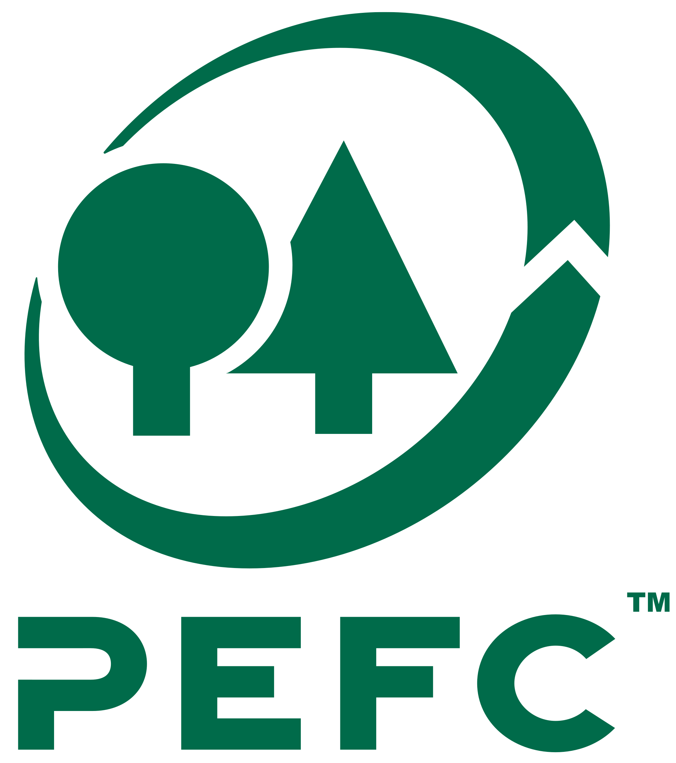





(Cross-) Product Labels

Slide 34

Cross-product labels –
EU Ecolabel
Currently 87,485 products EU-wide from over 20 product groups, from electrical appliances to textiles, paints and varnishes to camping sites
Managed by: European Commission, European Union Ecolabelling Board (EUEB) – at the national level by a competent body (CP) chosen by the Member State
Criteria development and revision: Product group-dependent award criteria, developed by the EU Commission in coordination with the EUEB in consultation with independent experts and NGOs; regular revision
Testing and control mechanisms: national competent body random inspections; withdrawal of the ecolabel in the event of non-compliance
Notes:
The European Commission sets EU Ecolabel criteria for different categories of products to minimise their environmental impacts over their entire lifecycle, while guaranteeing their high quality. Because each product category is different, the criteria are tailored to address their unique characteristics.
All criteria are developed in consultation with key stakeholders, including consumer associations and experts in the relevant field. They are periodically revised by the EU Ecolabelling Board (EUEB), which takes into account technical innovations or market changes to ensure they are up to date, robust, and trustworthy.
In accordance with the provisions of Article 4 of the Regulation (EC) No 66/2010 on the EU Ecolabel, each Member State of the EEA designates the body or bodies (competent body/ competent bodies, often abbreviated to CBs), within government ministries or outside, responsible for carrying out the tasks provided within the EU Ecolabel Regulation and ensure that they are operational. Competent bodies are responsible for ensuring that the verification process is carried out in a consistent, neutral and reliable manner by a party independent from the operator being verified, based on international, European or national standards and procedures concerning bodies operating product-certification schemes.
Each EU Ecolabel license holder has signed a contract that sets out the terms of use of the label (see ANNEX IV of the Regulation (EC) No 66/2010 for the standard contract covering the terms of use of the EU Ecolabel). Once the contract is in place, the competent body may at any time request the necessary documentation from the licence holder to monitor compliance of the product with the criteria and the conditions of use laid down in the contract. The competent body may also visit the premises of the license holder to ensure that the requirements are met.
More information can be found here: https://environment.ec.europa.eu/topics/circular-economy/eu-ecolabel/faq_en

Slide 35
Cross-product labels - Blue Angel
Currently a total of approx. 20,000 products and services from 1600 companies awarded
Product and service categories: “Everyday life & living”, “Paper and printing”, “Electrical appliances”, “Building and heating”, “Trade and municipality”, “Vehicles and mobility”
Managed by: Federal Ministry for the Environment, Nature Conservation and Nuclear Safety (BMU), Federal Environment Agency (UBA), Environmental Label Jury, RAL gGmbH (Germany)
Criteria development and revision: Product group-dependent award criteria, developed by the Federal Environment Agency based on a comprehensive consultation process, ongoing revision
Testing and control mechanisms: Testing by RAL for misuse in the event of indications; warning in the event of misuse, withdrawal in the event of violation of award criteria
Notes:
The Blue Angel (Blauer Engel) is Germany’s official eco-label, awarded to products and services that are environmentally friendly. It signals that a product meets high standards for environmental, health, and performance criteria, helping consumers choose sustainable options. Established in 1978, it's one of the world’s oldest and most trusted ecolabels.
The Blue Angel covers over 100 product groups, including the categories: “Everyday life & living”, “Paper and printing”, “Electrical appliances”, “Building and heating”, “Trade and municipality”, “Vehicles and mobility”
Criteria Setting
Criteria are developed by the German Environment Agency (UBA).
They are based on a life-cycle assessment (from production to disposal).
Factors include climate impact, resource use, toxicity, durability, and recyclability.
Draft criteria undergo stakeholder consultations (including industry, NGOs, and science).
Criteria are reviewed and updated every 3–4 years to reflect technological progress.
Monitoring & Certification
Independent certification is handled by RAL gGmbH (a neutral organization).
Manufacturers apply voluntarily and must submit detailed documentation and test results.
Products are regularly reviewed, and misuse of the label is prosecuted.
The label can be withdrawn if criteria are no longer met.

Slide 36
Cross-product labels –
Fairtrade
Currently more than 6,000 products: food, textiles, balls, flowers, cosmetics, gold
Managed by: Fairtrade international
Criteria development and revision: Development and regular revision by Fairtrade International in a transparent process in which all stakeholders are involved;
Testing and control mechanisms: Regular audits of contractual partners by auditors according to standardised procedures
Notes:
Fairtrade International, or Fairtrade Labelling Organizations International E.V.^{[1]} is a nonprofit product-oriented multistakeholder group aimed at promoting the lives of farmers and workers through fair trade. Fairtrade's work is guided by a global strategy^{[2]} focused on ensuring that all farmers earn a living income, and agricultural workers earn a living wage. Fairtrade works with farmers and workers of more than 300 commodities. The main products promoted under the Fairtrade label are coffee, cocoa, banana, flowers, tea, and sugar.
Fairtrade is an association of three Producer Networks, nineteen National Fairtrade Organisations (formerly: Fairtrade Labelling Organisations) and eight Fairtrade Marketing Organisations that promote and market the Fairtrade Certification Mark in their countries ^{[3]}
Producer Networks exist in Latin America, The Caribbeans, Africa, Middle East, Asia and the Pacific. National Fairtrade Organisations exist in 16 European countries as well as in Canada, the United States, Japan, Australia and New Zealand
For a product to carry the Fairtrade Mark, it must come from FLOCERT inspected and certified producer organizations. The crops must be grown and harvested in accordance with the International Fairtrade Standards set by Fairtrade International. The supply chain is also monitored by FLOCERT to ensure the integrity of labelled products. Only authorized licensees can use the Fairtrade Mark on their products. Flocert GmbH (stylized FLOCERT) is an auditor for Fairtrade headquartered in Bonn, Germany.
Source: Wikipedia https://en.wikipedia.org/wiki/FLOCERT

Slide 37



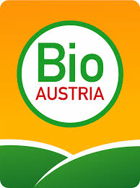
Labels in the food sector

Slide 38
Organic food
Bio or organic - legally defined designation
Production according to Regulation (EU) 2018/848 of the European Parliament and of the Council of 30 May 2018 on organic production and labelling of organic products
EU organic label mandatory for packaged goods
The following criteria must be met at least 95 percent:
  No use of chemical pesticides and fertilizers
  Maximum permitted number of animals per hectare
  species-appropriate forms of husbandry
  organic feed and a ban on antibiotics for non-medical purposes
  ban on genetic engineering only 53 additives are permitted in processed foods (instead of 316 in conventional products)
annual inspection by accredited bodies
Notes:
“Bio” or “Organic” – Legally Protected Terms
The terms “bio” and “organic” are legally defined designations within the EU.
Only products that meet specific standards set out in EU legislation are allowed to carry these terms.
Legal Basis – Regulation (EU) 2018/848
All organic food production and labelling must comply with Regulation (EU) 2018/848, adopted by the European Parliament and Council.
This regulation harmonises rules across all Member States and ensures that products labeled as “organic” meet the same high standards throughout the EU.
Mandatory EU Organic Label
The EU organic logo (the green leaf made of stars) is mandatory for all pre-packaged organic food produced within the EU and marketed as such.
Key Organic Criteria – At Least 95% Compliance
To qualify for the label, at least 95% of the ingredients must be certified organic. The core criteria include:
- No chemical pesticides or fertilizers – only natural substances are allowed.
- Animal welfare standards – including a limit on animal density per hectare and species-appropriate husbandry.
- Organic feed and a ban on antibiotics for anything other than necessary medical treatment.
- No genetic engineering – GMOs are strictly banned.
- Limited use of additives – only 53 approved additives are permitted in processed organic foods, compared to over 300 in conventional food.
These rules aim to promote environmental protection, animal welfare, and consumer trust.
Regular Inspections by Accredited Bodies
All certified organic operators are subject to annual inspections carried out by accredited control bodies or authorities.
This ensures ongoing compliance with organic rules and helps prevent misuse of the organic label.

Slide 39
Not all organic certifications are the same
EU requirements are minimum standards
Traditional labels of the associations mostly have higher standards, e.g.:
Complete conversion of the farm to organic farming
Larger area requirements for animal husbandry (e.g. pigs, chickens)
Notes:
While the EU organic certification ensures a baseline level of compliance, not all organic labels are created equal. Some go significantly beyond the EU minimum requirements.
There are private organic associations, such as Demeter, Bioland, or Naturland, which apply stricter criteria on top of the EU rules.
These labels often reflect a more holistic and ambitious approach to organic farming and are sometimes based on philosophical or ethical principles — such as biodynamic agriculture.
Examples of Higher Standards
- Complete farm conversion:
While EU rules allow parallel production (meaning only part of the farm may be organic), many traditional labels require full conversion of the entire farm. This eliminates the risk of contamination and ensures a consistent production philosophy.
- More space for animals:
Association standards often include stricter requirements for animal welfare, such as larger living areas for pigs and chickens compared to the EU minimums.
This results in better living conditions and healthier animals.

Slide 40

Fairtrade
Unlike organic, not a protected designation
Fairtrade label/Max Havelaar
  Minimum prices, long-term trade relations, fair wages, exclusion of child labor, fair trade premium
Naturland Fair: combination of organic and fair, fair trade also in the North
  Reliable trade relations
  Fair producer prices
  Regional sourcing of raw materials
Fair for life: minimum and development criteria, more flexible standards, producers also from Europe
  Disadvantaged small producers and workers
Notes:
Not a Protected Term
Unlike “organic,” the term “fair trade” is not legally protected. That means its use is not strictly regulated by law, so the quality and credibility of “fair” claims can vary significantly across products and certifiers.
That’s why it’s important to look at the specific label or certification scheme behind the claim.
Fairtrade/Max Havelaar Label
One of the most well-known and widely used certifications is the Fairtrade label, also known under the Max Havelaar foundation in some countries.
It is based on several core principles:
Minimum prices to protect producers from market fluctuations.
Long-term trade relationships, offering stability and planning security.
Fair wages for workers.
Exclusion of child labor, ensuring ethical production practices.
A Fair Trade Premium paid on top of the selling price, which is invested in community projects like schools or clean water.
This label is mostly used for products from the Global South, such as coffee, cocoa, and bananas

Slide 41
Food - Reference label
Organic food
  EU organic label
  High product availability
  State label
Fair trade food
  Fairtrade label
  High standard and high profile
  High product availability, even for bulk consumers

Slide 42
IT equipment - labels
 | Blue Angel workplace computers and keyboards https://www.blauer-engel.de/en Energy consumption, durability (repair options for at least 5 years, possibility of upgrading), recycling-friendly design (dismantling possible, suitable choice of materials so that materials can be recovered), avoidance of environmentally harmful materials
 | TCO certified https://tcocertified.com/
 | Nordic Ecolabel - laptops & co. http://www.nordic-ecolabel.org Low energy consumption, durable, recyclable materials and the avoidance of hazardous/harmful materials
 | EPEAT http://www.epeat.net Low power consumption, durability, social criteria, 3-stage bronze, silver, gold

Slide 43
IT equipment reference label - TCO certified
IT quality mark pioneer in terms of social criteria
Responsibility and transparency along the entire supply chain
Origin and degradation conditions of conflict raw materials and compliance with social standards in the final assembly of devices
Ecology: durability, upgradability and recyclable design

Slide 44
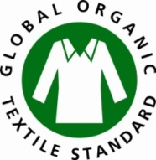
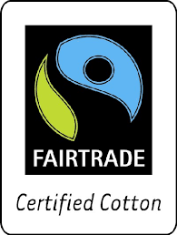



Product labels textiles
 | Global Organic Textile Standard 90% natural fibers, 70% organically grown; ILO core labor standards http://www.global-standard.org
 | Fairtrade Textile Production Raw material production and manufacturing: fair working conditions and environmentally friendly production www.fairtrade-deutschland.de/index.php
 | Natural textile IVN certified BEST 100% natural fibers, environmental and social requirements for the production and processing of natural fibers www.naturtextil.de/profil/qualitaetszeichen.html
 | bluesign Focus on the use of chemicals in the production of synthetic fibers and the further processing of synthetic and natural fibers https://www.bluesign.com

Slide 45
Textiles reference label - Fair Wear Foundation
Independent multi-stakeholder initiative
Goal: Promotion of decent working conditions along the textile value chain
Member companies undertake to enforce the FWF Code of Conduct in their own companies and with suppliers
FWF Code of Conduct is based on ILO core labor standards, other ILO standards and the Clean Clothes Campaign Code of Conduct
Implementation of the Code of Conduct is a joint process of the FWF and the companies
Compliance is monitored through regular, independent audits

Slide 46
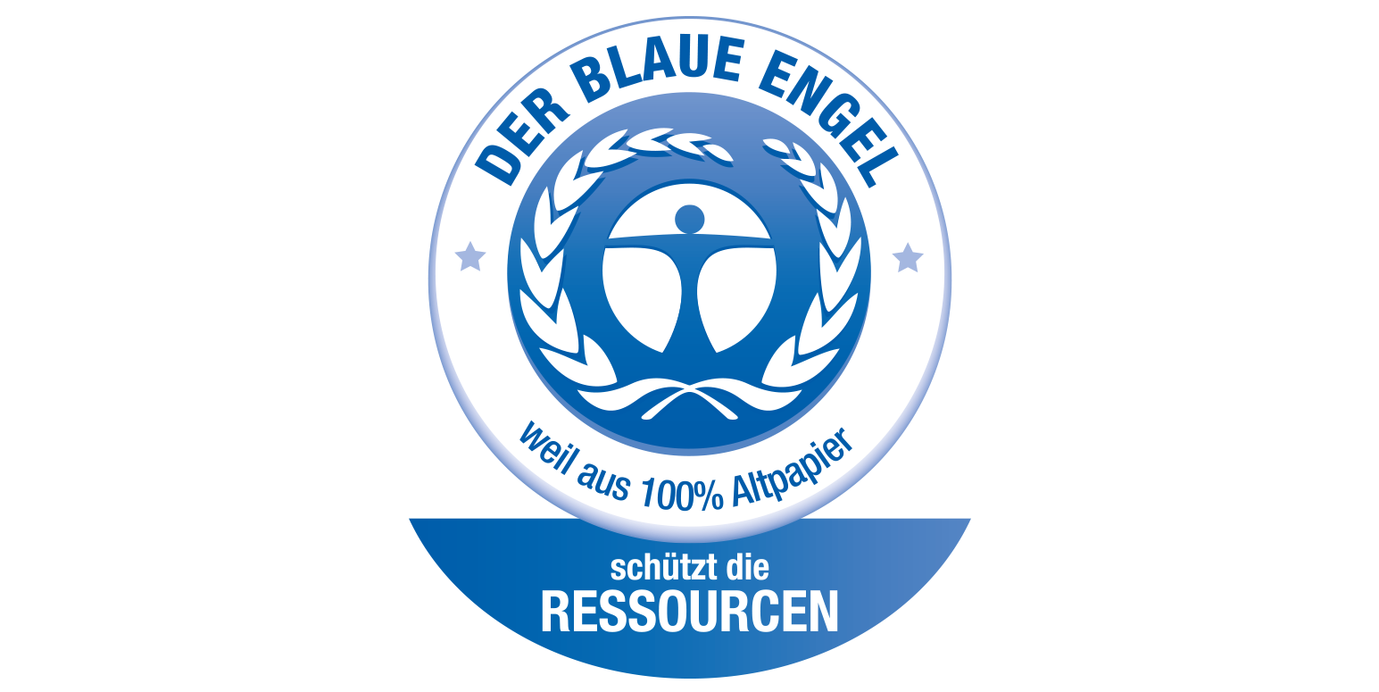



Paper labels
 | The Blue Angel 100% recycled paper, 65% from low quality, no use of chlorine, optical brighteners, halogenated bleaching agents and other chemicals https://www.blauer-engel.de/en
 | EU Ecolabel Less water and air pollution than with conventional production https://environment.ec.europa.eu/topics/circular-economy/eu-ecolabel_en
 | Forest Stewardship Council FSC Mix 70% from certified forests or waste paper, Recycled 100% waste paper http://www.fsc.org
 | Nordic Ecolabel / Nordic Swan 50% of the fibers from certified origin http://www.nordic-ecolabel.org
 | Programme for the Endorsement of Forest Certification Scheme PEFC PEFC certified (70% from certified forests), PEFC recycled 70% recycled material, PEFC regional https://pefc.org/

Slide 47
Paper reference label – Blue Angel
The Blue Angel (RAL-UZ 14 / recycled paper) requires that the paper fibers consist of 100% wastepaper, 65% of which must be low-quality wastepaper. This guarantees that paper is recycled several times, which means optimum utilisation of the raw material wood.
No use of chlorine, optical brighteners, halogenated bleaching agents and other chemicals.
The quality of the end products must meet the highest requirements, such as optimum functionality and the best printing results. The lifespan of the recycled papers of several hundred years and thus assures archival longevity.
Recommended: offers a guarantee for the highest possible use of wastepaper and the strictest criteria for the use of chemicals.

Slide 48
Thank you very much!

