Slide 1


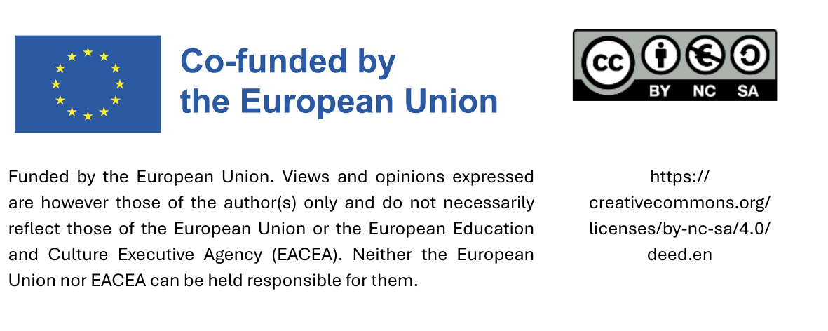
Sustainable procurement curriculum
Module 5: Implementation of sustainable procurement
Date

Slide 2
Agenda
How to implement sustainable procurement: Important steps
Group exercise
Risk management
Monitoring

Slide 3
1. How to implement sustainable procurement:
Important steps

Slide 4
1. How to implement sustainable procurement: Important steps
1.1 How to get started
1.2 Four approaches for procurement
1.3 Product labels as essential tools
1.4 Exploring the market and creating a catalogue
1.5 Purchasing products locally and regionally
1.6 How to communicate
Notes:
Grafisch darstellen

Slide 5
1.1 How to get started
Building a team and exploring support options
Conducting an inventory
Setting goals and defining scope

Slide 6
1.1 Building a team and exploring support options
Nominating a coordinator
Forming a small working group
Incorporating additional expertise if necessary
Using available tools and information

Slide 7
1.1 Conducting an inventory
Identifying colleagues involved in procurement
Collecting data by consulting with colleagues
Processing information and creating an overview

Slide 8
1.1 Setting goals and defining scope
Developing
SMART goals
Selecting products and services
Selecting sustainability criteria
Including sustainability criteria in procurement process
Notes:
Step 1: Develop goals that align with the community's overall priorities (goals should be SMART (Specific, Measurable, Achievable, Relevant, and Time-bound)

Slide 9
1. How to implement sustainable procurement: Important steps
1.1 How to get started
1.2 Four approaches for procurement
1.3 Product labels as essential tools
1.4 Exploring the market and creating a catalogue
1.5 Purchasing products locally and regionally
1.6 How to communicate
Notes:
Grafisch darstellen

Slide 10

1.2 Four approaches for procurement
1. Purchasing below the national tendering threshold: Direct purchase
2. Conducting a tender
3. Procuring via a central purchasing body
4. Procuring jointly with other municipalities

Slide 11

1.2 Purchasing below the national tendering threshold
If the value of a procurement is below the national threshold, a direct purchase or a simplified procedure may be used.

Slide 12

1.2 Conducting a tender
If the value of a procurement exceeds the national threshold, a tender must be issued.
Four ways to incorporate sustainability criteria into the tender:
Technical specifications
Award criteria
Contract terms
Suitability criteria

Slide 13
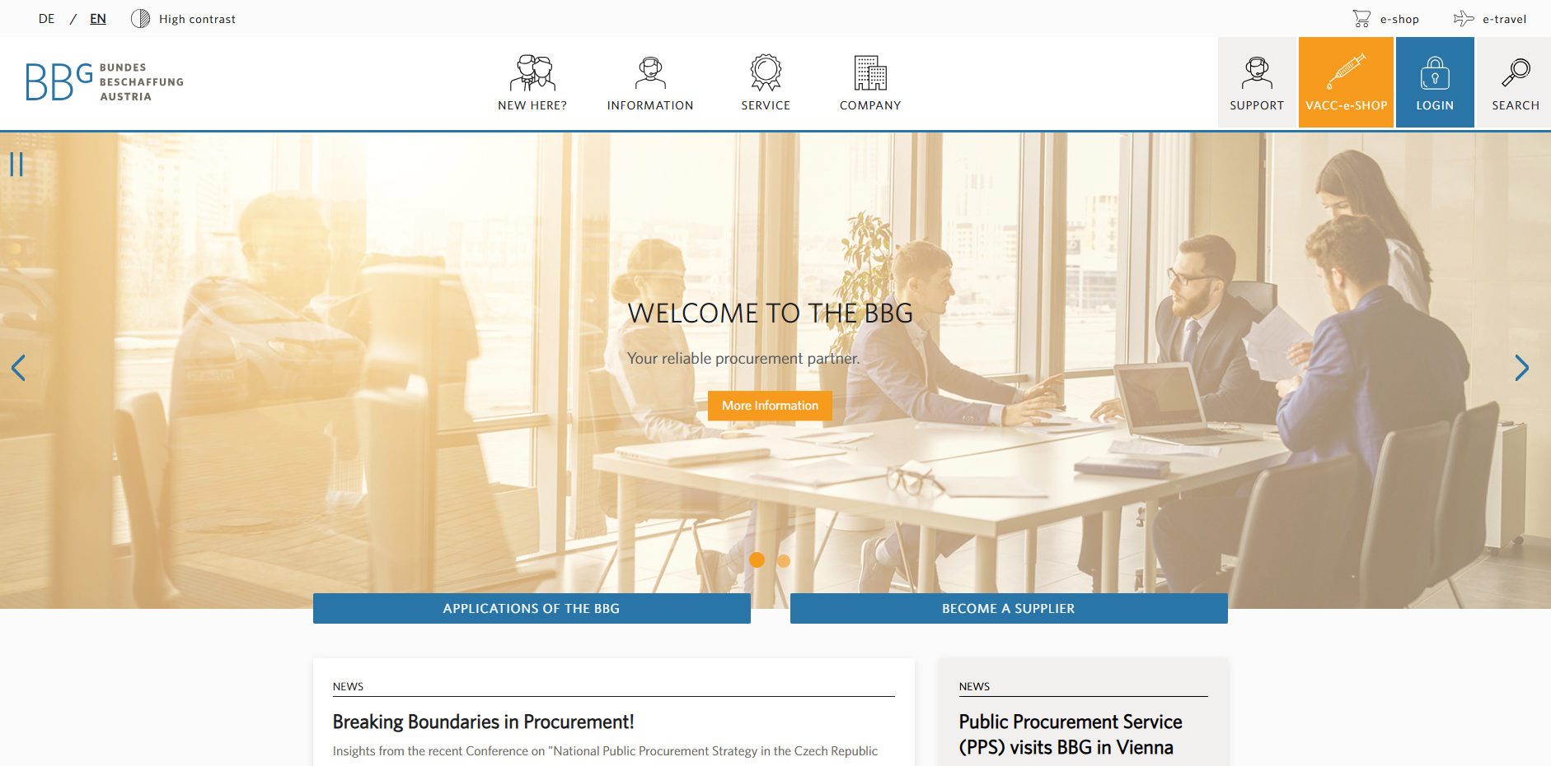
1.2 Procuring via a central purchasing body
Notes:
e.g. the BBG (Bundesbeschaffung) in Austria

Slide 14
1.2 Procuring jointly with other municipalities
For some municipalities (especially smaller ones), joint procurement with other municipalities makes sense.
Through joint procurement, municipalities can:
negotiate better prices by purchasing sustainable products or services in larger quantities
enforce sustainability criteria more effectively, as suppliers are more willing to meet requirements (e.g., proportion of recycled material) if the contracts are financially attractive
increase efficiency by streamlining procurement processes and reducing administrative costs

Slide 15
1. How to implement sustainable procurement: Important steps
1.1 How to get started
1.2 Four approaches for procurement
1.3 Product labels as essential tools
1.4 Exploring the market and creating a catalogue
1.5 Purchasing products locally and regionally
1.6 How to communicate
Notes:
Grafisch darstellen

Slide 16




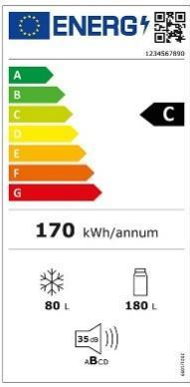







1.3 Product labels as essential tools
Labels from certification initiatives for products and services
Legally required labels
Labels awarded for individual or specific end products

Slide 17

1.3 Practice example Product labels as essential tools
Fair sports balls in schools, Munich
The city of Munich procures exclusively fair trade sports balls for schools, where available. Every two years, sports professionals and students test these balls for their suitability for use in lessons. Framework agreements are concluded based on the results. The range of fair trade sports balls has expanded in recent years.
Notes:
Source Text: https://www.eineweltnetzwerkbayern.de/fileadmin/assets/Kommunen_Eine_Welt/2024_6_A/2024_-_Kommunen_Eine_Welt_-_6_A_-_EWNB.pdf S. 36
Source Picture: https://www.fairtrade.net/de-de/produkte/fairtrade_produkte/sportbaelle.html

Slide 18
1. How to implement sustainable procurement: Important steps
1.1 How to get started
1.2 Four approaches for procurement
1.3 Product labels as essential tools
1.4 Exploring the market and creating a catalogue
1.5 Purchasing products locally and regionally
1.6 How to communicate
Notes:
Grafisch darstellen

Slide 19
1.4 Exploring the market and creating a catalogue
Creating the structure of the catalogue
Identifying and evaluating suppliers
Using the catalogue
Reviewing and updating regularly

Slide 20
1.4 Creating a catalogue
The catalog should contain the following information:
A list of products and services that are regularly procured by the municipality
Sustainability criteria for the products and services that the municipality wants to procure sustainably, e.g., eco-labels
Information on how these products and services are usually procured by the municipality, e.g., through direct purchasing, simplified procedures, tenders, central procurement agencies, or joint procurement with other municipalities
Details of suppliers of sustainable products and services (names, addresses, websites of shops and e-shops), including findings from supplier evaluations
If possible: price and cost differences between conventional and sustainable solutions

Slide 21
1.4 The structure of a catalogue
The main categories in the catalog are product and service groups, which are supplemented by:
Detailed descriptions
Sustainability criteria
Ways to prove compliance with the criteria
Procurement processes
Supplier information
Current procurement costs

Slide 22
1.4 Identifying and evaluating suppliers
Survey of potential suppliers
Obtaining evidence of sustainability criteria
Verification of this evidence
Comparison of prices and entry in the procurement catalog

Slide 23
1.4 Reviewing and updating regularly
Catalogue as an e-shop
An e-shop enables municipal employees to order pre-selected products and services directly from various suppliers - e.g., cleaning supplies from a local supplier or fire trucks from the central procurement office.
As markets continue to evolve, the catalogue must be updated regularly.
Another way to keep the catalogue up to date is to develop it into an e-shop.

Slide 24
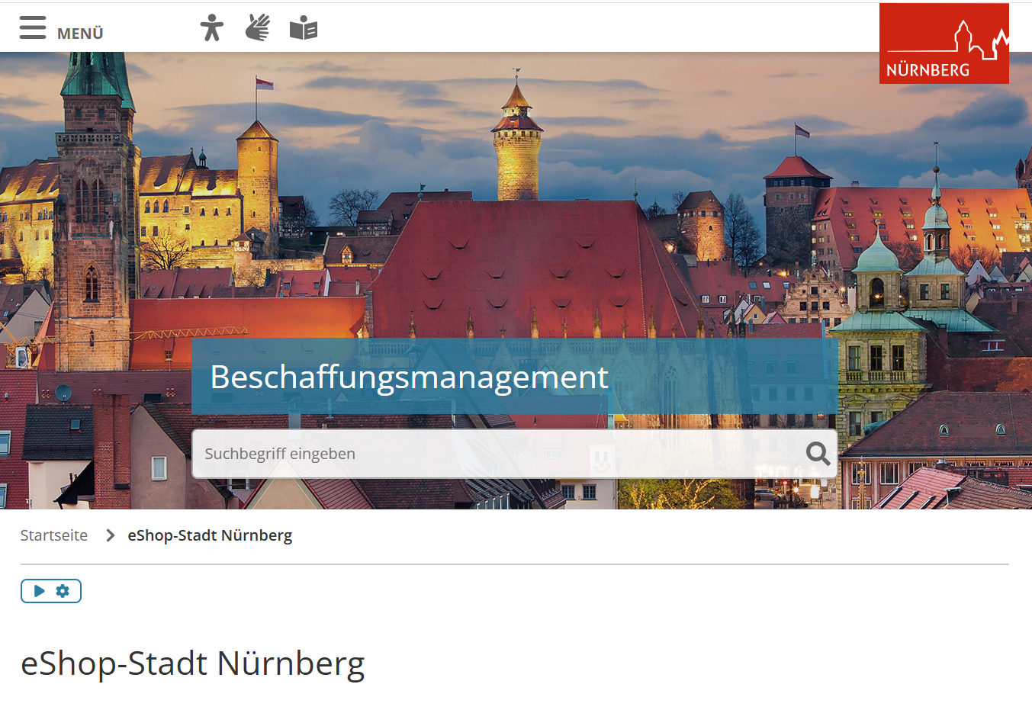
1.4 Practice example
Catalogue
Catalogue as E-Shop, Nuremberg
Since March 2023, the city of Nuremberg has been using a new electronic purchasing system. The catalogue shop system supports decentralised procurement by departments and municipal enterprises. Product catalogues in the system are based on tendered framework agreements or negotiated discount agreements. The central procurement office selects the suppliers and carries out the award procedures.
Notes:
The platform can be used to:
Order products directly from framework agreement catalogs
Place direct orders up to €5,000 net outside of framework agreements
Report individual requirements (“free text orders”) to the central procurement office
Source Text: https://www.kompass-nachhaltigkeit.de/kommunaler-kompass/bayern/rahmenbedingungen-nutzen#c42191036
Source Picture: https://www.nuernberg.de/internet/beschaffung/ekv_shop.html#_0_3

Slide 25
1. How to implement sustainable procurement: Important steps
1.1 How to get started
1.2 Four approaches for procurement
1.3 Product labels as essential tools
1.4 Exploring the market and creating a catalogue
1.5 Purchasing products locally and regionally
1.6 How to communicate
Notes:
Grafisch darstellen

Slide 26
1.5 Purchasing products locally and regionally
By implementing these strategies, municipalities can promote the local and regional economy while ensuring that procurement remains competitive and compliant with the law.
Requirements that give regional and local providers an advantage in tenders:
Low transport emissions
Division of larger orders into smaller batches
Setting short delivery or response times
Setting quality criteria that local suppliers are highly likely to meet

Slide 27
1. How to implement sustainable procurement: Important steps
1.1 How to get started
1.2 Four approaches for procurement
1.3 Product labels as essential tools
1.4 Exploring the market and creating a catalogue
1.5 Purchasing products locally and regionally
1.6 How to communicate
Notes:
Grafisch darstellen

Slide 28
1.6 How to communicate
Change in organisations is a social process, and communication about it is a key factor for success.
This includes:
Engaging municipal employees
Engaging stakeholders

Slide 29

1.6 Engaging municipal employees
Training and workshops for procuring staff
Principles and criteria display
Internal newsletters and emails
Internal good practices
International environment days for activities
User workshops (already during evaluation of the test product)

Slide 30

1.6 Practice example Engaging municipal employees
Ecological cleaning in Payerbach, Austria
The cleaning staff of the municipality of Payerbach (Lower Austria) completed a training course on ecological cleaning provided by “die umweltberatung.” The course covered ingredients, dosages, and occupational and skin protection. As a result, the municipality switched its cleaning methods and products to environmentally friendly alternatives.
The training led to greater awareness and motivation within the team, a more responsible approach to environmental issues, and a significant reduction in the use of chemicals. At the same time, the costs for cleaning agents were reduced and ecological standards were improved.
Notes:
Source Text: https://gemeindebund.at/images/uploads/downloads/2017/Projekte/Ressourceneffiziente_Gemeinde/Projekt_Ressourceneffiziente_Gemeinde_Massnahmenkatalog.pdf S. 41-42
Source Picture: https://www.umweltberatung.at/img/1400/4409.jpg

Slide 31
1.6 Engaging stakeholders
Local businesses
Supplier workshop/dialogue
Easy-to-understand guidelines for suppliers
Public information campaigns
Other local authorities and networks

Slide 32
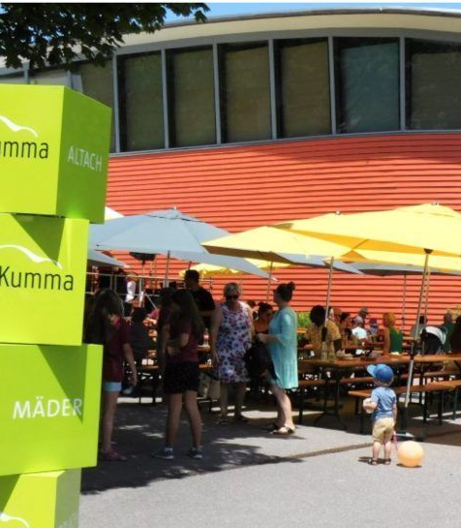
1.6 Practice example Engaging stakeholders
Sun Festival – Municipality of Mäder, Austria
For 15 years, the municipality of Mäder has been hosting the Sonnenfest (Sun Festival) and inviting over 1,000 co-owners of the photovoltaic system on the roof of the ÖKO secondary school to attend. The festival promotes environmental education and is hosted by a different Mäder association each year, with organic and regional products.
The journey there is climate-friendly, either on foot, by bike, or by public transport. Thanks to free bike cleaning and free public transport, car parking spaces are no longer necessary.
Sonnenfest Mäder 2023
Quelle: vol.at
Notes:
Source Text: https://www.klimabuendnis.at/wp-content/uploads/2024/03/6_kbu_lf_beschaffung.pdf
Source Picture: https://www.vol.at/maeder-feiert-sonnenfest/8131894 Sonnenfest Mäder 2023

Slide 33
2. Group exercise

Slide 34

2. Group exercise
Development of a plan for implementing sustainable procurement in a fictional municipality.

Slide 35
3. Risk management

Slide 36
3. Risk management
When it comes to sustainable procurement, it is important to keep an eye on potential risks.
Possible risks include:
Product does not meet expectations
Limited municipal budgets
Limited availability of sustainable products and services

Slide 37
3. Risk: Product does not meet expectations
Examples:
Clothes wear out quickly
Coffee doesn't taste good
Maintenance costs for electric cars are too high
Possible solutions are:
Gather as much information about the product as possible before purchasing (reviews, etc.)
Test the product under real conditions
Place your first order with small quantities
Notes:
Testung mit Personen, die das Produkt dann nutzen (z.B. Reinigungskräfte)

Slide 38
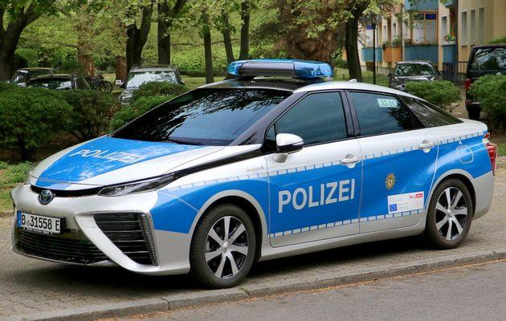
3. Practice example risk:
Long charging times for electric cars, Berlin Police Department
Police patrol cars must be ready for action day and night. Long charging times for electric cars require a great deal of logistical effort to ensure operational readiness.
Procurement officers at the Berlin Police Department would like to see certificates for the manufacture of vehicles (for cars with combustion engines as well as electric cars) so that they can also ensure sustainability for combustion engines.
In addition to electric cars, the Berlin police are also procuring hydrogen-powered cars.
Notes:
Source Text: Film von dieser Webseite https://www.kompass-nachhaltigkeit.de/grundlagenwissen/einblick-in-die-beschaffungspraxis
Source Picture: https://polizeibericht.info/ausruestung/fuhrpark/

Slide 39
3. Risk: Limited municipal budgets
Possible solutions include:
Transparency in prices and costs
Reducing procurement requirements
Sustainable procurement at competitive prices
Better prices through central procurement offices
Better prices through joint procurement

Slide 40
3. Risk: Limited availability of sustainable products and services
Possible solutions include:
Collaboration with other municipalities
Collaboration with suppliers
Reuse
Gradual transition and implementation

Slide 41
4. Monitoring

Slide 42

4. Monitoring
Monitoring involves tracking progress by regularly collecting data and analysing it using key indicators.

Slide 43
4. How to monitor progress
Step 1: Review of data types collected by the municipality
Step 2: Developing key indicators based on existing data
Step 3: Developing additional key indicators
Step 4: Developing a system to ensure regular data delivery
Step 5: Regular analysis of data
Step 6: Discussion and reporting of results

Slide 44

Review of Module 5
How to implement sustainable procurement
Group Exercise
Risk management
Monitoring

Slide 45
Many thanks!

Slide 46
Sources textes
Handbuch „Kleine Schritte, große Wirkung“ aus dem Projekt proCURE, Hrsg. Gemeindenetzwerk Allianz in den Alpen e.V. als Koordinator des Projekts proCURE
„Kommunen und Eine Welt – Handreichung für kommunale Eine Welt-Arbeit in Bayern“ Dr. Alexander Fonari, Vivien Führ und Norbert Stamm für Eine Welt Netzwerk Bayern e.V. 6. Auflage, Augsburg 2024. S. 36
Kompass Nachhaltigkeit „Nürnberg - Elektronisches Einkaufssystem zur Steuerung nachhaltiger Beschaffung (2023)“. Online verfügbar: https://www.kompass-nachhaltigkeit.de/kommunaler-kompass/bayern/rahmenbedingungen-nutzen#c42191036
Kompass Nachhaltigkeit, Film „Einblicke in die Beschaffungspraxis“. Online verfügbar: https://www.kompass-nachhaltigkeit.de/grundlagenwissen/einblick-in-die-beschaffungspraxis
Leitfaden „Klimaschutz in Gemeinden“, Kapitel „Nachhaltige Beschaffung für Gemeinden“, 2016. Herausgeber und Vertrieb: Klimabündnis Österreich GmbH. „Good-Practice Beispiel: Sonnenfest – Gemeinde Mäder, Vorarlberg“ S. 8. Online verfügbar: https://www.klimabuendnis.at/wp-content/uploads/2024/03/6_kbu_lf_beschaffung.pdf
Maßnahmenkatalog „ Ressourceneffiziente Gemeinde“ 2016, Hrsg. Ressourcen Management Agentur (RMA).S. 41 – 42. Online verfügbar: https://gemeindebund.at/images/uploads/downloads/2017/Projekte/Ressourceneffiziente_Gemeinde/Projekt_Ressourceneffiziente_Gemeinde_Massnahmenkatalog.pdf

Slide 47
Sources pictures
Die Umweltberatung „Ökologisch und effizient reinigen“. Online verfügbar: https://www.umweltberatung.at/img/1400/4409.jpg
Nuernberg.de „e-Shop Stadt Nürnberg“. Online verfügbar: https://www.nuernberg.de/internet/beschaffung/ekv_shop.html#_0_3
Fairtrade.net „Fairtrade-Sportbälle“. Online verfügbar: https://www.fairtrade.net/de-de/produkte/fairtrade_produkte/sportbaelle.html
Polizeibericht.net „Polizeibericht 2021 – Fahrzeuge“. Online verfügbar: https://polizeibericht.info/ausruestung/fuhrpark/
Vol.at „Mäder feiert Sonnenfest“. Online verfügbar: https://www.vol.at/maeder-feiert-sonnenfest/8131894

