Slide 1


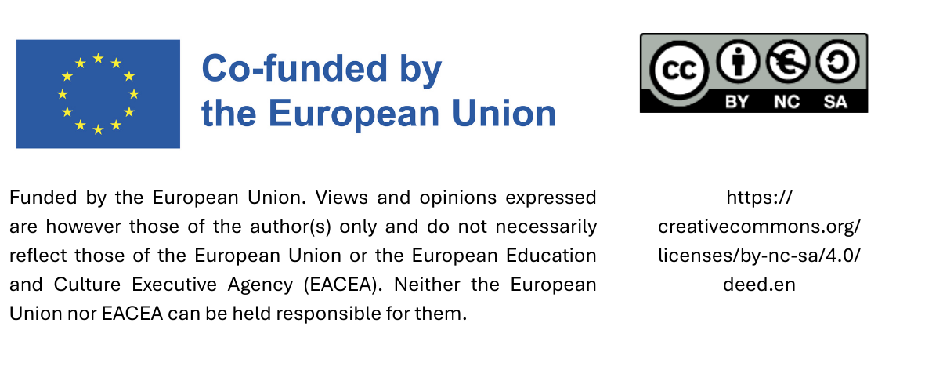
Sustainable procurement curriculum
Module 4: Product group-specific criteria for Sustainable Procurement
Date

Slide 2
Agenda – Textile
Environmental and Social impact of Textile and Leather Production
Strategic Goals of Sustainable Procurement
EU GPP Criteria for Textile and Leather
EU GPP Standars and Labels

Slide 3
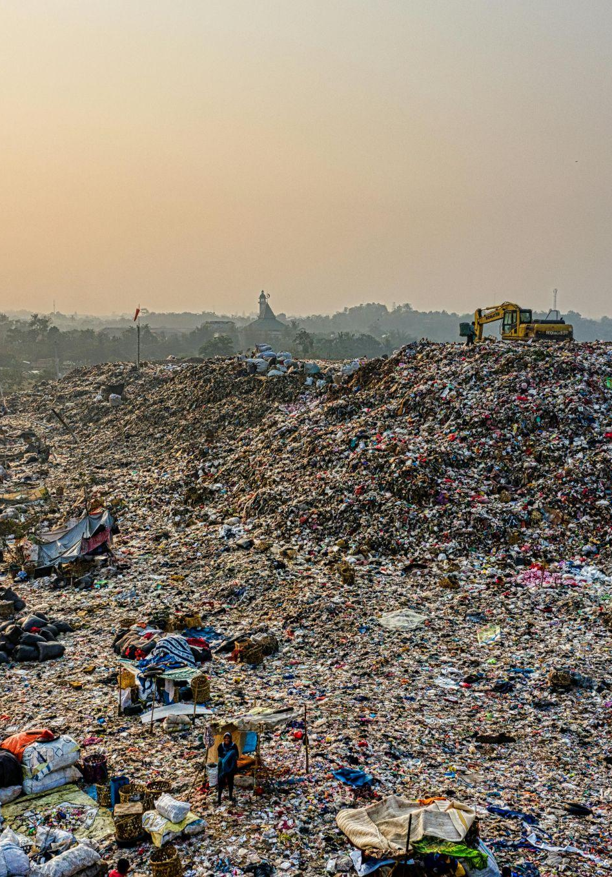




1. Environmental and Social impact of Textile and Leather production
Key Environmental impact
Overconsumption of natural resources
Water Pollution
Greenhouse gas emissions
Textile waste in landfills and low recycling rates
Photo by Tom Fisk: https://www.pexels.com/it-it/foto/vista-dall-alto-della-discarica-durante-l-alba-3174349/
Notes:
This section explores the massive global impact of the textile industry and how public procurement can be used to set strategic environmental and social goals. The textile industry is one of the most resource-intensive sectors. In 2020 alone, the average textile consumption per person in the EU required 400 m2 of land, 9 m3
of water, and 391 kg of raw materials, resulting in a carbon footprint of 270 kg. Key issues include overconsumption, low recycling rates (most textiles end up in landfills), water pollution from dyes, and high greenhouse gas (GHG) emissions. Production has doubled since 2000 and is projected to continue growing rapidly.

Slide 4




1. Environmental and Social impact of Textile and Leather production
Key Social impact
Exploitative labor practices: Low wages, long hours, unsafe working conditions and child labor
Gender inequality and Lack of Transparency
Health issues and community displacement
Photo by cottonbro studio: https://www.pexels.com/it-it/foto/persona-in-camicia-a-maniche-lunghe-rossa-che-tiene-le-forbici-nere-e-d-argento-3738075/
Notes:
The industry is often linked to exploitative labor practices, including low wages, dangerously long hours, and child labor. Because the workforce is predominantly female, gender inequality and a lack of transparency in the supply chain are major concerns.

Slide 5
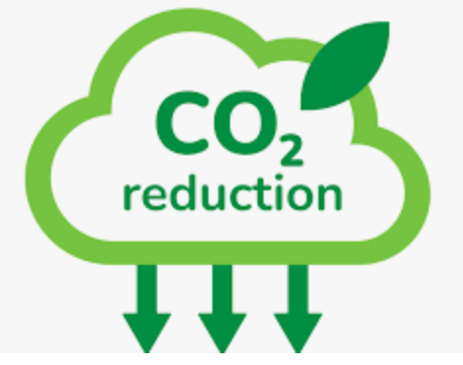



2. Strategic Goals for Sustainable Procurement
Environmental Sustainability
CO2 emissions reduction
Water and energy conservation
Sustainable materials sourcing
Eliminate hazardous chemicals
Notes:
Sustainable procurement aims to mitigate these impacts by prioritizing CO2 reduction, sourcing sustainable materials (like organic or recycled fibers), conserving water and energy during production, and eliminating hazardous chemicals.

Slide 6
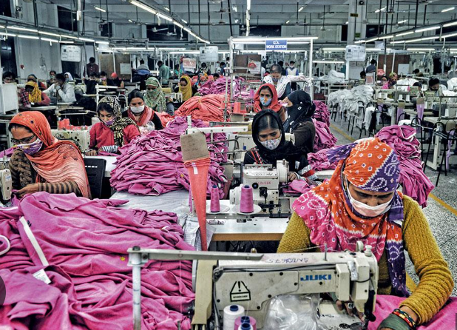


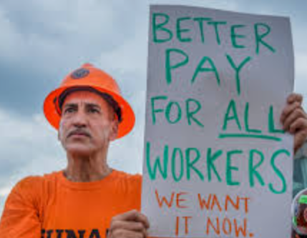
2. Strategic Goals for Sustainable Procurement
Social Responsability
Fair labour Practices
Gender equity and inclusion
Safe working condition
Worker right and wages
Notes:
Social responsibility in textile procurement focuses on ensuring fair labor practices, safe working conditions, gender equity, and the payment of fair wages.

Slide 7




2. Strategic Goals for Sustainable Procurement
Long-term supplier partnerships
Innovation adoption
Economic Viability and Supply Chain Resilience
Supplier capacity development
Risk mitigation

Slide 8


2. Strategic Goals for Sustainable Procurement
EU Strategy for Sustainable and Circular Textiles
Foto di Teona Swift: https://www.pexels.com/it-it/foto/secco-modello-trama-cespuglio-6850459/

Slide 9
EU Strategy for Sustainable and Circular Textiles
It addresses the production and consumption of textiles, whilst recognising the importance of the textiles sector.
It implements the commitments of the European Green Deal, the Circular Economy Action Plan and the European industrial strategy.
The Strategy looks at the entire lifecycle of textile products and proposes coordinated actions to change how we produce and consume textiles.
Notes:
The EU consumption of textiles has the fourth highest impact on the environment after food, housing, and mobility. This strategy aligns with the European Green Deal to move the entire industry toward a circular model, where products are designed to last longer and be easier to recycle.

Slide 10
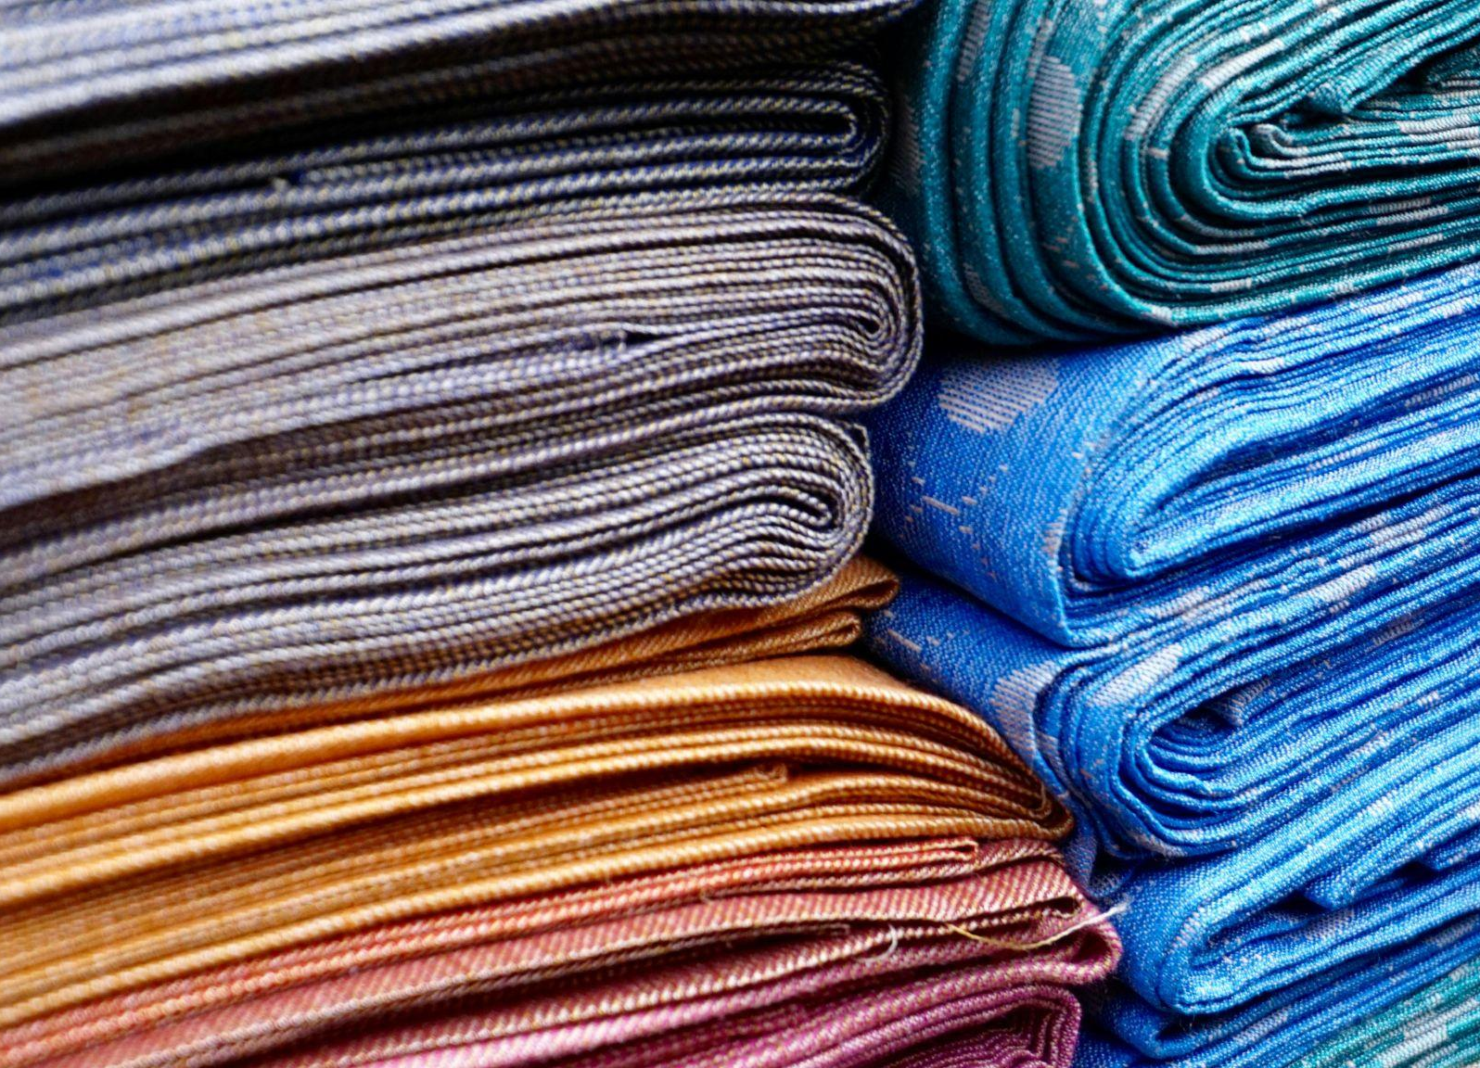
EU Strategy for Sustainable and Circular Textiles
EU consumption of textiles has, on average, the fourth highest impact on the environment and climate change, after food, housing and mobility. It is also the third highest area of consumption for water and land use, and fifth highest for the use of primary raw materials and greenhouse gas emissions.
Foto di Digital Buggu: https://www.pexels.com/it-it/foto/pila-di-stoffa-365066/

Slide 11

3. EU GPP Criteria for textile and leather
EU green public procurement (GPP) criteria are designed to make it easier for public authorities to purchase goods, services and works with reduced environmental impacts.
The criteria are split into selection criteria, technical specifications, award criteria and contract performance clauses.
Photo by Teona Swift: https://www.pexels.com/it-it/foto/luce-leggero-soleggiato-creativo-6850497/
Notes:
These criteria help authorities buy goods with reduced impacts. They are divided into:
◦ Selection Criteria: Ensuring the supplier has the right management systems.
◦ Technical Specifications: Hard requirements like Traceability Systems to prove the origin of fibers and Chemical Management (Restricted Substances Lists).

Slide 12
3. EU GPP Criteria for textile and leather
Supplier Requirements – Textile Sector
Tenderers must demonstrate resources, expertise, and documented systems for:
Textile Fibre Traceability
Systems to trace the origin, content, and production processes of natural and man-made fibres, supported by transaction records and third-party certifications.
Chemical Management
Implementation of a Restricted Substances List (RSL), communication to production sites, compliance monitoring (products and sites), and testing by accredited bodies (e.g. ISO 17025, ISO 17065, ISO 19011).

Slide 13
3. EU GPP Criteria for textile and leather
Technical Specification: Cotton Fiber, Wool Fiber and Wood Pulp
Cotton:
A minimum of 20 % of the content of cotton goods used to fulfil the contract must be either:
Organic;
Integrated Pest Management (IPM)
Wool Fiber:
The wastewater discharges from wool scouring must be ≤25 g for coarse wool and lambswool and ≤45 g for fine wool.
Sulphur emissions from viscose and modal must not exceed set annual limits.
Wood Pulp:
EU Member States apply different criteria and processes to define sustainable forest management.
Most agree that FSC and PEFC certifications generally provide sufficient assurance for compliance with national policies.
Notes:
To be considered "green," a contract may require that at least 20% of cotton be either Organic or grown via Integrated Pest Management (IPM). For wool, there are strict limits on the pollutants allowed in wastewater from "scouring" (cleaning the wool).

Slide 14
3. EU GPP Criteria for textile and leather
Technical Specification: Chemical restrictions and Durability Standards
The tenderer must declare the presence of any REACH Candidate List13 substances at a concentration of greater than 0.1 % (weight by weight) in the finished product. The final supplied product must not contain the substances listed in Annex 1 of the GPP Criteria at greater than the individual or sum total concentration limits.
The textile products must meet the relevant durability requirements.
Availability of Parts & Accessories:
Spare parts must be available for at least 2 years after delivery or contract duration
A price list for these parts must be included.
Notes:
Purchased textiles must meet durability standards to ensure they don't need frequent replacement. Suppliers must declare if products contain harmful substances listed under REACH. Additionally, spare parts (like buttons or zippers) must be available for at least 2 years.

Slide 15




3. EU GPP Criteria for textile and leather
AWARD CRITERIA:
Certified Cotton Content
Recycled Synthetic Fibres
Chemical Use Restriction
Wiederverwendung & Recycling
Points awarded for every + 10% over minimum IPM or organic cotton content
Points for every +10% over 20% minimum recycled polyester/nylon.
Points for restricting hazardous substances during dyeing, printing, and finishing
Garments must allow logos/Ids to be removed or overprinted without damage.
Notes:
"Award criteria" are used to give extra points to the best offers. For example, a bidder might get more points for every additional 10% of organic cotton or recycled synthetic fibers (like polyester or nylon) they provide beyond the minimum requirement. Points are also awarded for designing for reuse, such as making logos easy to remove so a garment can be reused by someone else.

Slide 16
3. EU GPP Criteria for textile and leather
SOCIAL CRITERIA:
The textile supply chain, due to its constitution, is often subject to risks of violation of human rights and fundamental workers’ rights.
By integrating social criteria relating to human rights, workers' rights and working conditions, it is possible to address these aspects of the supply chain.

Slide 17

Social criteria references
Fundamental Conventions of the International Labour Organisation (ILO)

Slide 18
4. EU GPP Standards for textile and leather
These criteria are often assessed through standards like:
GOTS (Global Organic Textile Standard) - Includes environmental and social criteria throughout the supply chain;
OEKO-TEX® MADE IN GREEN - product tested for harmful substances (OEKO-TEX® STANDARD 100) and manufactured under safe and socially responsible
Fair Trade / Fairtrade Textile Standard - guarantees decent working conditions, minimum living wages, respect for human and environmental rights;
EU Ecolabel - offers a reliable way of identifying high performing environmentally friendly textile and footwear products.
SA8000 (Social Accountability International) - guarantees international standards on labour rights, working hours, health and safety, freedom of association.
Notes:
Because it’s hard to check every factory, authorities use Labels as proof:
◦ GOTS: Covers both environmental and social criteria for organic textiles.
◦ OEKO-TEX: Focuses on safety from harmful substances and social responsibility.
◦ EU Ecolabel: Identifies the top environmental performers.
◦ SA8000: The gold standard for certifying fair labor and human rights.

Slide 19
Sources
https://www.europarl.europa.eu/topics/en/article/20201208STO93327/the-impact-of-textile-production-and-waste-on-the-environment-infographics
https://environment.ec.europa.eu/strategy/textiles-strategy_en
https://environment.ec.europa.eu/document/download/74126c90-5cbf-46d0-ab6b-60878644b395_en?filename=COM_2022_141_1_EN_ACT_part1_v8.pdf
https://www.ilo.org/sites/default/files/wcmsp5/groups/public/%40ed_dialogue/%40sector/documents/normativeinstrument/wcms_828429.pdf
https://green-forum.ec.europa.eu/green-business/green-public-procurement/good-practice-library/application-international-labour-organisation-ilo-conventions-textiles-tender_en

Slide 20
Agenda – ICT Equipment
Environmental and Social impact of ICT Equipment
Strategic Goals of Sustainable Procurement
EU GPP Criteria for ICT Equipment
EU GPP Standards and Labels

Slide 21


1. Environmental and Social impact of ICT Equipment
Key Environmental impact
Consumption of energy and materials – End-of-life management
Energy consumption
High Global Warming Potential gases (GWP) and GHG emissions
Hazardous substances
Photo by 霍天赐: https://www.pexels.com/it-it/foto/paralume-tra-computer-e-scaffali-bianchi-3775620/6
Notes:
The main issues are the consumption of rare materials and energy during manufacturing, the use of hazardous substances, and high GHG emissions during use. End-of-life management is critical because electronic waste (e-waste) is difficult to process safely.

Slide 22


1. Environmental and Social impact of ICT Equipment
Key Social impact
Unsafe working conditions and child labor in mines
Workers’ rights and health in manufacturing
Unsafe e-waste practices
Photo by 霍天赐: https://www.pexels.com/it-it/foto/paralume-tra-computer-e-scaffali-bianchi-3775620/6
Notes:
ICT has a "dark side" in its supply chain, including unsafe mining conditions (often involving child labor) for raw materials and poor worker rights in electronics assembly factories.

Slide 23

2. Strategic Goals for Sustainable Procurement
CO2 emissions reduction
Energy-efficient models
Environmental Sustainability
Product life extension End-of-life management
Eliminate hazardous constituents
Notes:
The goal is "Beyond Green ICT," which means looking at:
◦ Environmental: Energy efficiency and circularity.
◦ Social: Inclusive design and ethical digital ecosystems.
◦ Economic: Cost savings through better design and "green jobs".

Slide 24
2. Strategic Goals for Sustainable Procurement
Social Responsability
Fair labour Practices
Gender equity and inclusion
Safe working condition
Worker right and wages

Slide 25
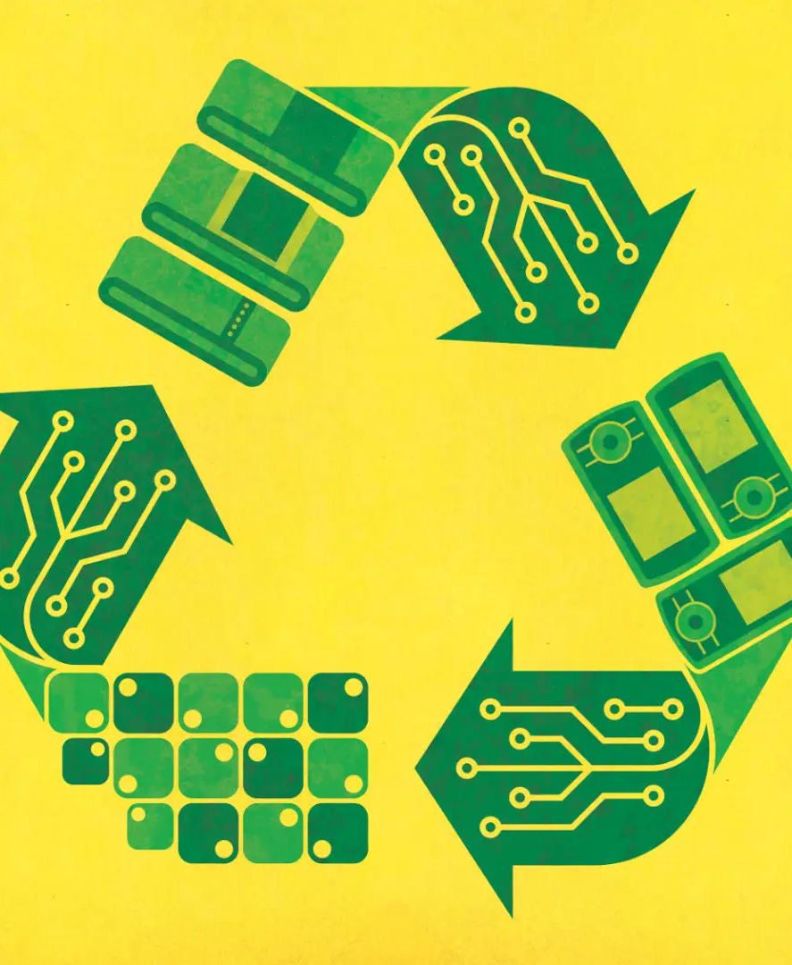

2. Strategic Goals for Sustainable Procurement
EU Strategy for ICT Equipment

Slide 26

EU Strategic Goals for Sustainable ICT Equipment
3 Strategic Environmental Areas:
Energy & Resource Efficiency of Digital Infrastructure
Circular Economy
Lower Emissions
Photo by Kevin Ku: https://www.pexels.com/it-it/foto/occhiali-da-vista-neri-davanti-al-computer-portatile-577585/

Slide 27
EU Strategic Goals for Sustainable ICT Equipment
The EU’s “Beyond Green ICT” strategy integrates:
Environmental Responsibilities: through efficiency, circularity, cost-conscious design, and user empowerment.
Social Responsibilities: via inclusive design, ethical digital ecosystems, cultural inclusion, and fair socio-economic practices.
Economic Responsibilities: Cost savings, green jobs and market opportunity

Slide 28

3. EU GPP Criteria for ICT Equipment
EU green public procurement (GPP) criteria for ICT Equipmente are divided into:
EU green public procurement criteria for computers, monitors, tablets and smartphone
EU green public procurement criteria for data centres, server rooms and cloud services
Photo by 洋榤 郭: https://www.pexels.com/it-it/foto/scheda-madre-del-computer-nero-e-rosso-2399840/

Slide 29
3. EU GPP Criteria for Computers, Monitors, Tablets & Smartphones
The revised (2021) EU GPP criteria target the most critical environmental impacts over the lifecycle. Key thematic areas include:
Product Lifetime Extension – Promote durability, reparability and longer warranty periods, and support procurement of remanufactured devices
Energy Efficiency
Reduction of Hazardous Substances – Align with EU regulation ( e.g., RoHS, REACH)
End-of-Life Management – Ensure high collection and recycling rates and support remanufacturing and reuse pathways
Refurbished Device Criteria
Notes:
The 2021 revised criteria focus on Product Lifetime Extension. This means prioritizing devices that are reparable, have longer warranties, and supporting the purchase of remanufactured/refurbished devices.

Slide 30
3. EU GPP Criteria for data centres, server rooms and cloud services
According to the EU GPP (2020) the Key focus areas are:
Energy Efficiency – Reduce electricity use by servers, cooling and infrastructure
Life-Cycle Costing (LCC) – Effective criteria can lower electricity costs and avoid infrastructure expansion
Refrigerant Management – Monitor and report refrigerant emissions and their Global Warming Potential (GWP)
Standardisation & Alignment – Ensure alignment with EU Ecosdesign regulation
Notes:
For large-scale computing, the focus shifts to Energy Efficiency (reducing electricity for cooling) and Life-Cycle Costing (LCC), which helps authorities realize that a more expensive, efficient server is actually cheaper over time due to lower energy bills.

Slide 31
3. EU GPP Criteria for ICT Equipment
SOCIAL CRITERIA:
Social risks are present throughout electronics supply chains, both inside and outside the EU, but their complexity makes them difficult to manage.
While EU policies address environmental aspects of electronics, they largely overlook social risks, with only fragmented references to social sustainability.
The existing policy tools are all voluntary and generally rely on social audits.
The ambition level of specific requirements such as those in labelling schemes on working hours do not necessarily represent a reasonable level of ambition.
Lastly, efforts in extending the lifetime of devices, may have positive social impacts but this SHOULD NOT be assumed.
Notes:
The sources admit that while environmental issues are well-addressed, social risks are often overlooked because electronics supply chains are incredibly complex. Most tools for social auditing are still voluntary.

Slide 32
4. EU GPP Standards for ICT Equipment
These criteria are often assessed through standards like:
GOTS (Global Organic Textile Standard) - Includes environmental and social criteria throughout the supply chain;
OEKO-TEX® MADE IN GREEN - product tested for harmful substances (OEKO-TEX® STANDARD 100) and manufactured under safe and socially responsible
Fair Trade / Fairtrade Textile Standard - guarantees decent working conditions, minimum living wages, respect for human and environmental rights;
EU Ecolabel - offers a reliable way of identifying high performing environmentally friendly textile and footwear products.
SA8000 (Social Accountability International) - guarantees international standards on labour rights, working hours, health and safety, freedom of association.

Slide 33

4. EU GPP Standards for ICT Equipment
These criteria are often assessed through standards like:
TCO Certified - TCO Certified is a global, comprehensive sustainability certification with everything included. Criteria in TCO Certified drive social and environmental responsibility in four key areas: climate, substances, circularity and supply chain. All criteria are mandatory, and compliance is always independently verified.
EU Ecolabel - guarantees that electronic displays are energy efficient, repairable and contain a limited quantity of hazardous substances. In addition, the criteria require a minimum of recycled content as well easy product dismantling to ensure that parts can be recovered and recycled.
Notes:
TCO Certified TCO Certified is the most comprehensive label for ICT. It is independently verified and covers climate impact, hazardous substances, circularity, and supply chain social responsibility.

Slide 34
Sources
https://digital-skills-jobs.europa.eu/en/latest/briefs/beyond-green-ict-building-truly-sustainable-digital-future-deep-dive
https://green-forum.ec.europa.eu/green-business/green-public-procurement/good-practice-library/sustainability-and-circularity-starting-point-ict-procurement_en
https://eeb.org/wp-content/uploads/2020/06/Towards-a-socially-sustainable-and-circular-ICT-sector.pdf
https://environment.ec.europa.eu/topics/circular-economy/eu-ecolabel/product-groups-and-criteria/electronic-equipment_en#:~:text=The%20EU%20Ecolabel%20guarantees%20that,can%20be%20recovered%20and%20recycled.

Slide 35
Agenda – Cleaning Products and Services
Environmental and Social impact of Cleaning Products and Services
Strategic Goals of Sustainable Procurement
EU GPP Criteria for Cleaning Products and Services
EU GPP Standards and Labels

Slide 36
1. Environmental and Social impact of Cleaning Products and Services
Key Environmental impact
Energy consumption
Waste Generation
Toxicity
Water and Air Pollution
Notes:
Environmentally, cleaning causes water pollution (chemicals in the drain) and waste generation (plastic bottles).

Slide 37
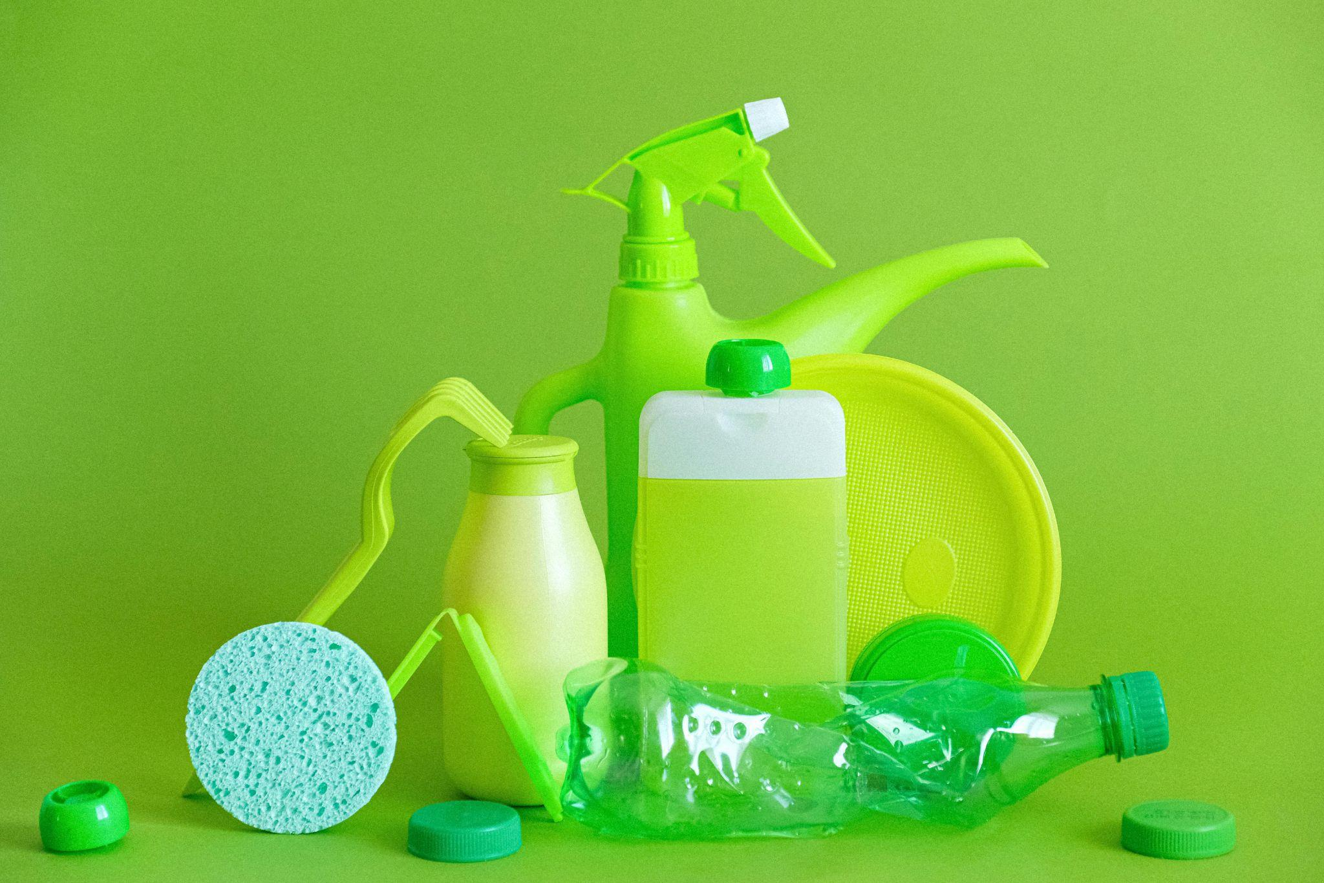

1. Environmental and Social impact of Cleaning Products and Services
Key Social impact
Low wages and poor working conditions
Workers’ health and safety
Gender stereotypes and equity
Photo by Anna Shvets: https://www.pexels.com/it-it/foto/piastre-danno-pulito-ambiente-5217774/
Notes:
Socially, it is a sector known for low wages, precarious part-time work, and health risks for workers who handle toxic chemicals.

Slide 38
2. Strategic Goals for Sustainable Procurement
Green energy use in production
Eco-labeled products
Environmental Sustainability
Reduce the qauntity of packaging and ensure recyclability
Eliminate hazardous constituents
Notes:
The EU aims for energy-efficient equipment (like vacuums), better wastewater management, and improved recycling of cleaning waste.

Slide 39
2. Strategic Goals for Sustainable Procurement
Fair labour Practices
Gender equity and inclusion
Social Responsability
Safe working condition
Worker right and wages

Slide 40


2. Strategic Goals for Sustainable Procurement
EU Strategy for Cleaning Products and Services

Slide 41
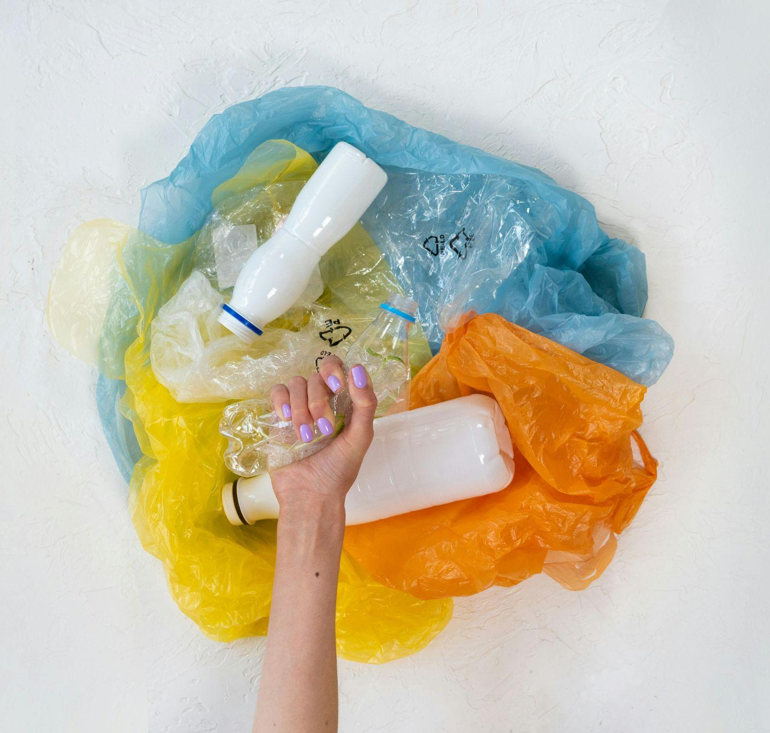
Photo by Mikhail Nilov: https://www.pexels.com/it-it/foto/mano-tenendo-inquinamento-natura-morta-7475829/
EU Strategic Goals for Sustainable Cleaning Products and Services
The five largest markets for professional cleaning services are Germany, France, Italy, UK and Spain.
Office cleaning dominates, representing 50% of the turnover.
Sustainable practices in the cleaning service industry are driven by resource and cost saving opportunities, government policies, voluntary standards and market demand.

Slide 42
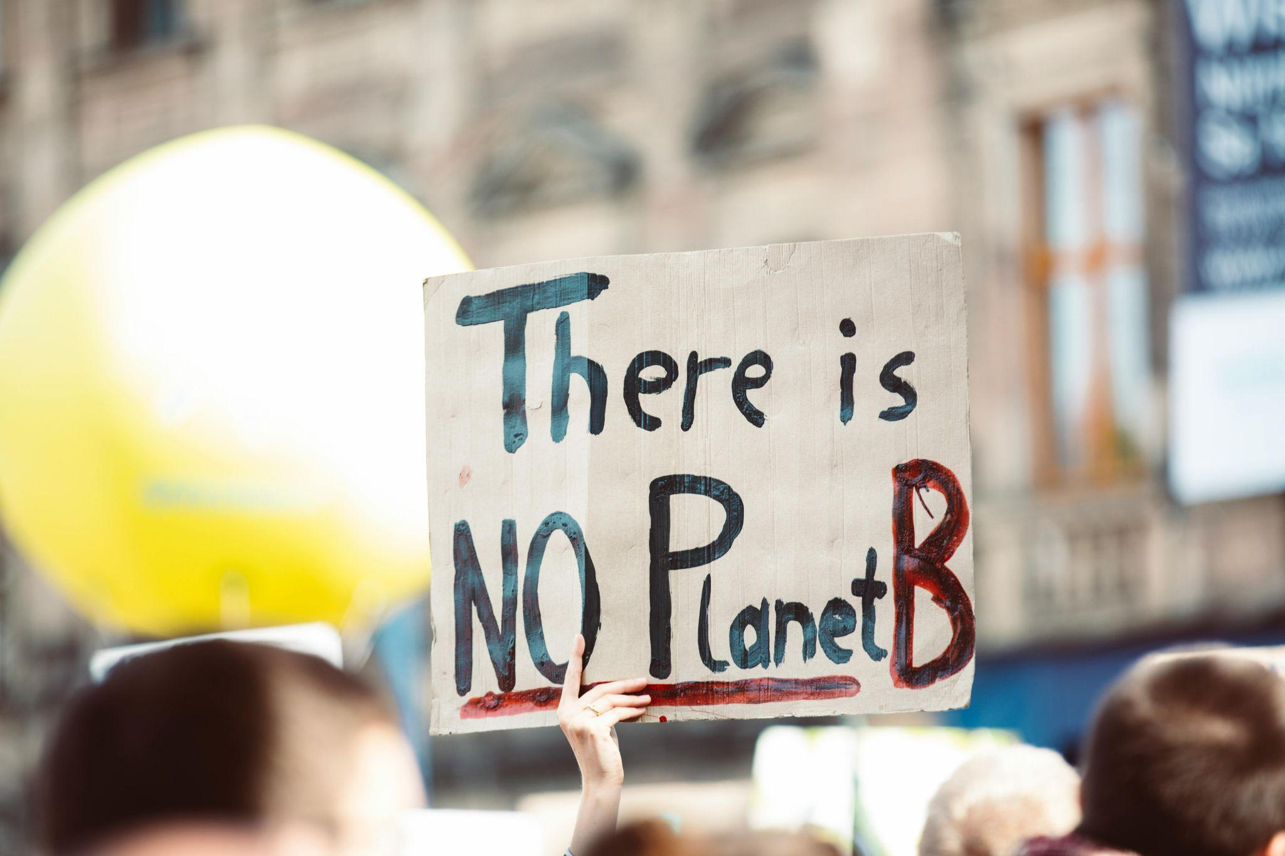
EU Strategic Goals for Sustainable Cleaning Products and Services
Environmental Improvements Areas:
Cleaning products with lower environmental impact
Energy efficiency of cleaning power equipment
Wastewater discharge
Solid waste collection, sorting and recycling
Foto di Markus Spiske: https://www.pexels.com/it-it/foto/clima-strada-paesaggio-persone-2990650/

Slide 43
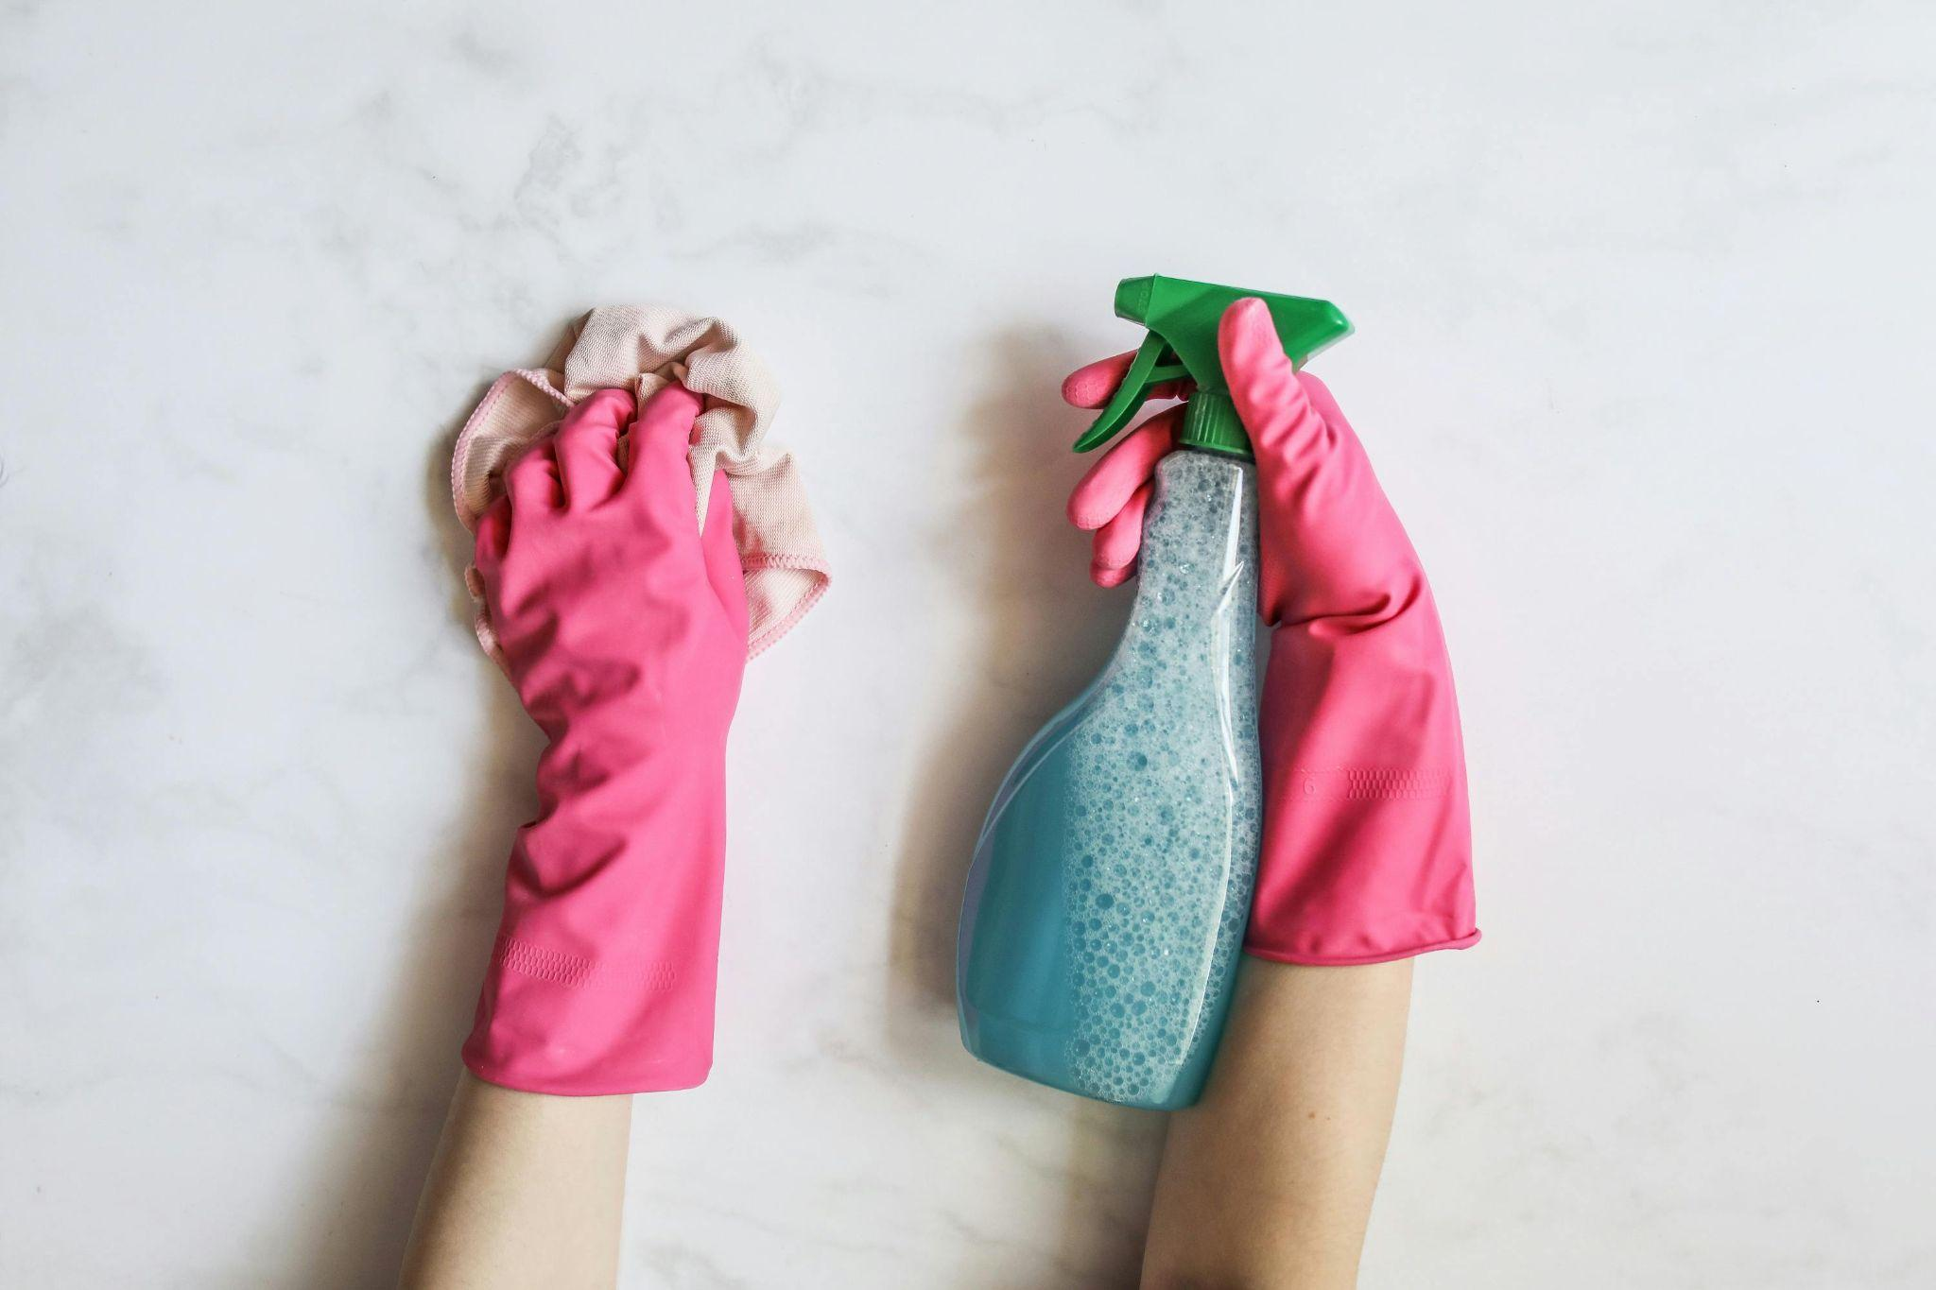
3. EU GPP Criteria for Cleaning Products and Services
There is a link between EU Ecolabel criteria and EU GPP criteria for Cleaning products and services.
Foto di Polina Tankilevitch: https://www.pexels.com/it-it/foto/mani-sapone-pulizia-spray-4440533/

Slide 44
3. EU GPP Criteria for Cleaning Products and Services
Technical Specifications:
Use of eco-labelled cleaning products and accessories
Use of concentrated, undiluted cleaning products – to minimize packaging and transport
Microfiber products – for better cleaning efficiency
Environmental Management Measures and Practices
Notes:
Authorities are encouraged to require eco-labelled products and the use of concentrated, undiluted products, which drastically reduce the energy needed for transport and the amount of plastic packaging waste.
Concerning Environmental management measures and practices, the tenderer must have operational procedures which will be applied during the contract’s performance to:
1. monitor and record the indicators that must be specified in the tender. The minimum monitoring frequency required must be at least once every 4 months for a representative day and must include the following indicators:
• amount of cleaning products used (indicating whether they are ecolabelled and their dilution rate, if relevant)
• cleaning accessories used (type and whether they are reusable or not)
• amount of water used for cleaning tasks and location of water discharge
• power equipment used (indicating energy class) and duration of use 16
• amount of solid waste generated as part of cleaning tasks and its sorting.
2. minimise the environmental impacts associated with the indicators monitored and recorded in 1, towards a defined target. The procedures must especially consider the following aspects, seeking to:
• reduce the use of cleaning products as much as possible
• increase the use of ecolabelled cleaning products
• reduce the use of disposable cleaning accessories
• reduce water use
• improve the energy class of the power equipment used
• reduce the amount of solid waste generated as part of cleaning tasks and increase its sorting/recycling.
3. evaluate the implementation of points 1 and 2 by tracking any change in the indicators and the implementation of the procedures.
4. in case of deviations, implement the necessary actions to correct those deviations, and if possible, prevent them in the future.
5. produce an annual report on the changes of these indicators.

Slide 45
3. EU GPP Criteria for data centres, server rooms and cloud services
Award Criteria:
Enhanced environmental management practices in service delivery
Eco-labelled cleaning products and accessoires above must criteria
Energy efficiency of vacuum cleaners
Notes:
Quality of the environmental management system: Points are awarded in proportion to the quality of the environmental management systems that bidders undertake to establish in the course of fulfilling the contract.
Cleaning products and accessories with eco-labels exceeding the minimum criteria: Bidders for whom more than xx% of cleaning products (by volume at the time of purchase) to be used to perform tasks related to the contract meet criterion 1 regarding toxicity to aquatic organisms and criterion 4 regarding prohibited or restricted substances of the EU Ecolabel for hard surface cleaning products will receive a number of points calculated proportionally. Bidders where more than xx% of the total textile cleaning accessories (e.g. cloths, mop heads) to be used to perform tasks related to the contract are made of microfibres will receive a proportionate number of points.
Energy efficiency of vacuum cleaners: Bidders for whom a certain proportion of the vacuum cleaners to be used to perform tasks related to the contract comply with at least the energy efficiency classes of Commission Delegated Regulation (EU) No 665/2013 at the time of purchase will receive a proportionate number of points.

Slide 46
3. EU GPP Criteria for data centres, server rooms and cloud services
Contract performance clauses:
Documentation and report on cleaning agents and accessories used
Proper dosage of cleaning agents
Staff training for cleaning staff on sustainable and safe practices
Notes:
•Cleaning agents and accessories used
-Twice yearly submission of documentation and report on:
oType, dilution ratio and volume when purchasing cleaning agents used to provide cleaning services, specifying which products meet the minimum environmental requirements
oType and quantity of cleaning accessories used to provide cleaning services, specifying which products meet the minimum environmental requirements
The contractor must provide the cleaning staff with suitable dosing and dilution devices for the cleaning agents used (e.g. automatic dosing machines, measuring cups or caps, hand pumps, sprays) and appropriate instructions for correct dosing and dilution, either at the cleaning site or at the contractor's premises (as appropriate).
Staff training: During the term of the contract, the contractor must have an internal training programme for staff or provide staff with the means to participate in an external training programme covering the following topics, insofar as they are relevant to the contractual tasks performed by the respective employee:
Cleaning agents
Energy saving
Water conservation
Waste
Health and safety (handling of chemicals, etc.)

Slide 47
3. EU Ecolabel Criteria for Cleaning products and services
SOCIAL CRITERIA:
Fair labor practices and employee well-being.
Ethical Production – No Animal Testing and Vegan Ingredients
EU Ecolabel – this label for cleaning services includes mandatory criteria on staff training and well-being, as well as social considerations in its product criteria.
Key features and drivers in the cleaning service sector include the expansion of outsourcing, cost-led contracting and over-representation of part-time (and very short 9 part-time) employment.
The sector is also particularly sensitive to wage regulations due to high labor intensity.
Notes:
The EU Ecolabel for cleaning services is unique because it includes mandatory criteria on staff training and well-being, making it a tool for both environmental and social sustainability.

Slide 48
4. EU GPP Standards for Cleaning Products and services
These criteria are often assessed through standards like:
EU-Ecolabel
Blue Angel
ECOCERT «Ecodetergent»
ECOCERT "Ecodetergents made with Organic“
Nature Care Product (NCP)
ISO 14001

Slide 49
Sources
https://susproc.jrc.ec.europa.eu/product-bureau/sites/default/files/2020-02/cleaning.pdf

Slide 50
Agenda – Office Material
Environmental and Social impact of Office Material
Strategic Goals of Sustainable Procurement
EU GPP Criteria for Office Material
EU GPP Standards and Labels

Slide 51

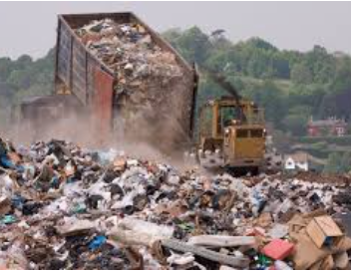
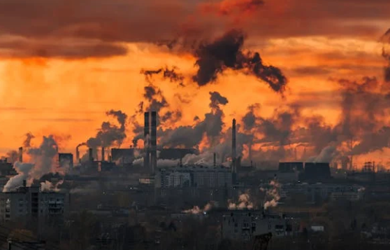
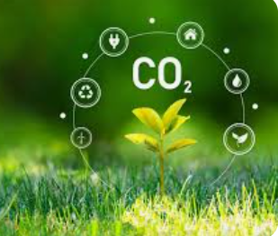
1. Environmental and Social impact of Office Material
Key Environmental impact
Pollution and emissions
CO2 Emissions
Resource Depletion and Deforestation
Waste generation
Notes:
The primary concerns are resource depletion (deforestation), pollution from paper bleaching, and the massive waste generated by single-use toner and ink cartridges.

Slide 52

1. Environmental and Social impact of Cleaning Products and Services
When we talk about office materials, we refer to different product categories.
More specifically, to assess their impact, we refer to the production chain of the different materials.
We therefore consider:
- paper production chain,
- printer production;
- toner production;
- plastic production.
Foto di Frans van Heerden: https://www.pexels.com/it-it/foto/foto-di-foglietti-adesivi-e-penne-colorate-rimescolate-sul-tavolo-632470/

Slide 53
2. Strategic Goals for Sustainable Procurement
Green energy use in production
Eco-labeled products
Environmental Sustainability
Reduce the quantity of packaging and ensure recyclability
Eliminate hazardous constituents

Slide 54
2. Strategic Goals for Sustainable Procurement
Social Responsability
Fair labour Practices
Gender equity and inclusion
Safe working condition
Worker right and wages

Slide 55


2. Strategic Goals for Sustainable Procurement
EU Strategy for Office Materials

Slide 56

Foto di cottonbro studio: https://www.pexels.com/it-it/foto/post-it-e-fogli-spiegazzati-5185076/
EU Strategic Goals for Sustainable Office Materials
The signatories of the new European Declaration on Paper Recycling 2021-20301 committed to reach a 76% paper recycling rate by 2030.
The European Commission has included Imaging Equipment in the new Ecodesign and Energy Labelling Working Plan 2022-2024¹ and launched the preparation of regulatory measures for this product group.
The EU is taking action on plastics to tackle plastic pollution and marine litter, and to accelerate the transition to a circular plastics economy.
Notes:
The EU has a goal to reach a 76% paper recycling rate by 2030. There is also a strong push to tackle plastic pollution by reducing packaging.

Slide 57
EU Strategic Goals for Sustainable Office Materials
Environmental Improvements Areas:
Sustainable sourcing of fiber (paper products)
Reduce chemical use ( paper products, toner and Ink cartidges, plastic materials)
Energy efficiency (Printing processes and devices)
Reduce energy and water use in production (paper and printed products)
Design for recyclability and Durability and reuse: Circular models

Slide 58

3. EU GPP Criteria for Office Materials
There are currently separate EU GPP criteria for:
Graphic and printed paper products;
Printers, toners and cartridges;
EU plastics strategy

Slide 59
3. EU GPP Criteria for Imaging equipment, consumables and print services
Technical Specifications:
Design for Circularity – durability, spare parts, modularity, but also Reusability of the consumables.
Energy Efficiency – requirements for imaging equipment and for the Printing Services
Chemical Restrictions (REACH, RoHS, VOCs)
End-of-life Management – Take back, recyclability info etc. for imaging equipment, consumables and printing services.
Recycled Material Content
Noise and Emissions – for imaging equipment
Notes:
For printers, the criteria emphasize Design for Circularity: the machine must be durable and the consumables (toner) must be reusable rather than thrown away.

Slide 60
3. EU GPP Criteria for Graphic and printed paper products
Technical Specifications:
Sustainable sourcing of Fibres
Recycled Content – to meet EU Ecolabel thresholds
Hazardous Substances – exclusion/restriction of heavy metals, azo deyes etc.
Quality - Paper strength and durability meeting EN standards and suitability for high-speed printers.
Recycled Material Content
Packaging Materials – minimized + use of recycled or certified paper-based packaging.
Notes:
"Green" paper must come from sustainably sourced fibers and contain a high percentage of recycled content. Hazardous substances like heavy metals or certain dyes are strictly restricted.

Slide 61
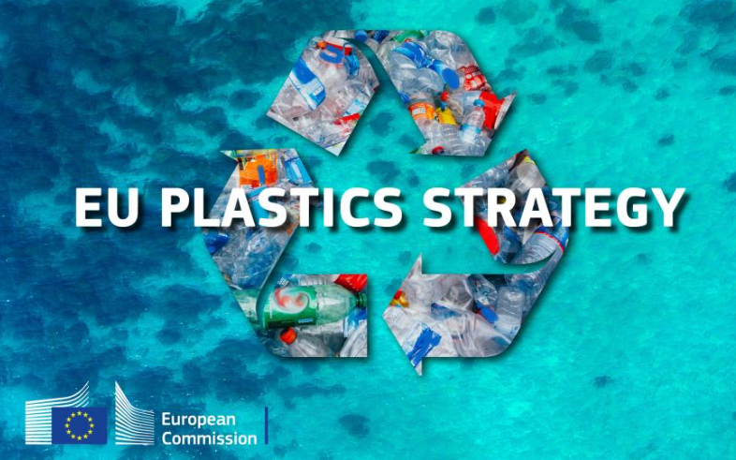
3. EU plastics strategy
The EU adopted a European strategy for plastics in January 2018. It is part of the EU’s circular economy action plan, and builds on existing measures to reduce plastic waste.
Policy Areas:
Chemicals
Circular Economy
Plastics
Waste and Recycling

Slide 62
3. EU GPP Criteria for Office Materials
SOCIAL CRITERIA:
Common social criteria:
ILO Core Conventions
Fair Working Conditions
Social Responsibility in Contract Performance
The EU GPP framework and the broader EU Public Procurement Directives (2014/24/EU) also encourage the use of social criteria across categories.

Slide 63


4. EU GPP Standards for Cleaning Products and services
These criteria are often assessed through standards like:
EU-Ecolabel
Blue Angel
Energy STAR
FSC - Forest Stewardship Council (FSC)
PEFC - Programme for the Endorsement of Forest Certification Schemes
Notes:
To ensure paper comes from a well-managed forest, look for the FSC or PEFC logos. For office electronics, the Energy STAR label ensures the equipment meets high energy-efficiency standards.

Slide 64
Sources
https://green-forum.ec.europa.eu/green-business/green-public-procurement/gpp-criteria-and-requirements_en
https://susproc.jrc.ec.europa.eu/product-bureau/product-groups/529/home
https://susproc.jrc.ec.europa.eu/product-bureau/product-groups/460/home
https://susproc.jrc.ec.europa.eu/product-bureau/product-groups/441/home
https://susproc.jrc.ec.europa.eu/product-bureau/product-groups/410/home
https://environment.ec.europa.eu/topics/plastics_en
https://environment.ec.europa.eu/strategy/plastics-strategy_en
https://www.eurosac.org/media/news/monitoring-report-2024/?utm_source=chatgpt.com
https://circabc.europa.eu/ui/group/44278090-3fae-4515-bcc2-44fd57c1d0d1/library/f1b77f0a-74cf-4d1f-adfd-e43e111e637f/details
https://circabc.europa.eu/ui/group/44278090-3fae-4515-bcc2-44fd57c1d0d1/library/95364f55-0e94-405d-a867-a5e7e0936c80/details

Slide 65
Thank you very much!

